Slide 1
DPA*: Dynamically Pruned A* for Re-planning in Navigation Meshes

Slide 2
Introduction
Path planning and crowd simulation

Slide 3
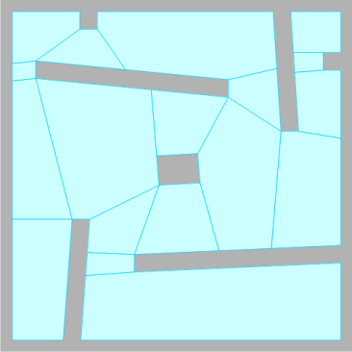
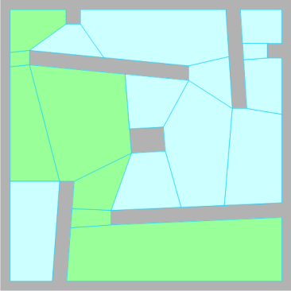
Path planning in virtual environments
A navigation mesh represents the walkable surfaces
Regions
Graph
Characters have individual goals
A* search on the graph
Plan an indicative route
In each simulation step:
Path following
Collision avoidance
...

Slide 4
Crowd simulation

Slide 5
Dynamic environments
Obstacles (dis)appear at runtime
Navigation mesh changes
Characters need to re-plan
Re-planning from scratch?
Old and new path might be similar
Idea: re-use old path without losing optimality

Slide 6
Dynamic re-planning
Related work
e.g. D* Lite (Koenig & Likhachev 2002)
Remember search state
Too memory-intensive for crowds
We present Dynamically Pruned A*
Re-planning optimal paths
Speed up A* based on the old path only
More memory-friendly

Slide 7
Algorithm
Dynamically Pruned A*

Slide 8
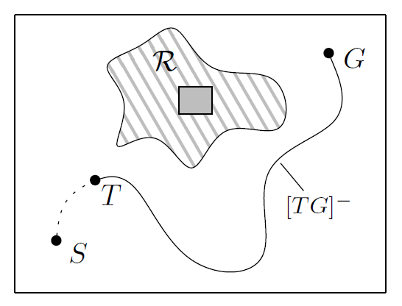
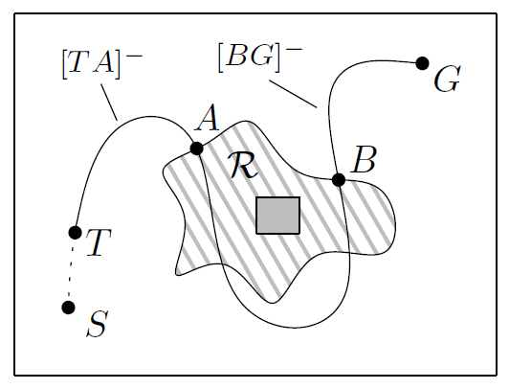
Problem description
Path planning from S to G on a graph
Character notices dynamic event at vertex T
Compute optimal path [TG]⁺ based on old path [TG]⁻
Event affects the graph in a region R
[TG]⁻ either does or doesn’t pass through R
Obstacle was either inserted or deleted
4 scenarios

Slide 9
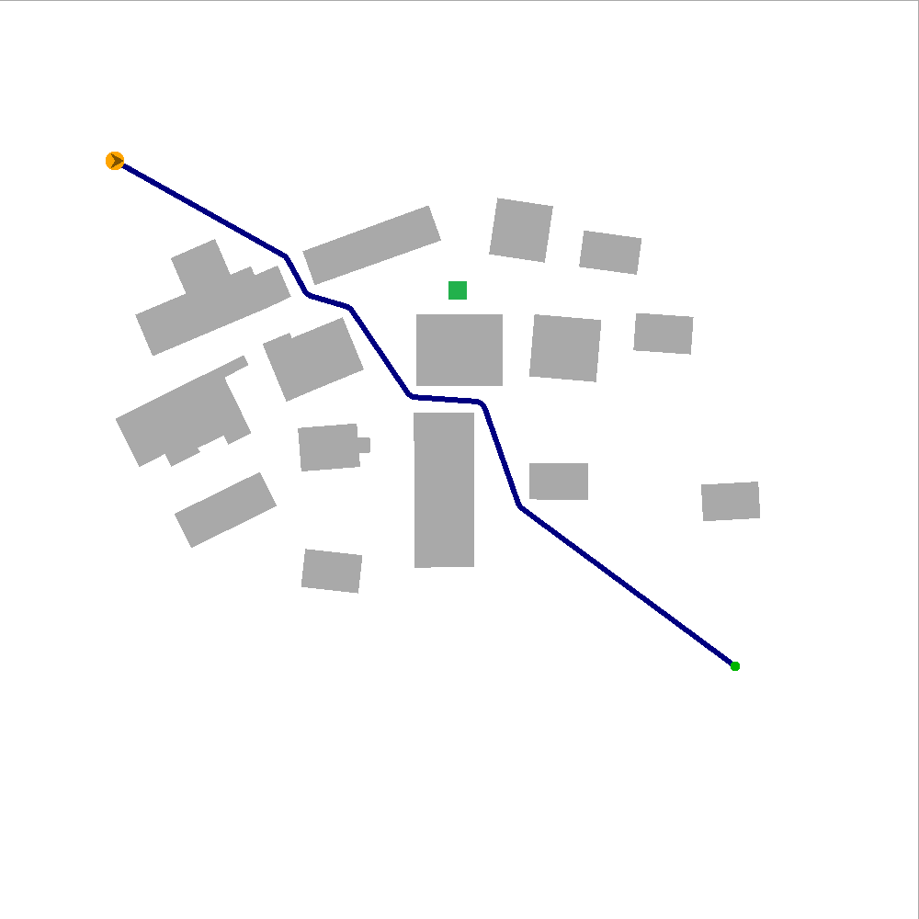
Scenario 1
Obstacle inserted, old path not in R
Old path is still optimal
DPA* terminates immediately

Slide 10
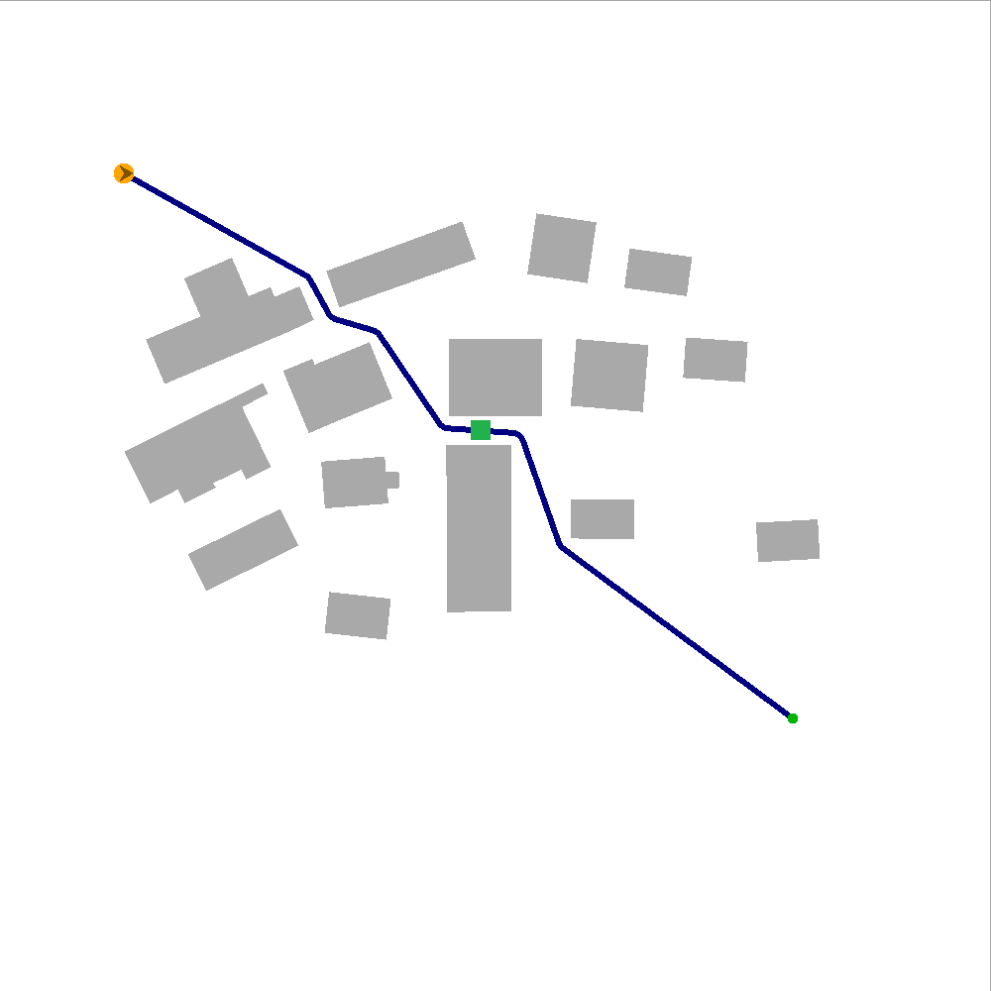
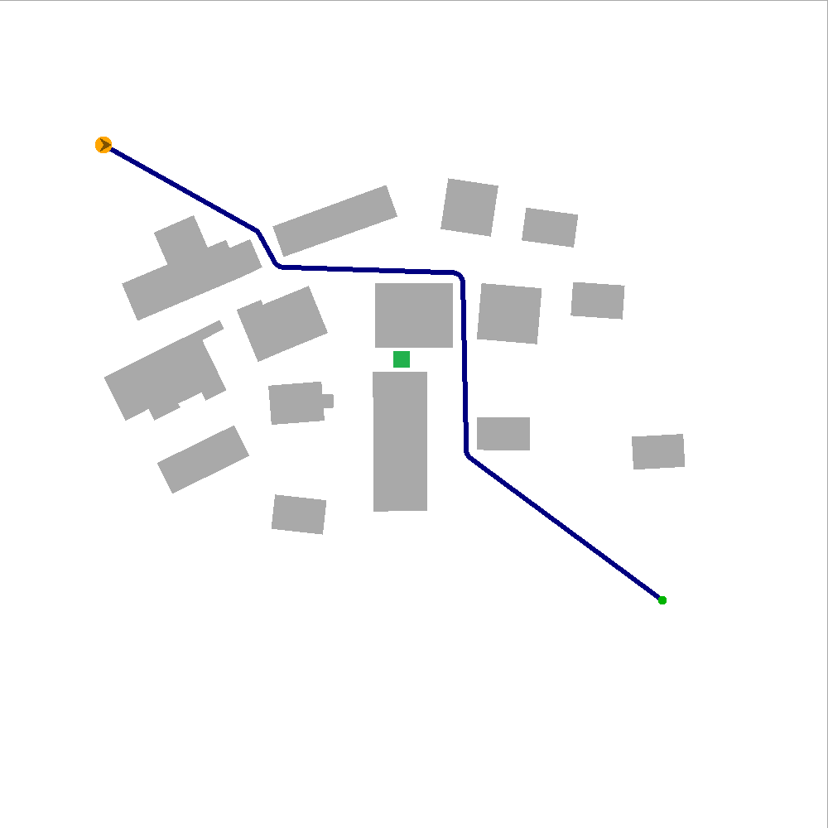
Scenario 2
Obstacle inserted, old path in R
We need to find a “detour”
Pruning in DPA*:
For each V on [BG]⁻, we know that [VG]⁺ = [VG]⁻
→ Skip all neighbors of V except its successor
Best results when the event is close to the character

Slide 11
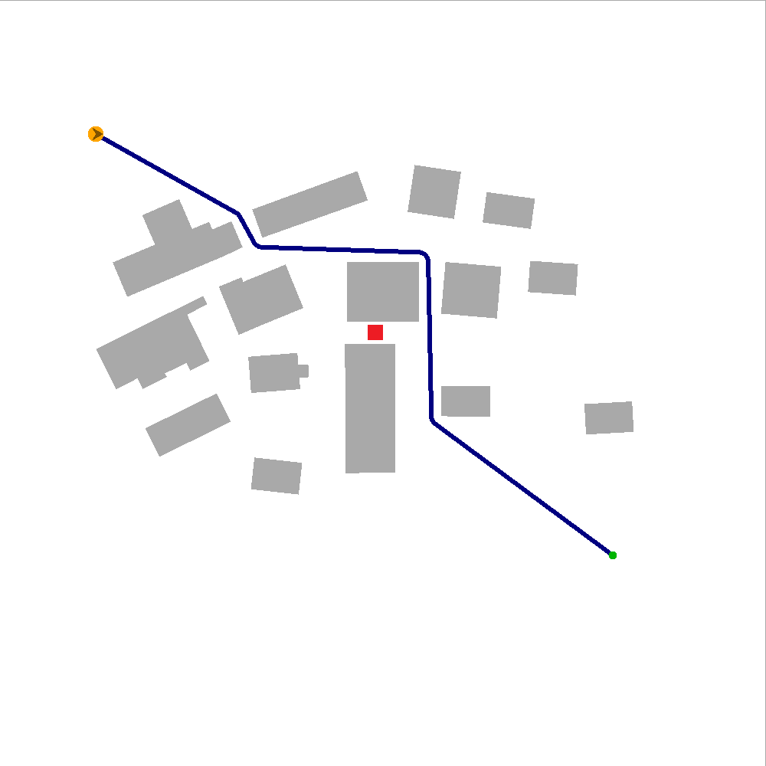
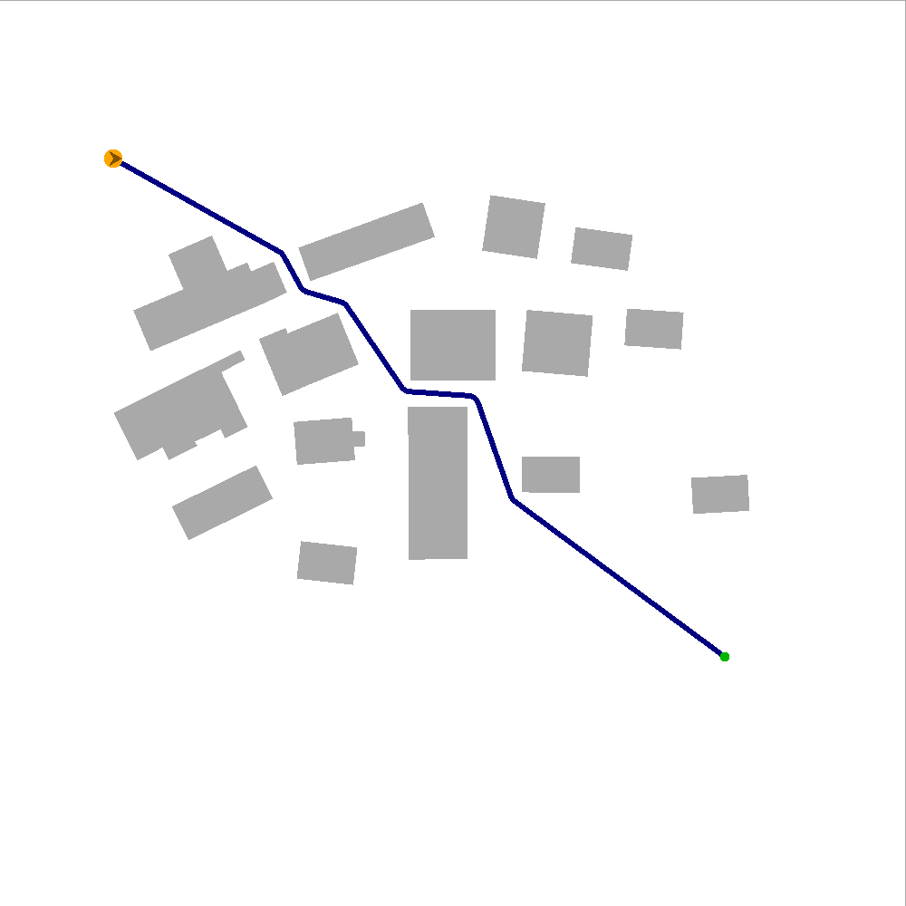
Scenario 3
Obstacle deleted, old path not in R
Detour may no longer be needed
If a better path exists, it must visit the affected region R
Pruning in DPA*:
If we haven’t visited R yet and V is too far away from R, skip V

Slide 12
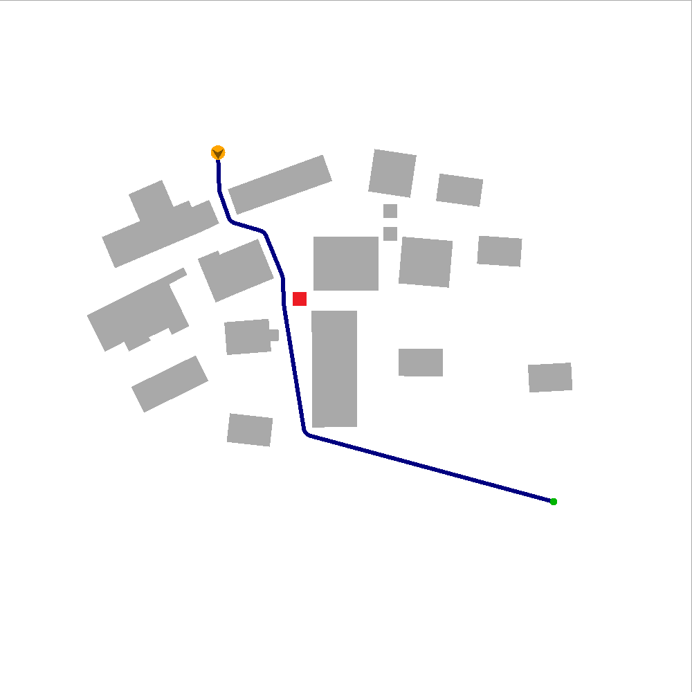
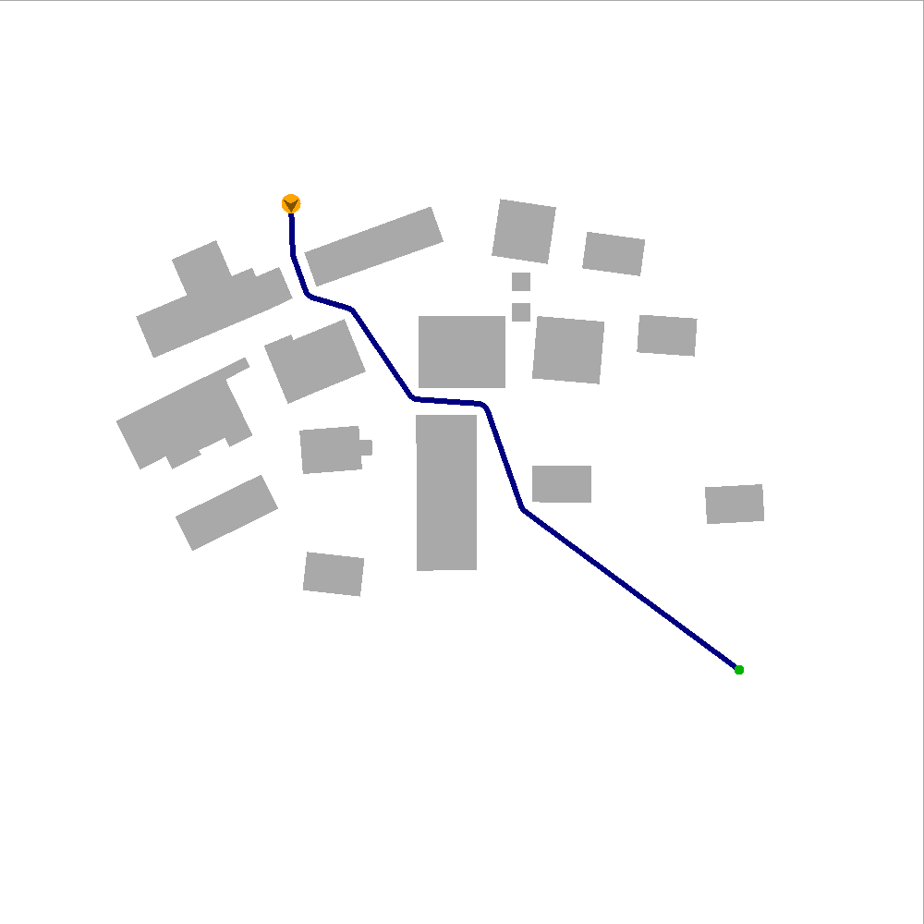
Scenario 4
Obstacle deleted, old path in R
Old path close to deleted obstacle
Still collision-free, but a better path may now exist
Pruning A*:
Similar to Scenario 3

Slide 13
Experiments & Results
DPA* versus A*

Slide 14
Experimental set-up
5 environments, 17 - 235 dynamic obstacles
Navigation mesh: Explicit Corridor Map
500x for each dynamic obstacle:
Plan path from random start to random goal
Insert dynamic obstacle; re-plan
Remove dynamic obstacle; re-plan

Slide 15
Results
Percentual improvement of DPA* over A*
Ins, affected: -13% to +3%
Del, unaffected: -18% to +63%
Del, affected: -17% to +15%
Start in visibility polygon of obstacle
Re-plan when the character sees the event
Ins, affected: -5% to +46%
Del, unaffected: -18% to +47%
Del, affected: -19% to +23%

Slide 16
Crowds in dynamic environments
Simulate various behaviours

Slide 17
Conclusions & Future work

Slide 18
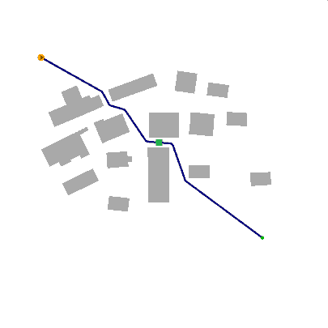
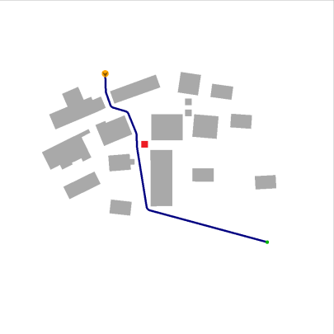
Conclusions
Re-planning in navigation meshes
Obstacles (dis)appear at run-time
DPA*: remember only the old path
Good for situations with limited memory per character
Based on four scenarios
Results
Particularly fast in large graphs
Good for visibility-based replanning

Slide 19
Future work
Handling multiple events at once
Simulate incomplete knowledge
Memory model per character?

Slide 20
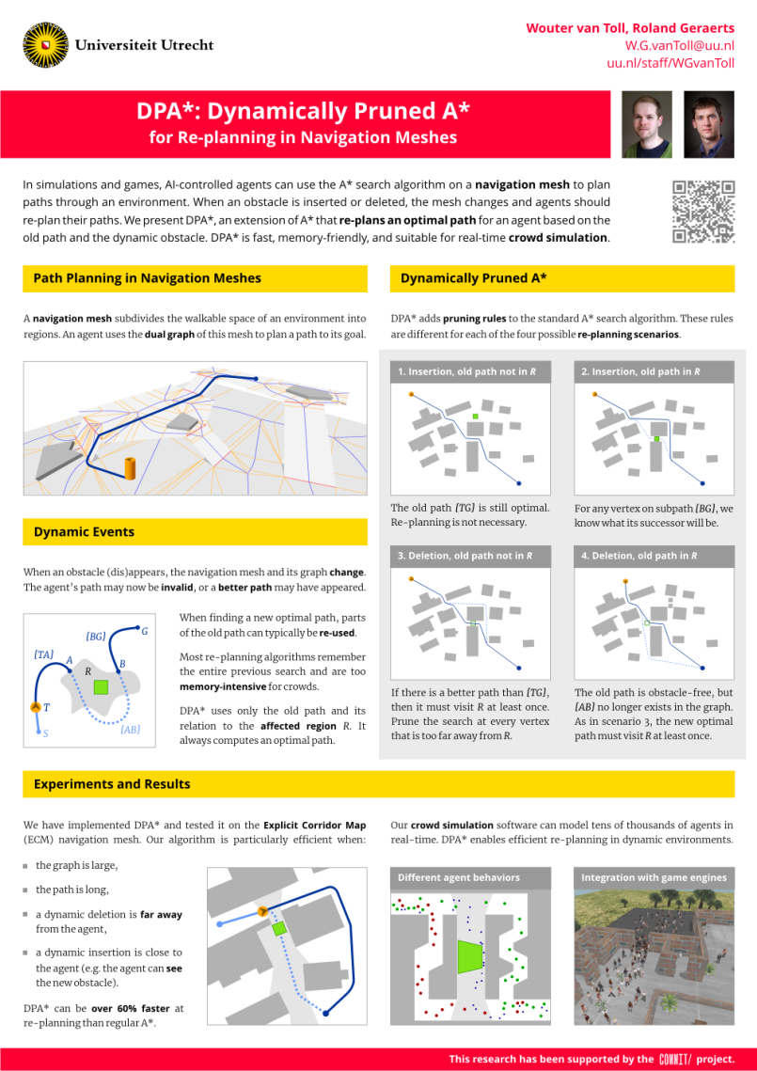
The final slide
Contact info
W.G.vanToll@uu.nl
uu.nl/staff/WGvanToll
Poster
Spot the difference

Slide 21
The final slide 2

