Slide 1
Dynamically Pruned A* for Re-planning in Navigation Meshes

Slide 2
Introduction
Path planning in dynamic environments

Slide 3
Path planning in dynamic environments
Disks on planar surfaces
Obstacles (dis)appear at runtime
Re-planning
Dynamic navigation mesh
Crowd simulation

Slide 4
Related work / Contributions
e.g. D* Lite (Koenig & Likhachev 2002)
Remember search state
e.g. Anytime Dynamic A* (Likhachev et al. 2005)
Iteratively improve a path
Too memory-intensive for crowds
We present Dynamically Pruned A*
Re-planning optimal paths
Speed up A* based on the old path only

Slide 5
Algorithm
Dynamically Pruned A*

Slide 6
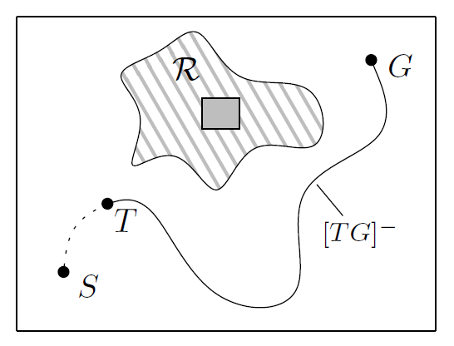
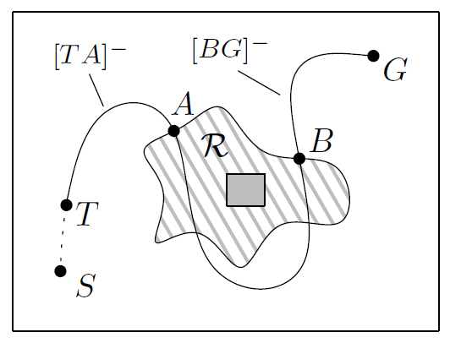
Problem description
Path planning on a graph
Agent notices dynamic event at vertex T
Compute optimal path [TG]⁺ based on old path [TG]⁻
Event affects the graph in a region R
[TG]⁻ either does or doesn’t pass through R
Obstacle was either inserted or deleted
4 scenarios

Slide 7
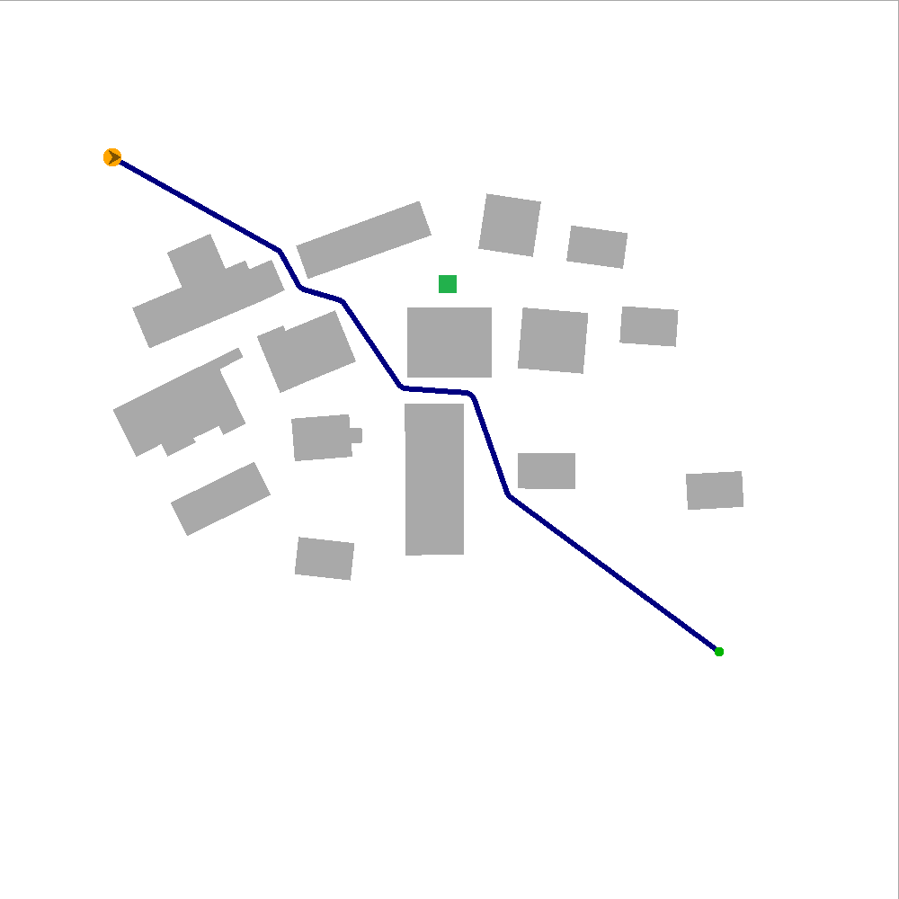
Scenario 1
Obstacle inserted, old path not affected
Old path is still optimal
DPA* terminates immediately

Slide 8
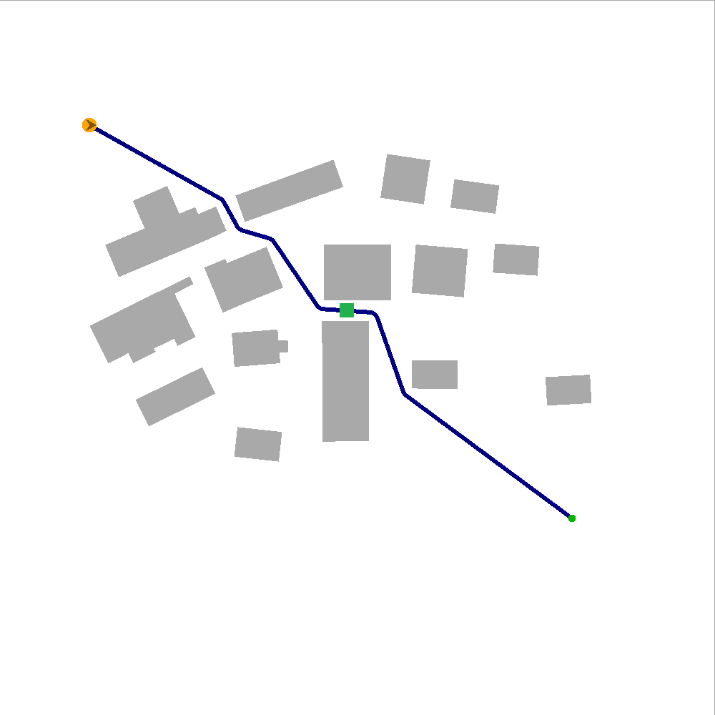
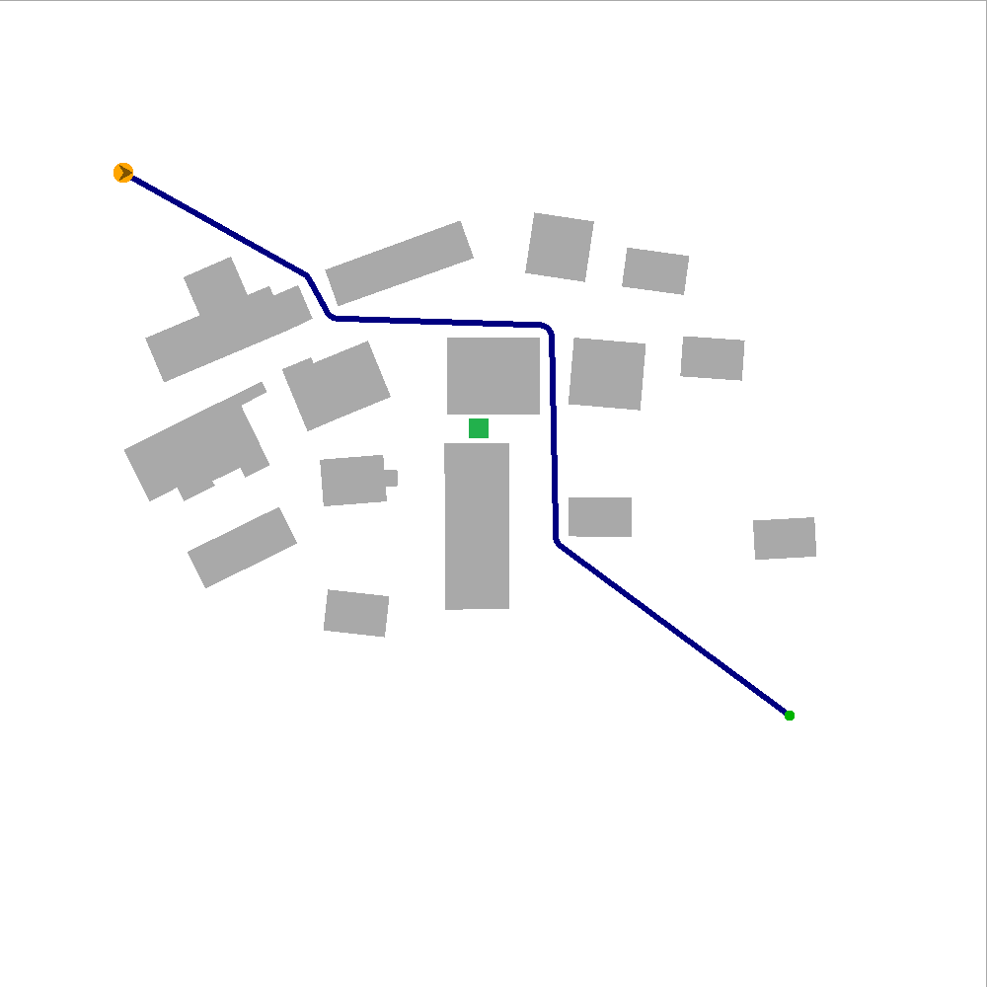
Scenario 2
Obstacle inserted, old path affected
We need to find a “detour”
Pruning in DPA*:
For each V on [BG]⁻, we know that [VG]⁺ = [VG]⁻
→ Skip all neighbors of V except its successor
Best results when the event is close to the agent

Slide 9
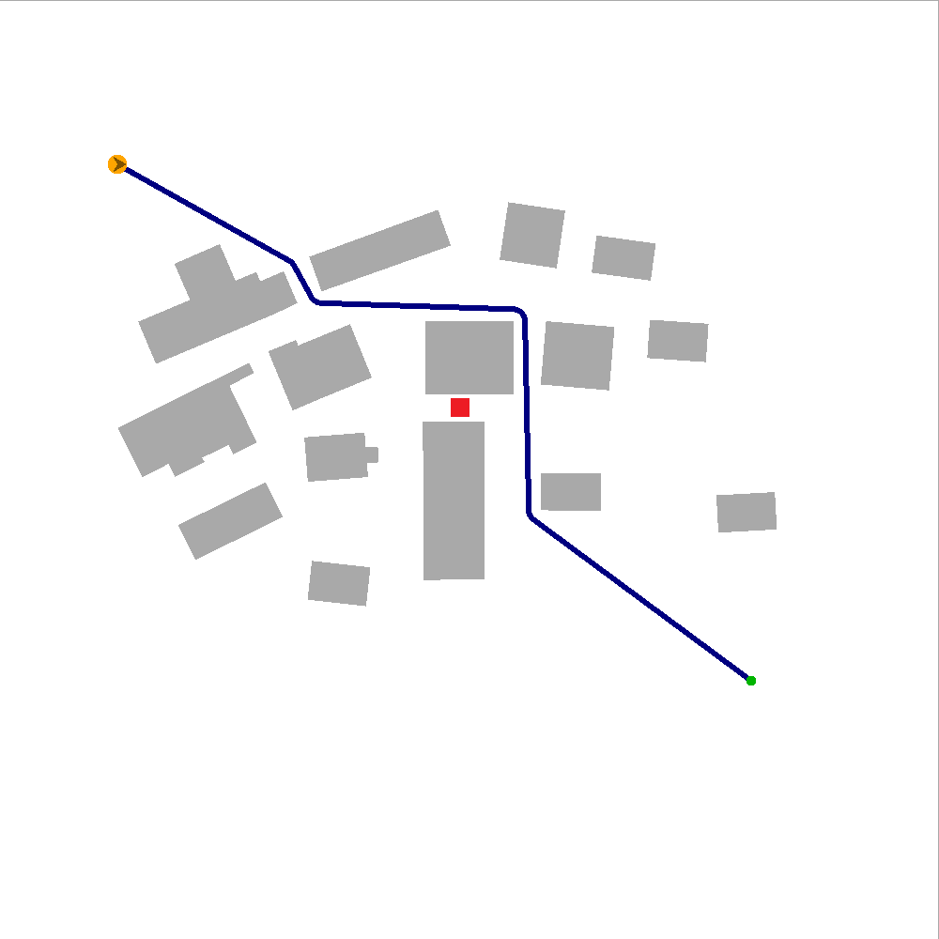
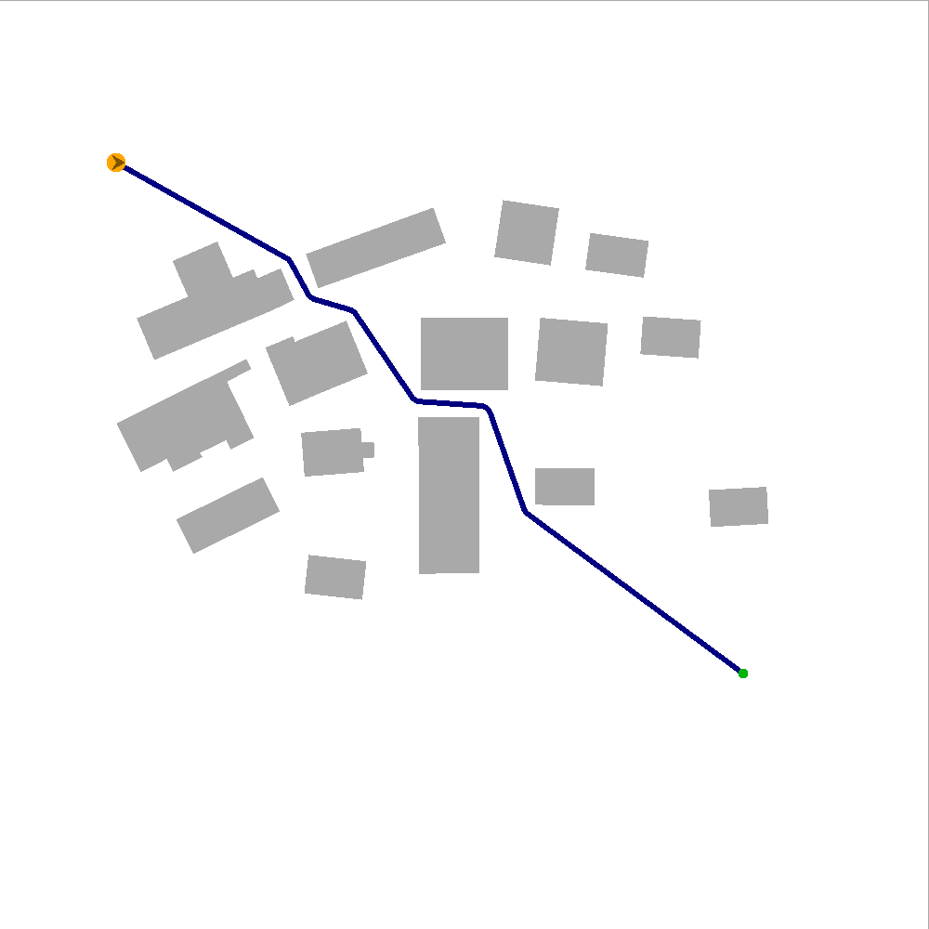
Scenario 3
Obstacle deleted, old path not affected
Detour may no longer be needed
If a better path exists, it must visit the affected region R
Pruning in DPA*:
Check if V is too far away from R
Best results when the event is far away

Slide 10
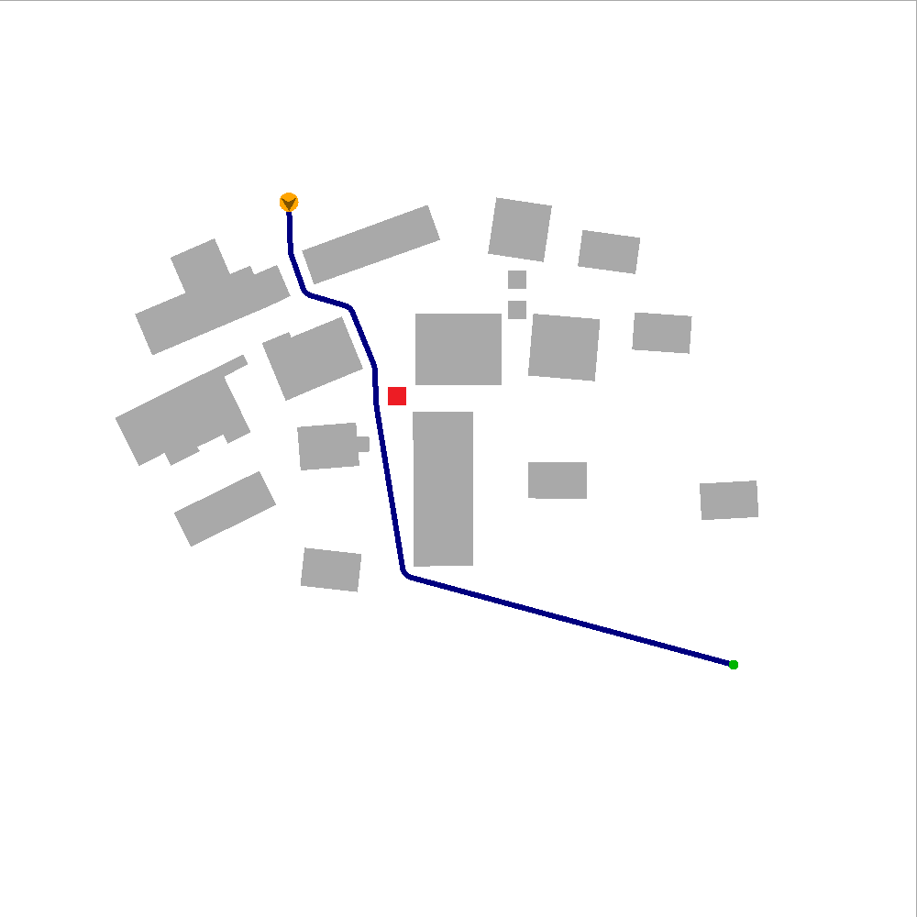
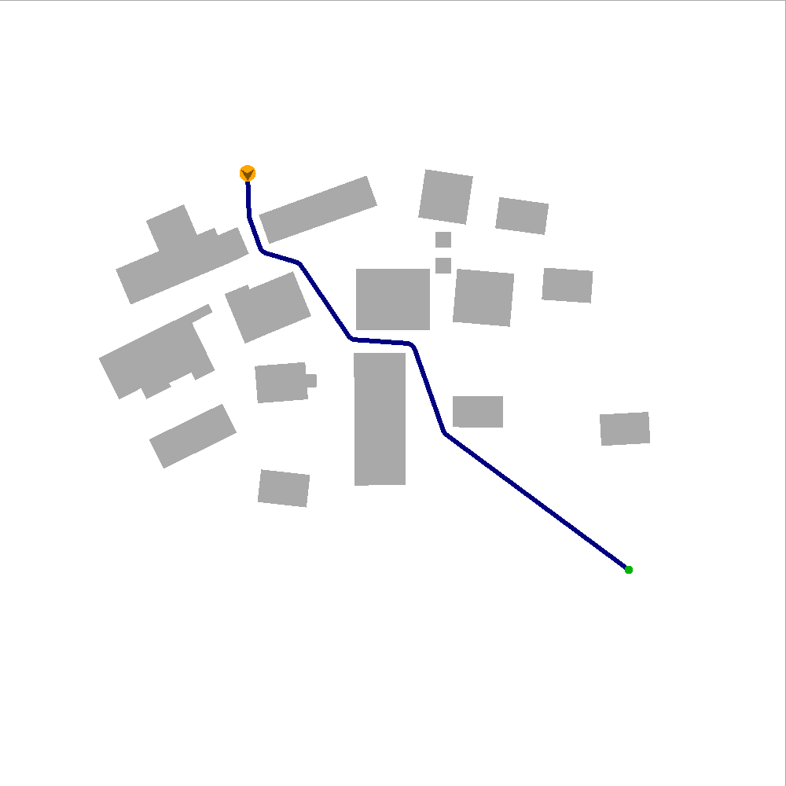
Scenario 4
Obstacle deleted, old path affected
Old path close to deleted obstacle
Still collision-free, but a better path may now exist
Pruning A*:
Similar to Scenario 3

Slide 11
Experiments & results
DPA* versus A*

Slide 12
Experimental set-up
5 environments, 17 - 235 dynamic obstacles
500x for each dynamic obstacle:
Plan path on the ECM (random start/goal)
Insert dynamic obstacle; re-plan
Remove dynamic obstacle; re-plan

Slide 13
Results
Percentual improvement of DPA* over A*
Ins, affected: -13% to +3%
Del, unaffected: -18% to +63%
Del, affected: -17% to +15%
Start in visibility polygon of obstacle
Re-planning when the agent sees the event
Ins, affected: -5% to +46%
Del, unaffected: -18% to +47%
Del, affected: -19% to +23%

Slide 14
Crowds in dynamic environments
Simulate various behaviours

Slide 15
Conclusions & Future work

Slide 16
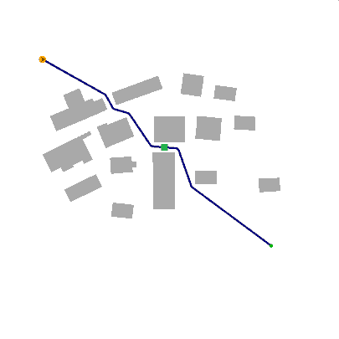
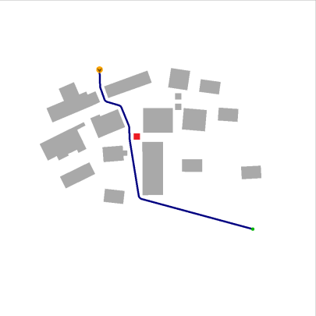
Conclusions
Re-planning in navigation meshes
Obstacles (dis)appear at run-time
DPA*: remember only the old path
Good for situations with limited memory per agent
Based on four scenarios
Results
Slower than A* in small graphs; faster in large graphs
Good for visibility-based replanning

Slide 17
Future work
Handling multiple events at once
Simulate incomplete knowledge
Memory model per agent?

Slide 18
The final slide
Questions?
Contact info
W.G.vanToll@uu.nl
uu.nl/staff/WGvanToll

