Slide 1
GPGPU-Accelerated Construction of High-Resolution Generalized Voronoi Diagrams and Navigation Meshes
Rudi Bonfiglioli
Textkernel
Wouter van Toll
Utrecht University
Roland Geraerts
Utrecht University
Motion in Games 2014

Slide 2
Motivation
Crowd simulation

Slide 3
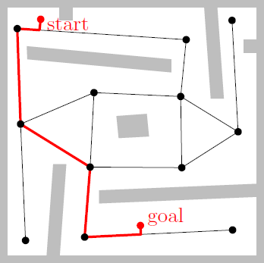
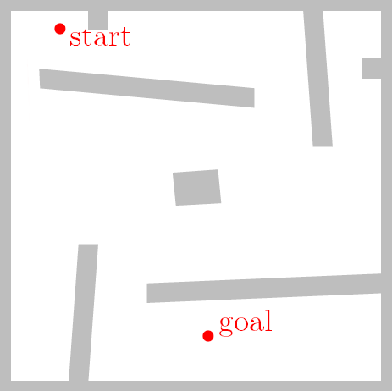
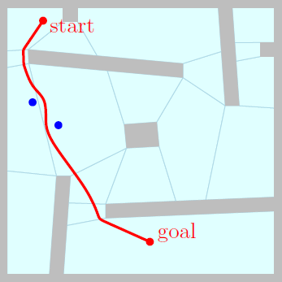
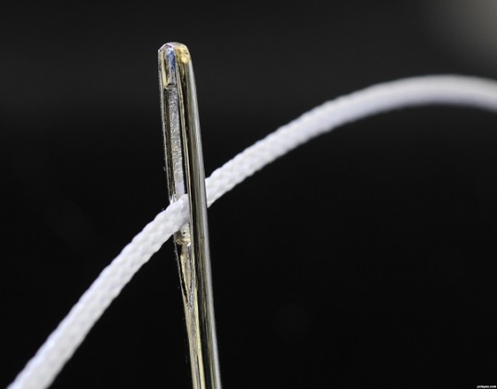
Motivation
Path planning for 1 agent
Navigation graph
Not flexible enough for crowds
Navigation mesh
Global path: sequence of polygons
Local planning during movement
Common in modern games / simulations
Large, complex environments
High precision is required
High speed is preferred
In this paper, we improve both

Slide 4
Overview
Our navigation mesh: ECM
Based on the Generalized Voronoi Diagram
GPGPU-enhanced GVD/ECM construction
Original algorithm
Improvements
Multi-tiled extension
Results
Conclusions / Discussion

Slide 5
Our navigation mesh

Slide 6
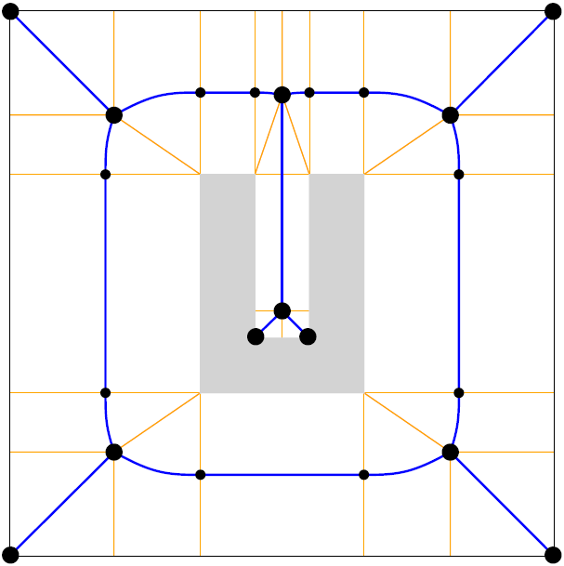
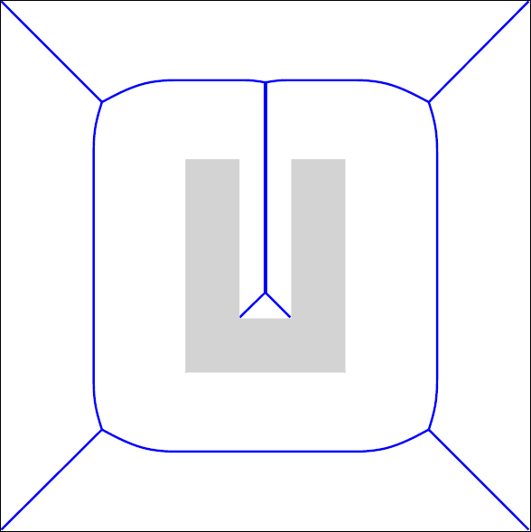
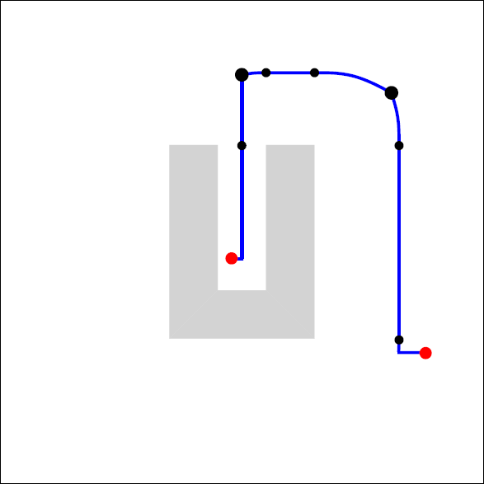
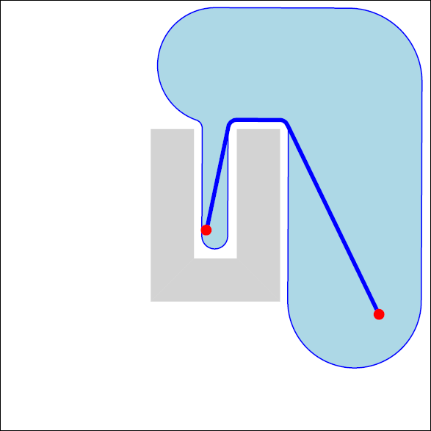
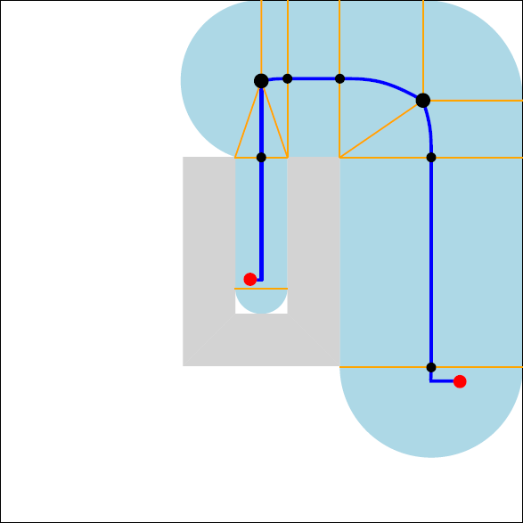
Explicit Corridor Map
An exact and flexible navigation mesh
Medial axis (pruned GVD)
Closest-obstacle annotations
Clearance is known everywhere
→ supports all character sizes
A* → path + corridor
Short paths with clearance
Collision avoidance
Multi-layered environments
Dynamic updates

Slide 7
GPGPU-Enhanced GVD

Slide 8
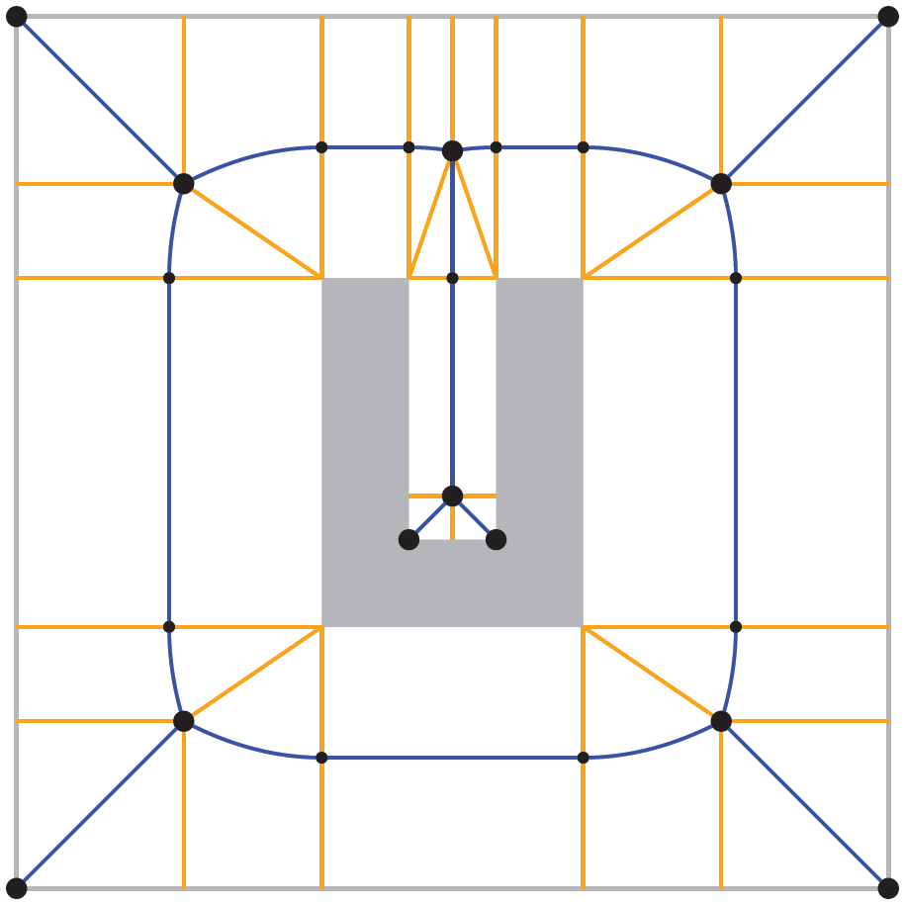
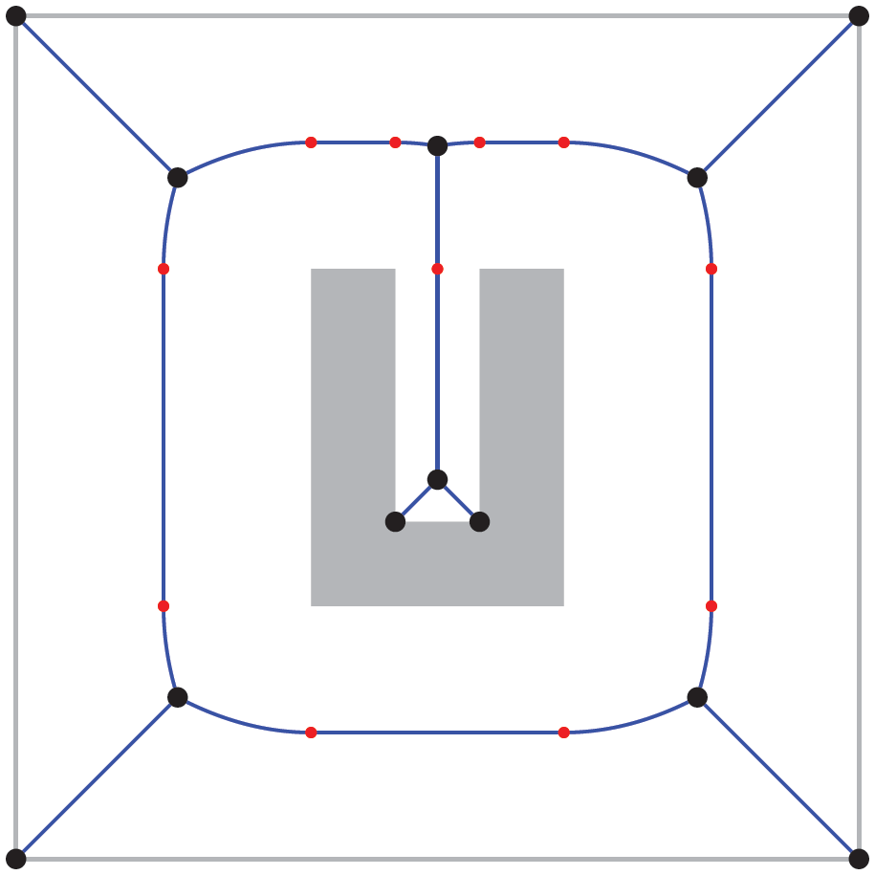
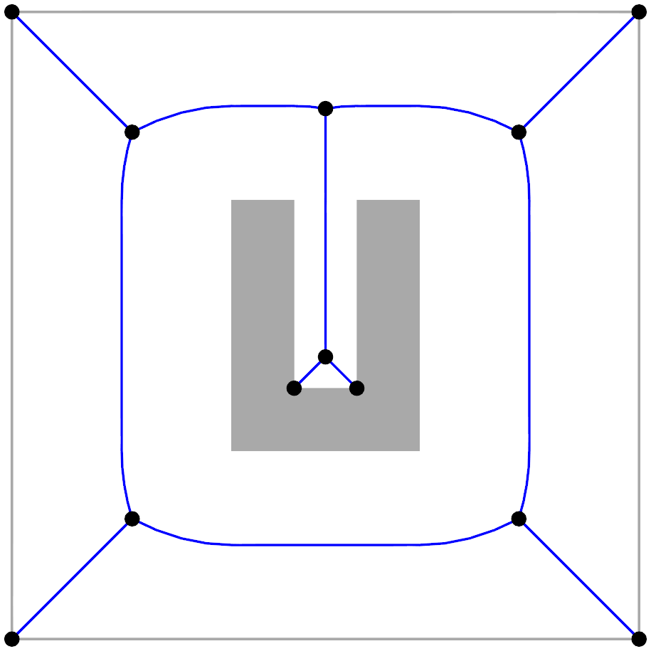
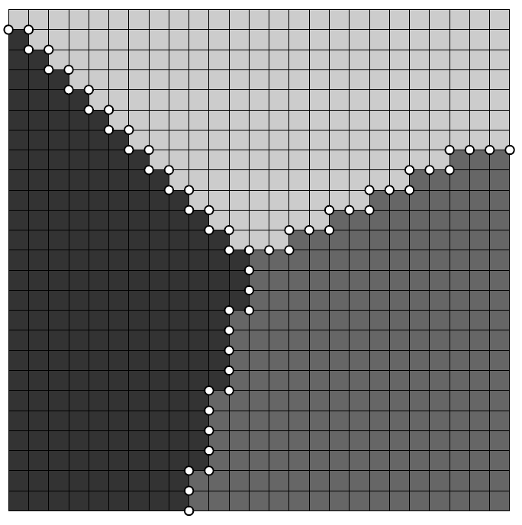
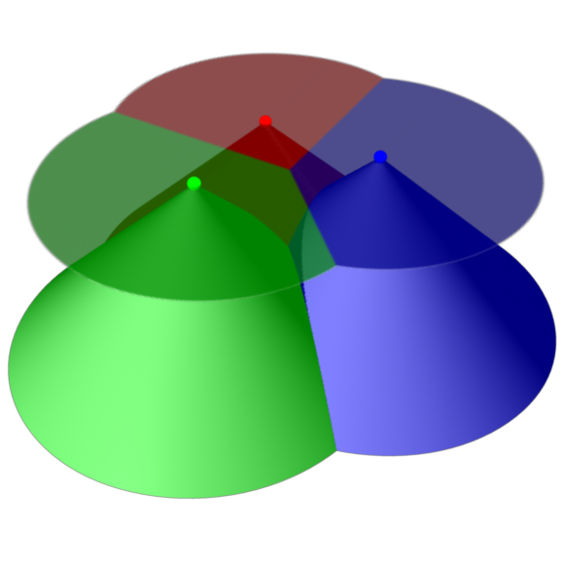
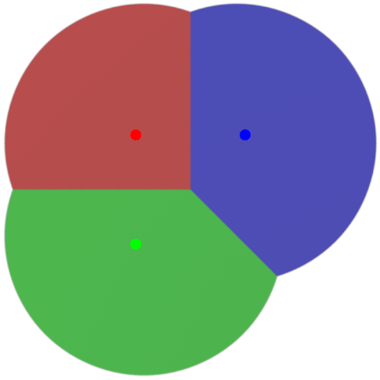
GVD / ECM by rendering
Based on Hoff et al. (1999)
GPU
CPU
color buffer data
Render distance meshes
Find relevant
pixels
GVD
Compute
normals
Assign normals
to pixels
Find
event points
Compute CPs
ECM

Slide 9
Move work to the GPU
Less copying
More parallel computations
GPU
CPU
color buffer data
Render distance meshes
partial color buffer data
Find relevant
pixels
GVD
Find relevant
pixels
Compute
normals
Assign normals
to pixels
Compute
normals
Assign normals
to pixels
Find
event points
Compute CPs
Compute CPs
ECM

Slide 10
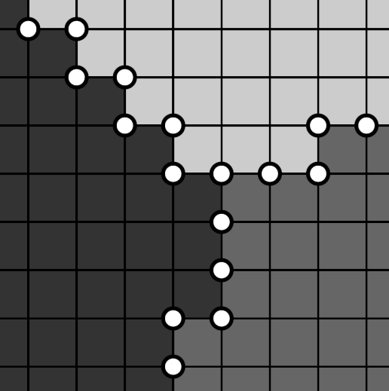
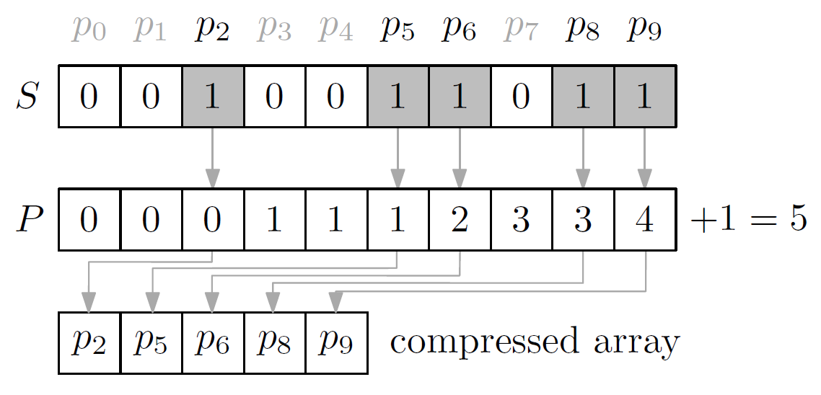
Some details
GPU is good at SIMT
Single instruction, multiple threads
“Doing a simple thing massively parallel”
Find relevant pixels
2 colors = potential edge point
3,4 colors = potential vertex
Marker buffers: 000011110100111001000
Compression: prefix sum
Closest points & normals
For all relevant pixels, check all 2/3/4 nearest obstacles
Some redundant work, but faster than checking if it’s needed

Slide 11
Multi-tiled extension

Slide 12
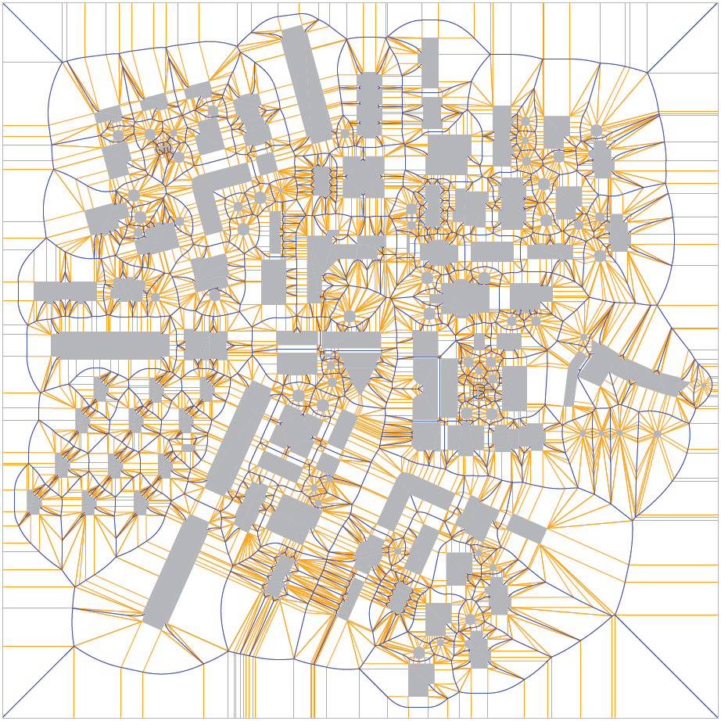
Multi-tiled extension
Large environments need high resolutions
Split into tiles; size = framebuffer size

Slide 13
Multi-tiled: old style
GPU
color buffer data
CPU
Render distance meshes
Find relevant
pixels
limited
Per tile
Compute
normals
Assign normals
to pixels
Find
event points
Compute CPs
ECM

Slide 14
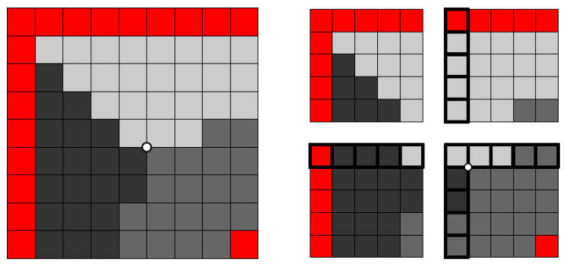
Multi-tiled: new style
GPU
CPU
Render distance meshes
Find
event points
Find relevant
pixels
Partial ECM
Per tile
Compute
normals
Assign normals
to pixels
Compute CPs
ECM

Slide 15
Results

Slide 16
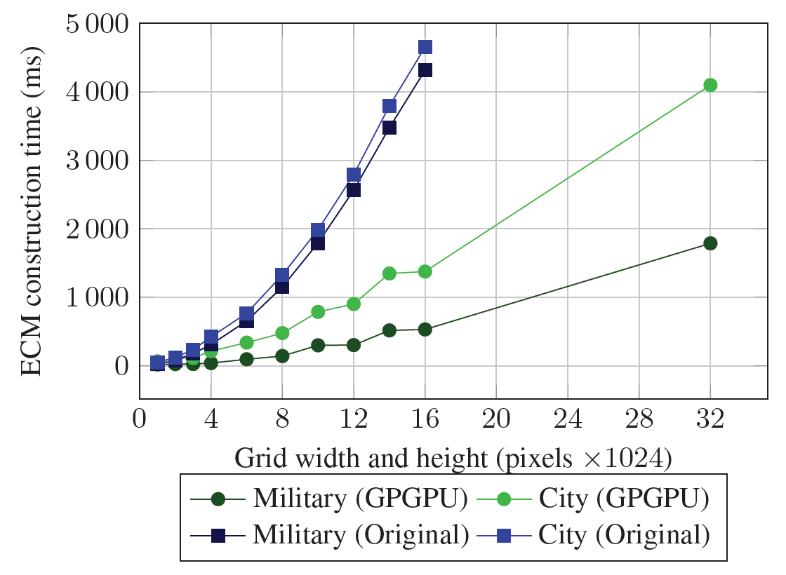
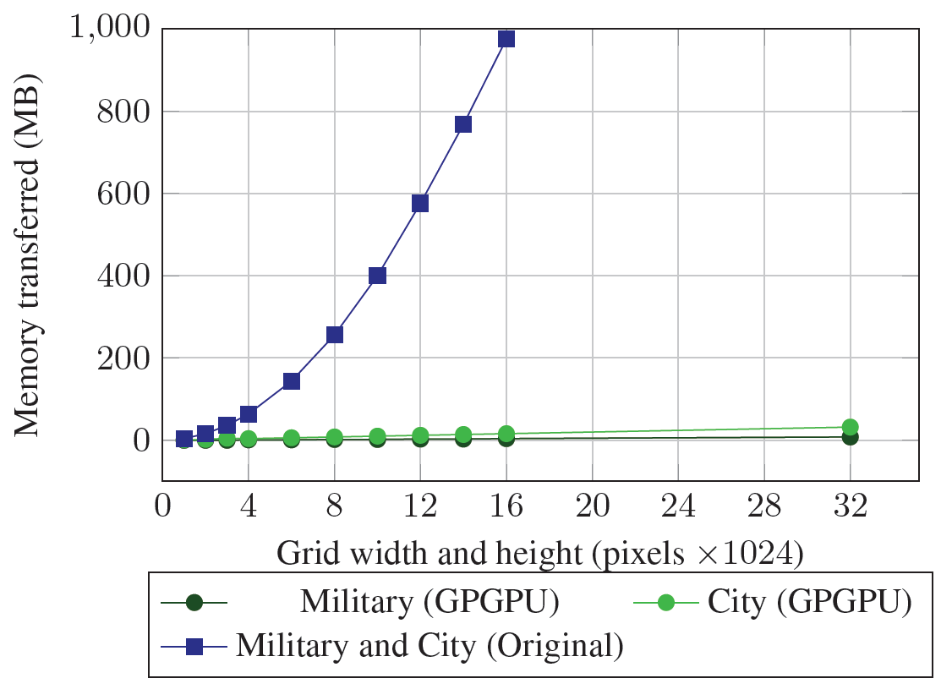
Improvements
Faster construction of ECMs
Less memory transferred
Resolutions that used to be impossible

Slide 17
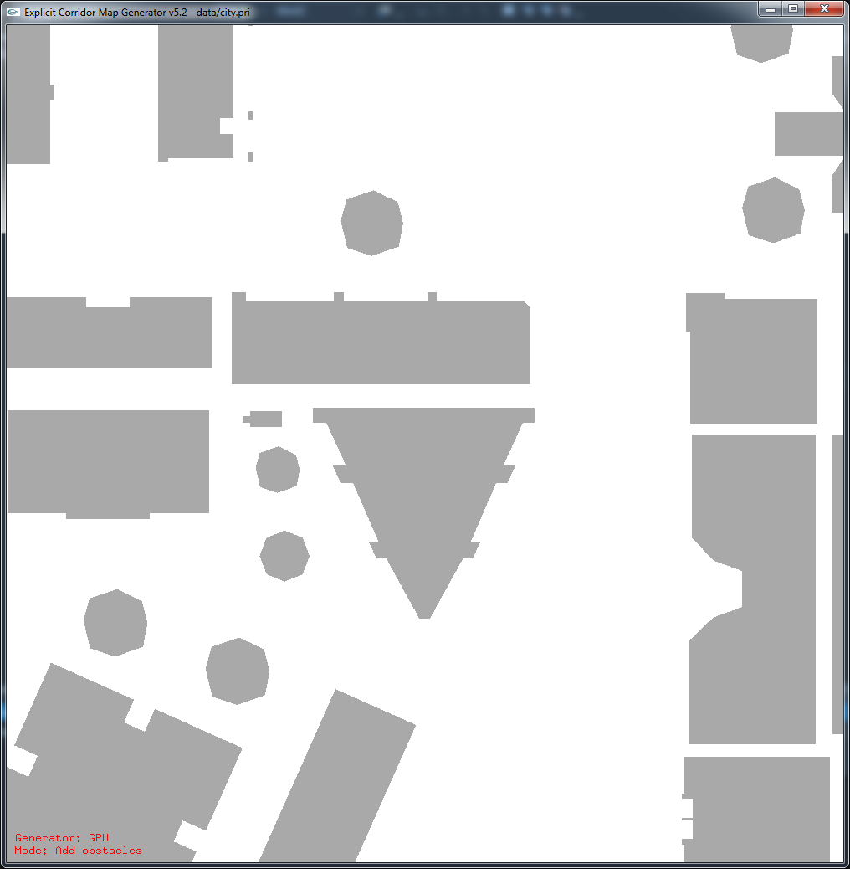
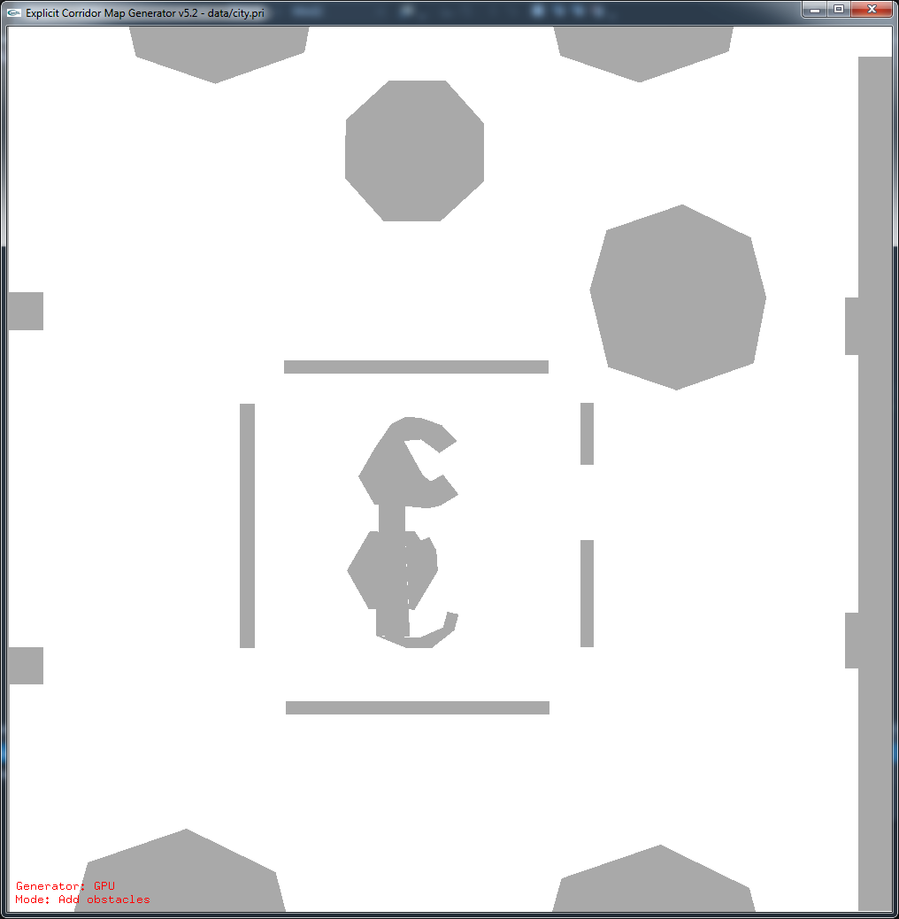
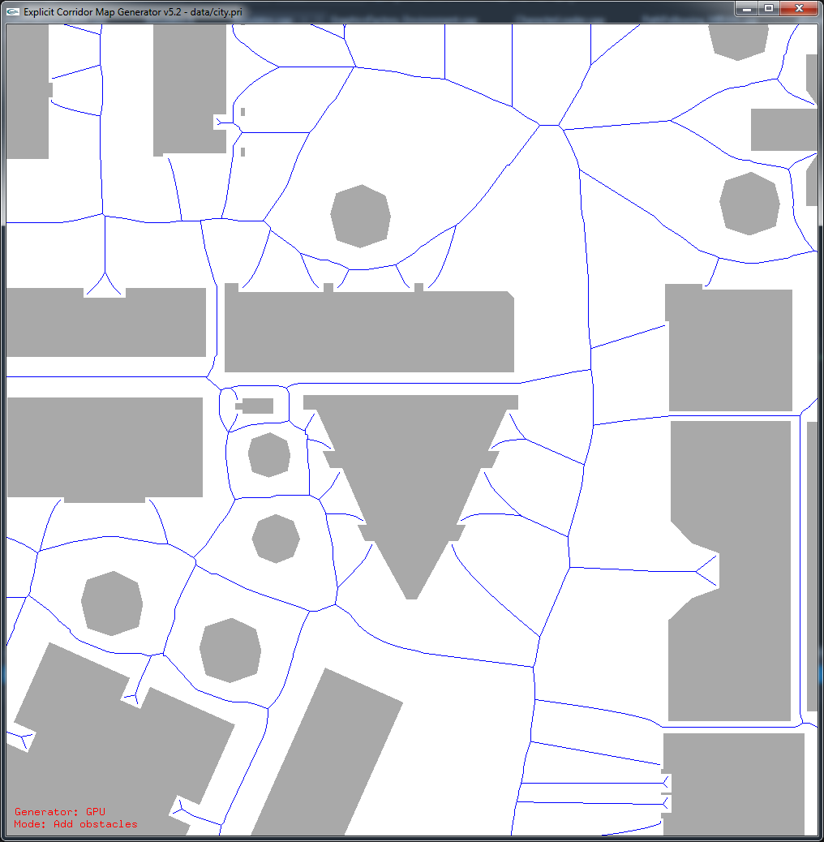
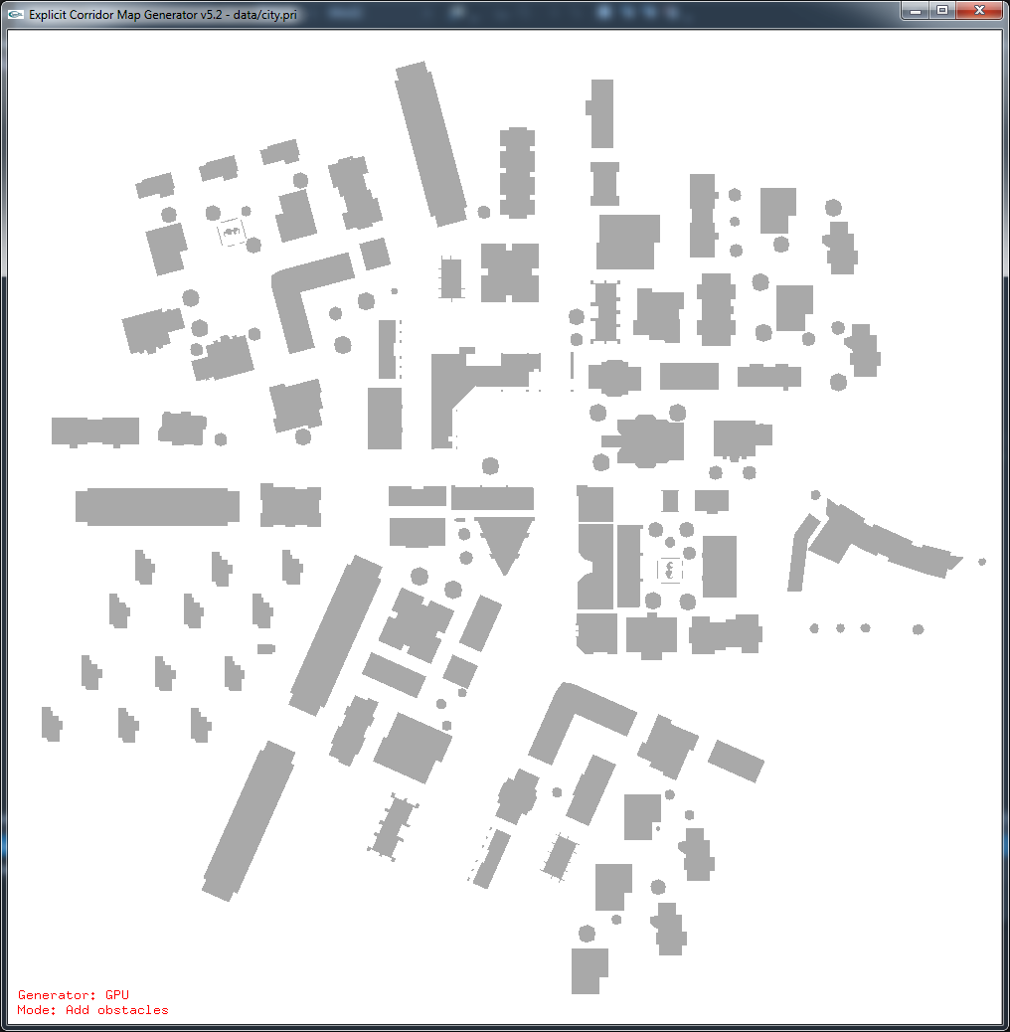
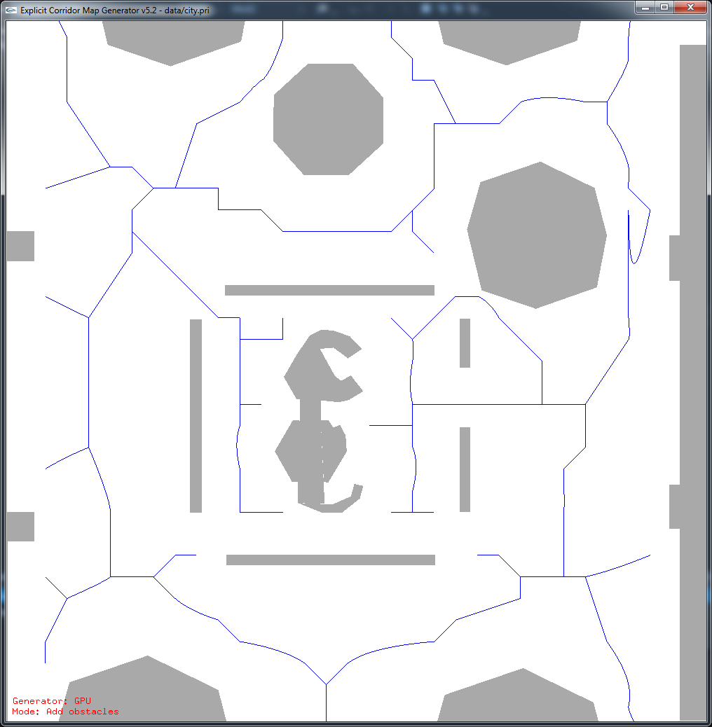
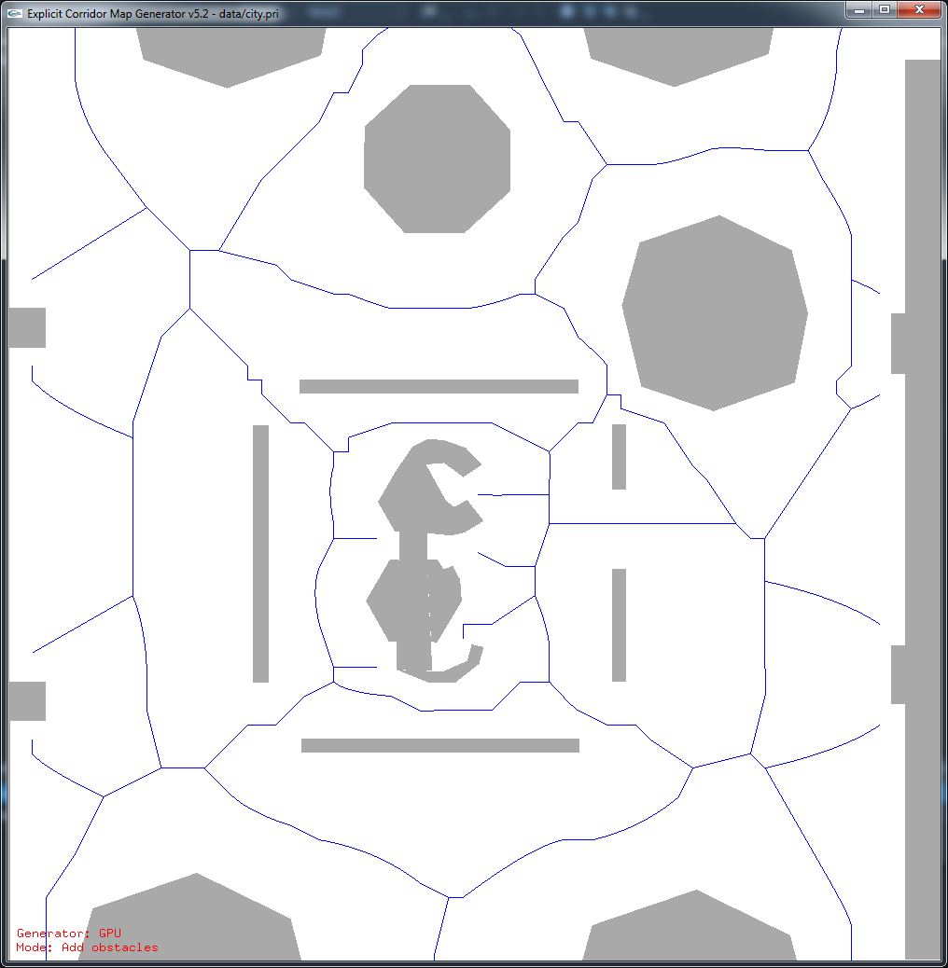
High resolutions reduce errors
10000x10000
3000x3000
1500x1500
5000x5000
500x500

Slide 18
Conclusions

Slide 19
Conclusions
ECM: flexible navigation mesh
Based on the medial axis / GVD
Can be computed using rendering
GPGPU enhancements
Highly parallel computing
Less memory transferred
Much higher resolutions

Slide 20
Discussion / Future work
More technical improvements?
“Perfect resolution” is unknown
Exact methods are getting better, too
VRONI
Boost
CGAL?

Slide 21
Thank you
Contact info
W.G.vanToll@uu.nl
http://www.uu.nl/staff/WGvanToll/

