Slide 1
Towards Believable Crowds A Generic Multi-Level Framework for Agent Navigation
ASCI.OPEN - March 23, 2015

Slide 2
Motivation
Crowd simulation
Many types of problems/algorithms
Contributions:
Five-level hierarchy for agent navigation
Navigation mesh
Software framework

Slide 3
Planning Hierarchy
Five levels of planning

Slide 4
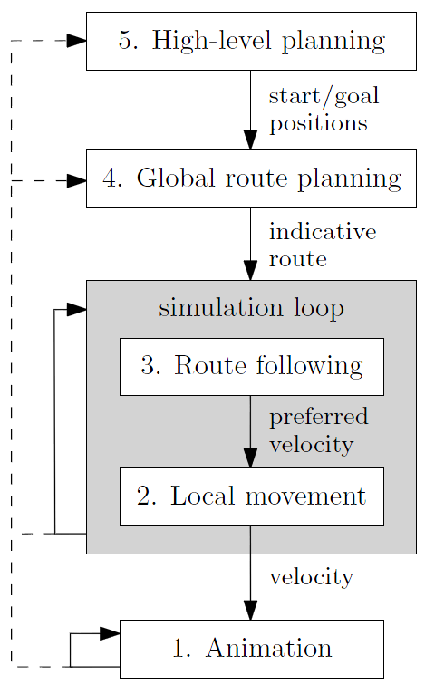
5-level hierarchy

Slide 5
High-level planning
Semantic action → Geometric queries
“take the train to work” →
“go to the station, buy a ticket, go to the platform, ...” →
find paths between positions in space
Traditional AI techniques
Out of scope
We focus on geometric planning (4, 3, 2)

Slide 6
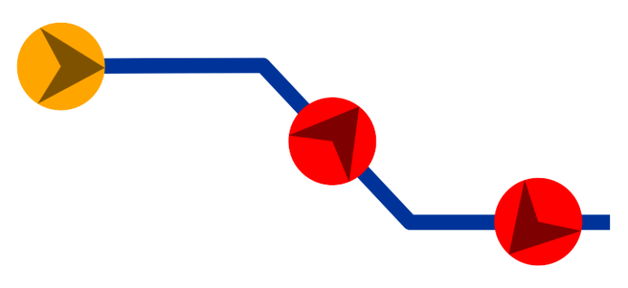
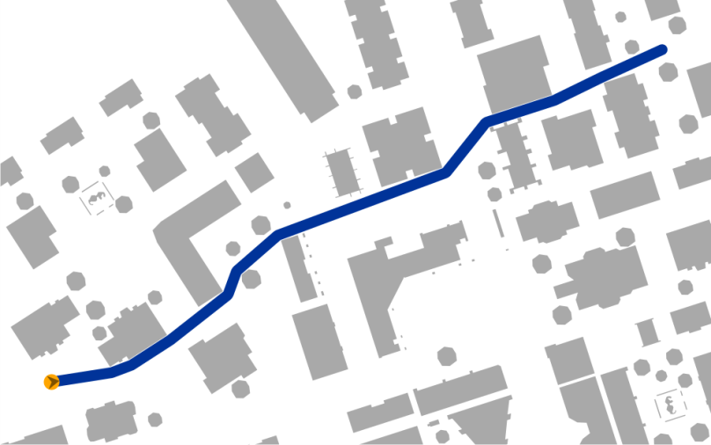
Global route planning
“A path planner should not compute a path”
A path planner should not compute a path
Lack of flexibility
Compute a rough geometric route
An indicative route
The agent will follow it smoothly during the simulation

Slide 7
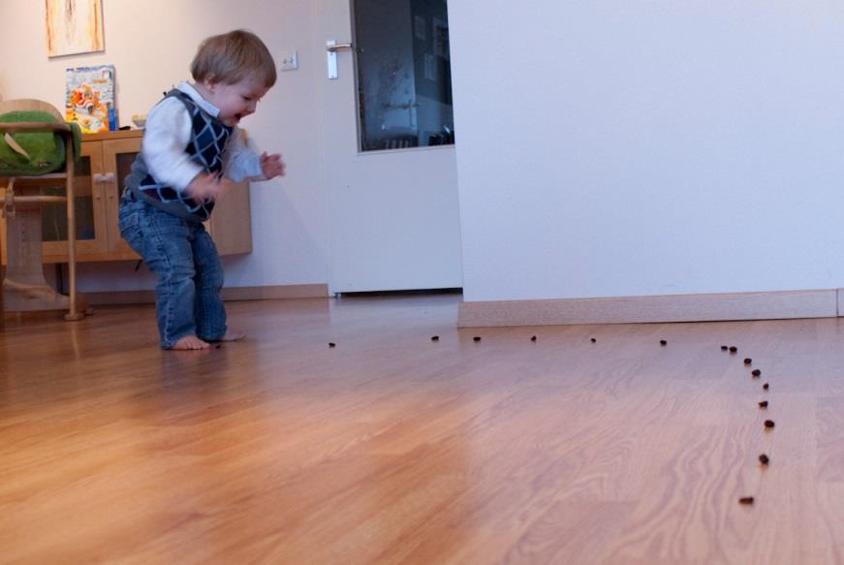
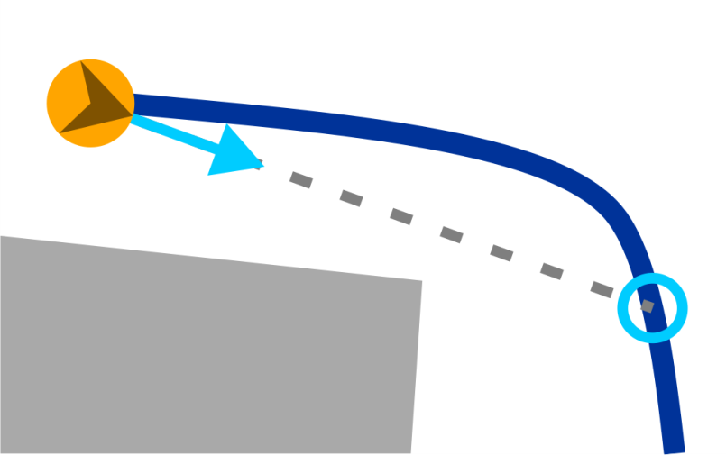
Route following
In each simulation step (e.g. 10 FPS)
Follow the indicative route smoothly
Compute a preferred velocity, e.g. to an attraction point on the route

Slide 8
Local movement
In each simulation step (e.g. 10 FPS)
Compute the actual velocity
Close to the preferred one
Avoid collisions with obstacles/agents
Follow the crowd flow
Maintain group formation
...
Finally: update all agent positions
p(t + dt) = p(t) + v ∙ dt

Slide 9
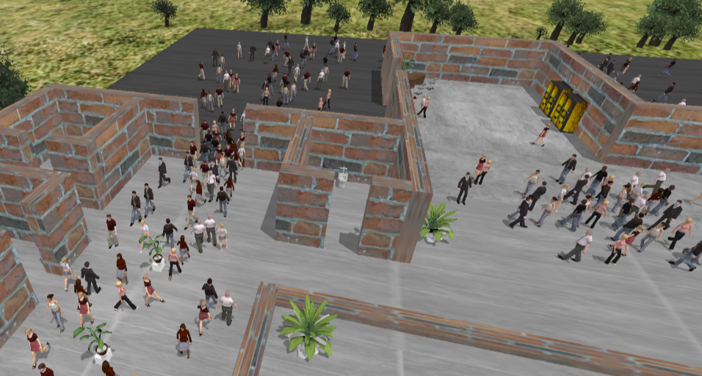
Animation
Smoothly move the agents’ models to their new positions
Different framerates: interpolation

Slide 10
Environment Representation
Navigation mesh / Weighted regions

Slide 11
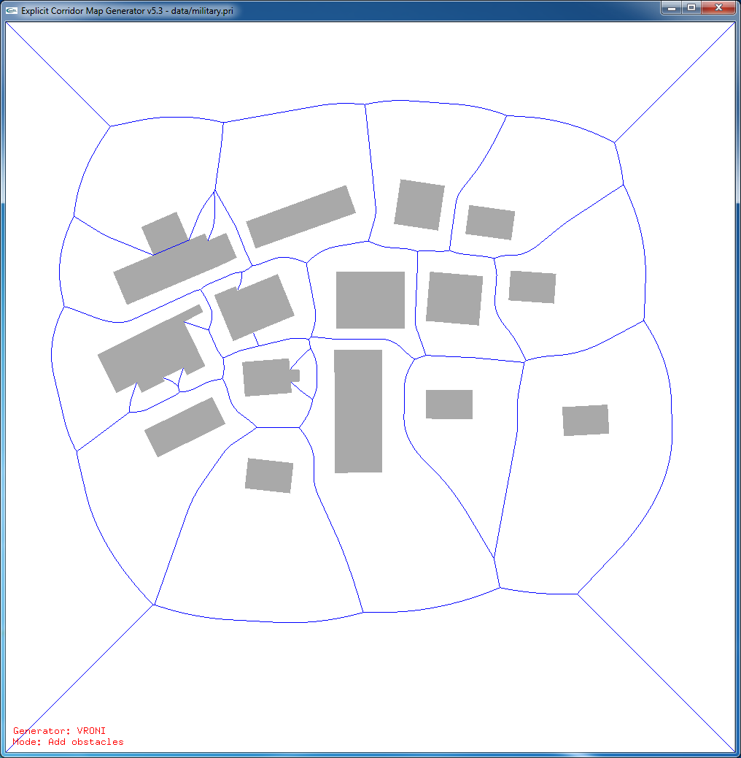
Demo
Explicit Corridor Map
Dynamic updates
Visibility
Path planning
Path following
Local movement
Weighted regions

Slide 12
Implementation
Crowd simulation software

Slide 13
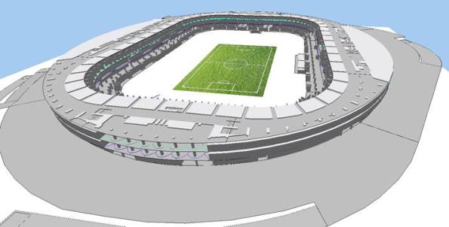
ECM crowd simulation framework
Computing the ECM
Various implementations for levels 4/3/2
Sequence of loops
Easy to parallellize
Modular setup
Easy to mix/match algorithms, add components
API / DLL
Integration into e.g. Unity3D
Used in the simulation industry
Crowd control (Incontrol)
Driving simulators (GreenDino)

Slide 14
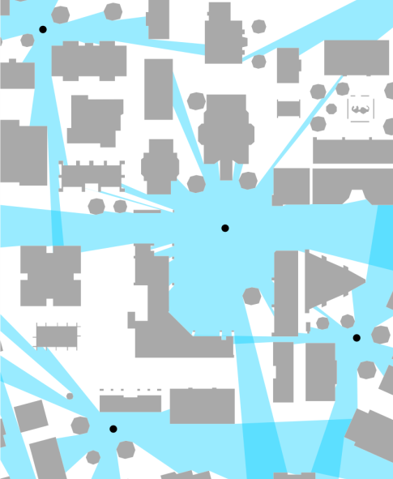
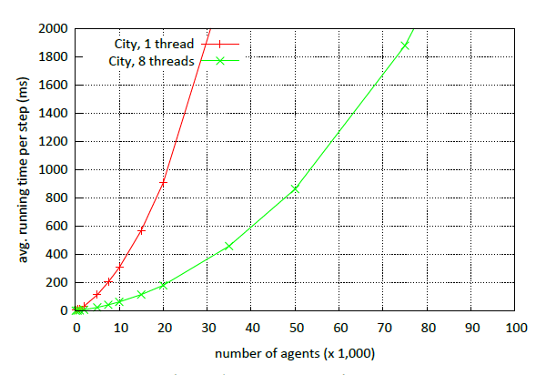
Experimental results
Computation of large ECMs (<1 s)
2D and multi-layered 3D
Dynamic updates (~4 ms)
Visibility polygons (~0.15 ms)
Computing indicative routes (<2 ms)
A* on the ECM
Depends on complexity/ path length
Crowd simulation
With collision avoidance: 10,000 agents in real-time
Memory-efficient: 1 million agents

Slide 15
Conclusions / Future Work

Slide 16
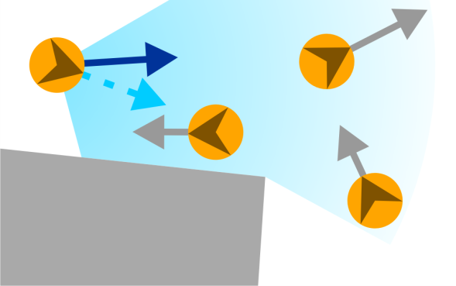
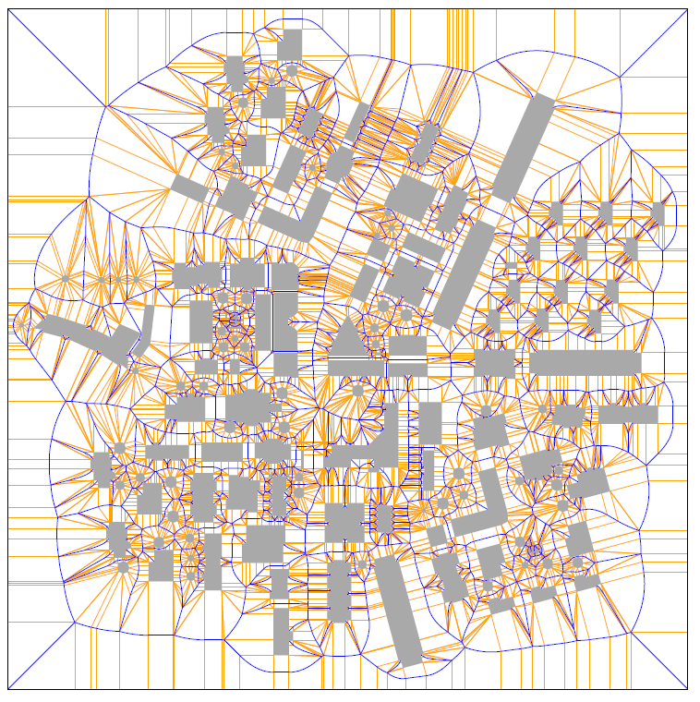
In conclusion
5-level hierarchy for agent navigation
Subdivision into subproblems
3 are geometric: global planning, route following, local movement
We need a good environment representation
ECM navigation mesh
Implementation: crowd simulation framework
Modular setup; multiple algorithms per level
>10,000 agents in real-time
Possible extensions
Different agent heights
Better high-level coordination between agents

Slide 17
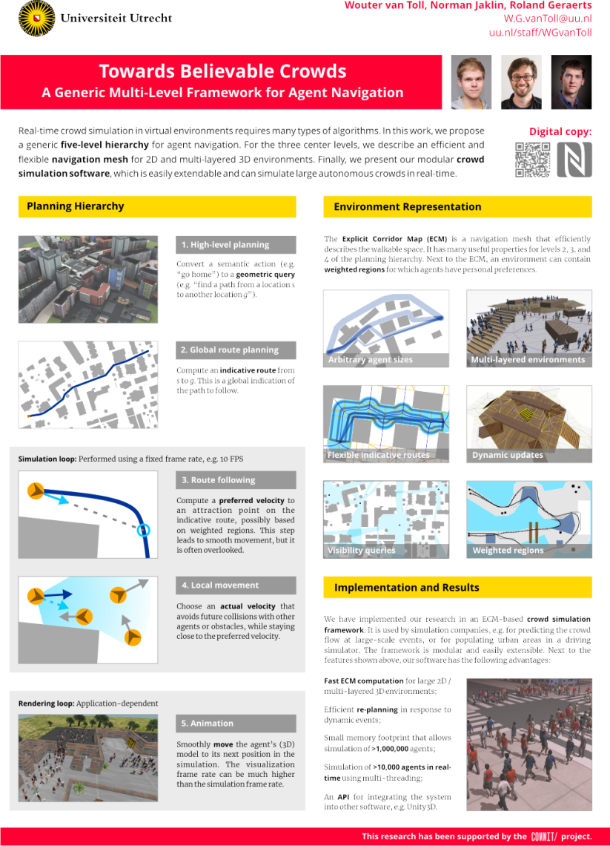
The final slide
ICT.OPEN
Poster #18
Demo on Tuesday
Contact info
W.G.vanToll@uu.nl
uu.nl/staff/WGvanToll

