Slide 1
Way to go: A framework for multi-level planning in games
Norman Jaklin Wouter van Toll Roland Geraerts
Department of Information and Computing Sciences
Utrecht University, The Netherlands

Slide 2
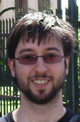


About us
Norman Jaklin, Wouter van Toll: PhD Students
Roland Geraerts: Assistant Professor
Part of the Games and Virtual Worlds group
  Research on animation, motion planning, ...
  For us: path planning and crowd simulation

Slide 3
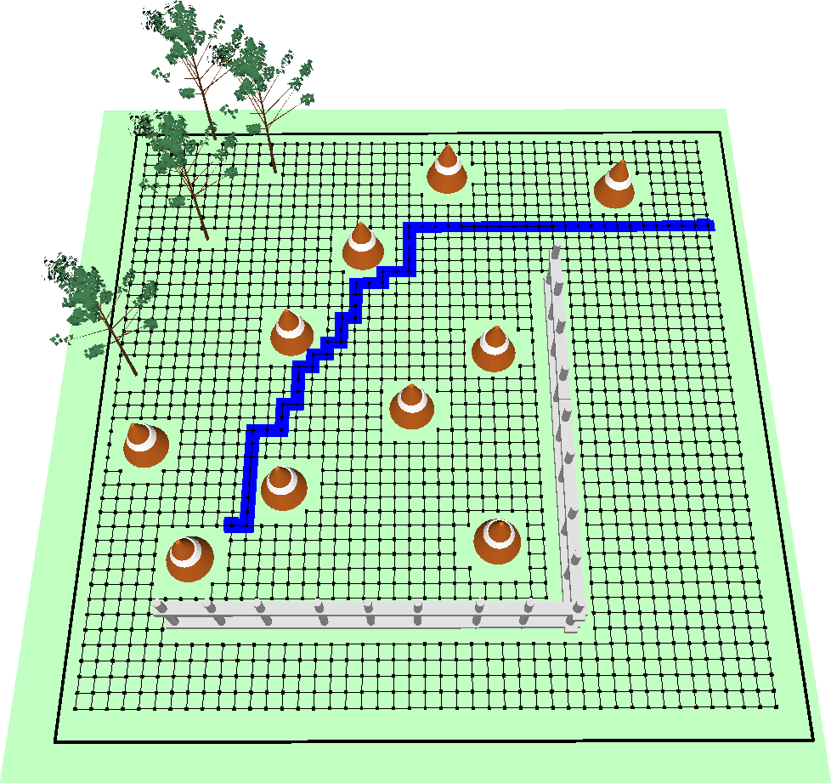
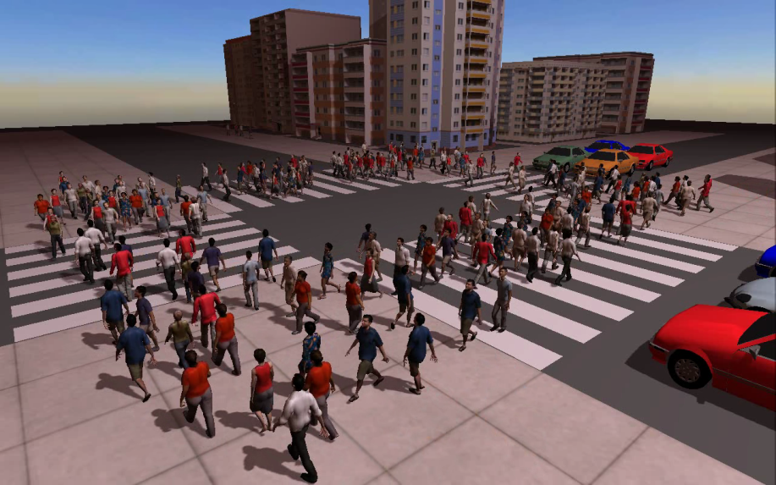
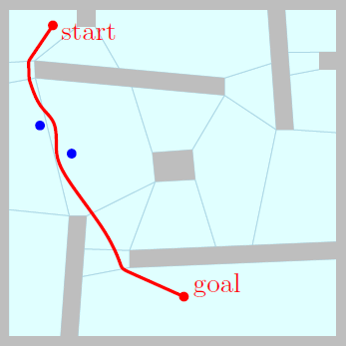
Path planning in games
Finding a path for one character
  A* on a grid
  Navigation meshes
Many characters: crowd simulation
  Individual goals
  Collision avoidance
Problem solved?
  Approximations, assumptions, memory
  We need an efficient and flexible framework

Slide 4
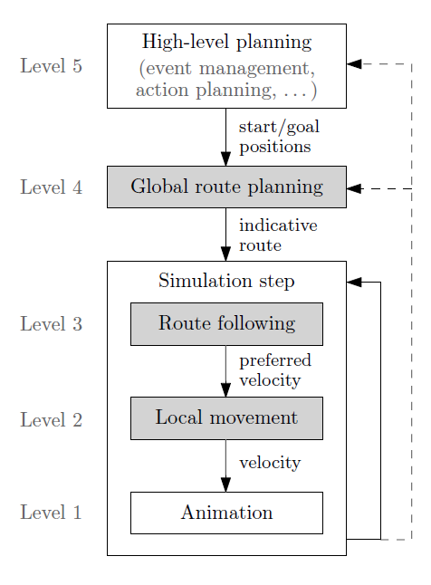
Planning hierarchy
Five levels
5: ICAPS / PG
4/3/2: our framework
  Navigation mesh
  Indicative routes
  Velocity-based models

Slide 5
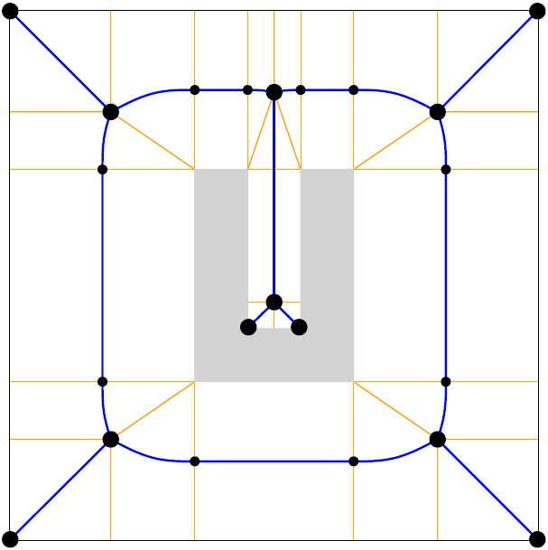
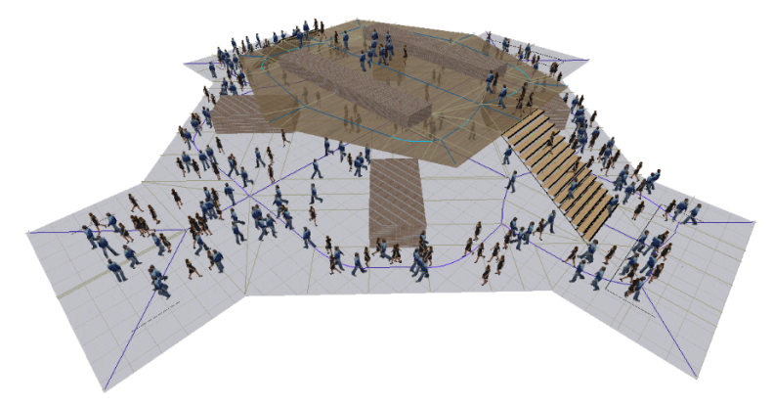
Our framework
Explicit Corridor Map: navigation mesh
  Computed automatically
  Clearance info: supports all character sizes
  2D and multi-layered environments
  Dynamic updates
  Visibility queries

Slide 6
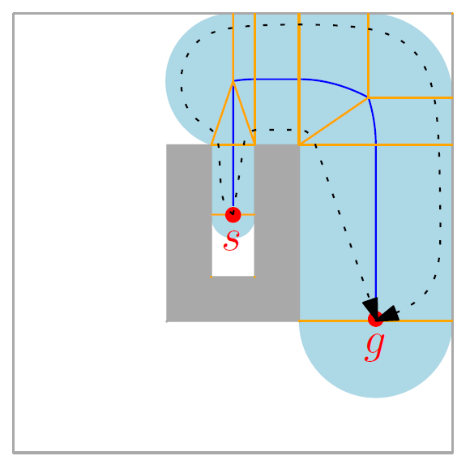
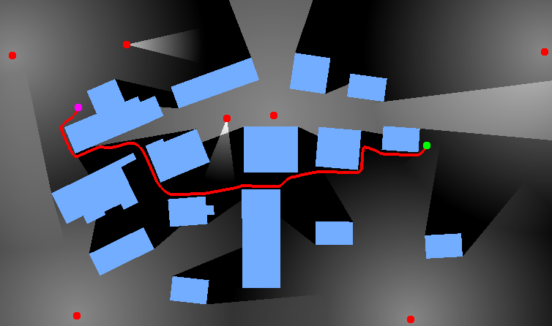
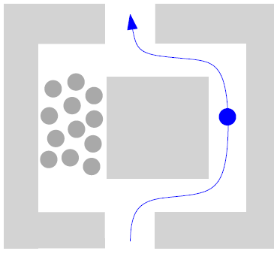
Our framework
Level 4: Route planning
  Medial axis → corridor
  Any route in the corridor (e.g. the shortest)
  Or: visibility, crowd density, ...
  Result: indicative route (IR)

Slide 7
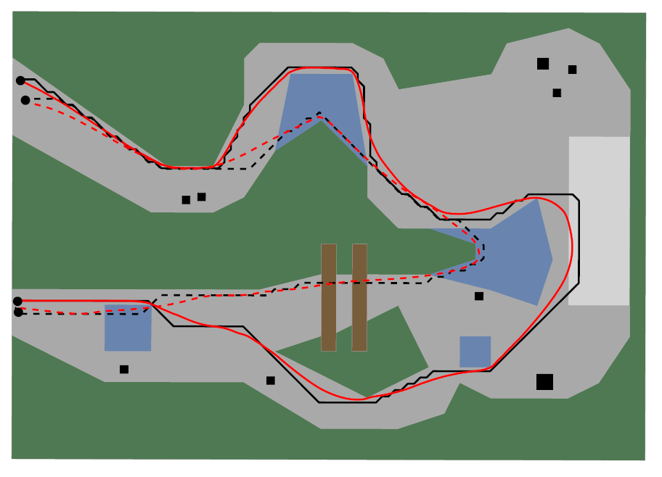
Our framework
Level 3: Route following
  Character follows IR smoothly: attraction point
  Indicative Route Method: basic
  MIRAN: supports terrain preferences
Level 2: Local movement
  Preferred velocity → actual velocity
  Collision avoidance: many models exist

Slide 8
Demo

Slide 9
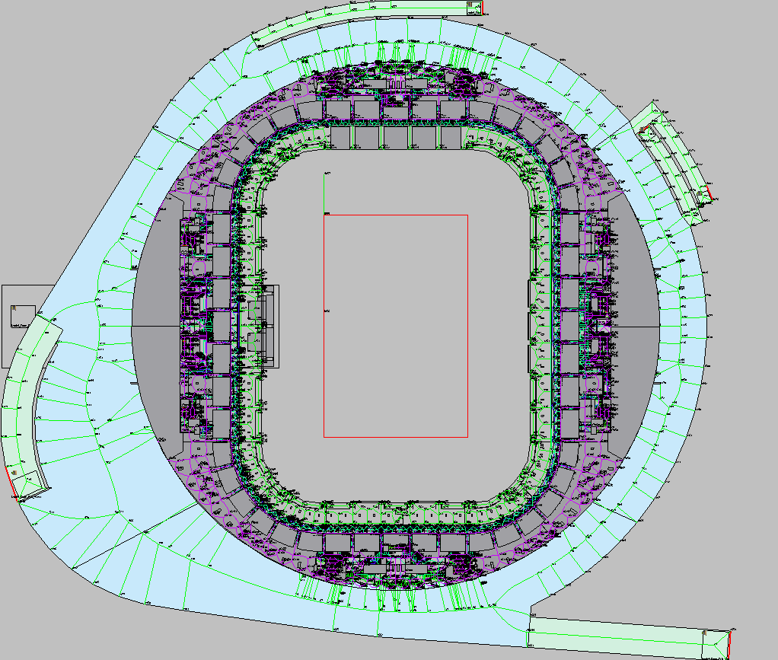
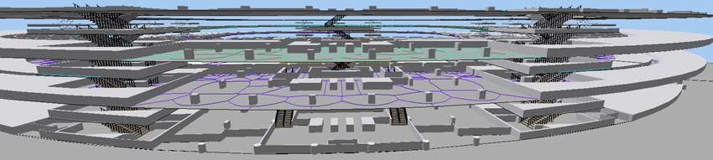
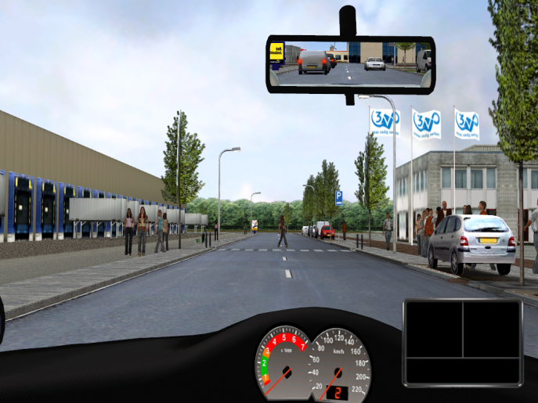
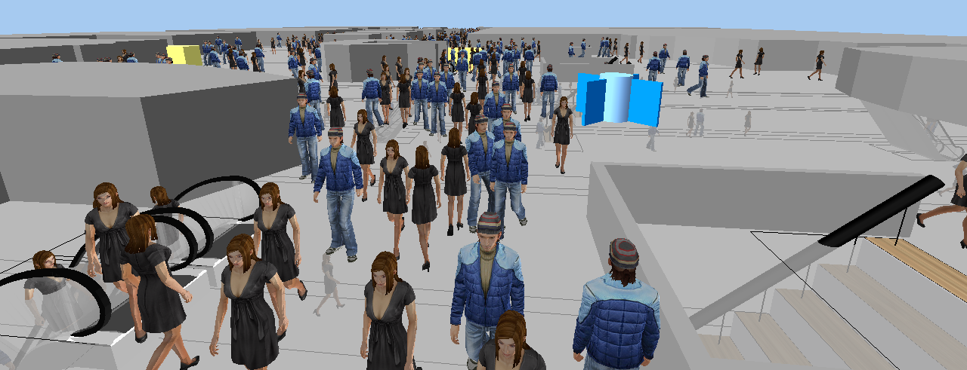
Current / Future work
Crowds in dynamic environments
Combinations with...
  Game engines (Unity)
  High-level planning?

