Slide 1
A Comparative Study of Navigation Meshes . Motion in Games 2016
Wouter van Toll¹
Roy Triesscheijn¹
Marcelo Kallmann²
Ramon Oliva³
Nuria Pelechano³
Julien Pettré⁴
Roland Geraerts¹
1
2
3
4

Slide 2
Introduction
Motivation for a comparative study

Slide 3
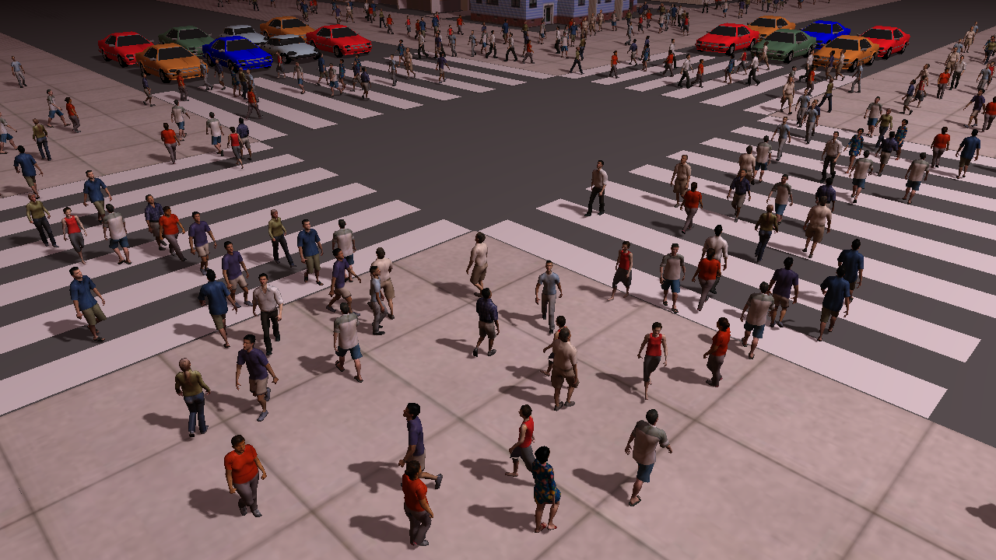
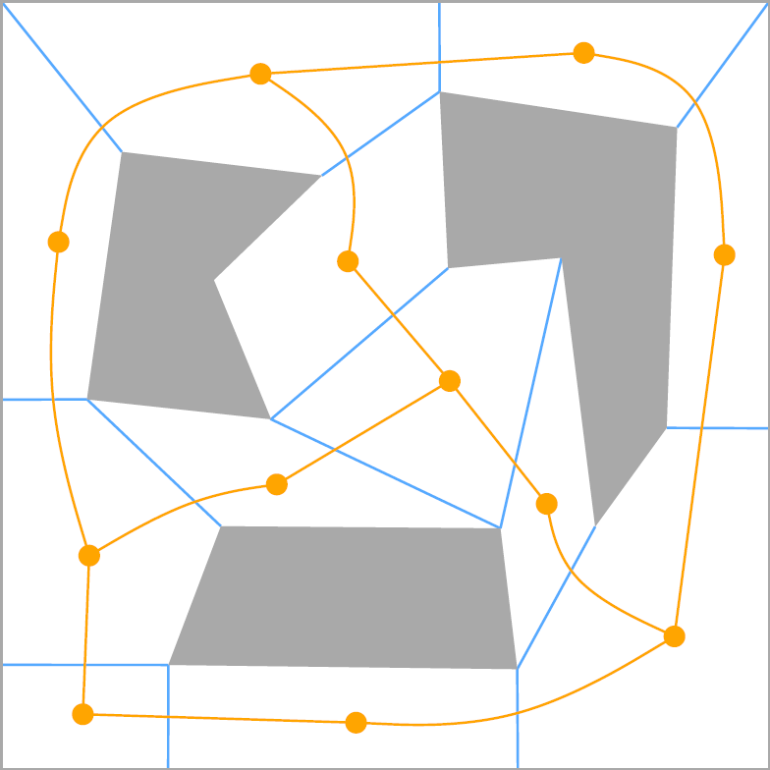
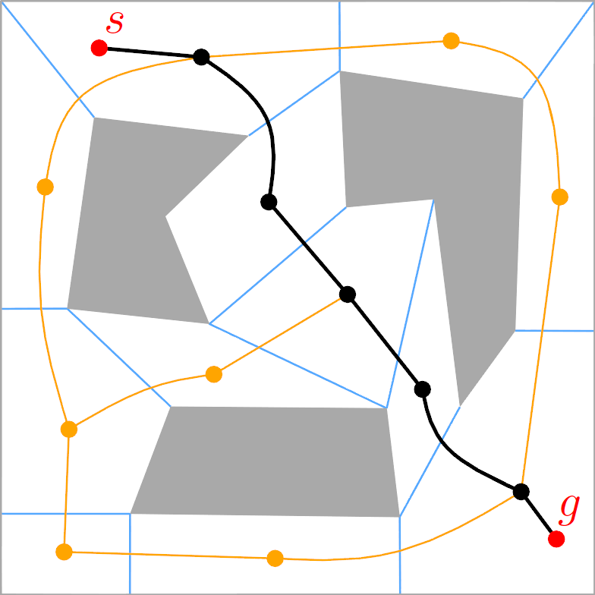
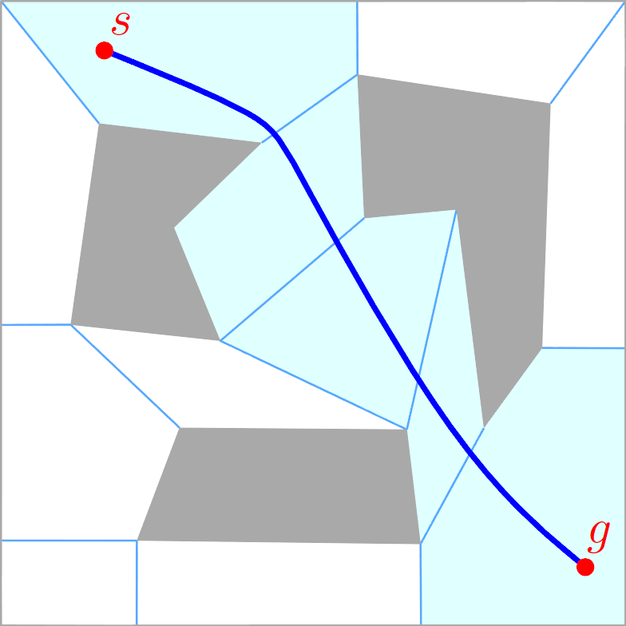
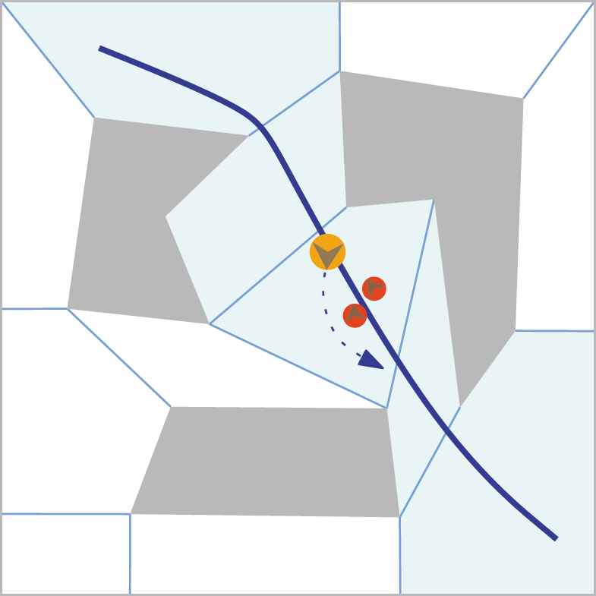
Navigation Meshes 101
Path planning for characters in virtual environments
Many characters: crowd simulation
Games: real-time performance
→ Requires efficient data structures
Navigation mesh
Environment representation for path planning purposes
Geometric regions
Path planning in (dual) graph
Path → indicative route
Flexibility for local movement

Slide 4
State of the Art
Many navigation meshes have been developed
Automatic construction for 2D/3D environments
Different papers...
...use different assumptions about the input
...may have different applications in mind
...use different environments, hardware, settings, etc.
How “good” is a navigation mesh?
Where should research go next?

Slide 5
Comparative Study
Successful benchmarking in related areas
Grid-based path planning [Sturtevant 2012]
Collision avoidance [Singh et al. 2009]
Time to do it for navmeshes as well
Set a standard for evaluation / comparison
Gain insight in (dis)advantages of each method
Steer future research

Slide 6
Definitions
Environments and navigation meshes

Slide 7
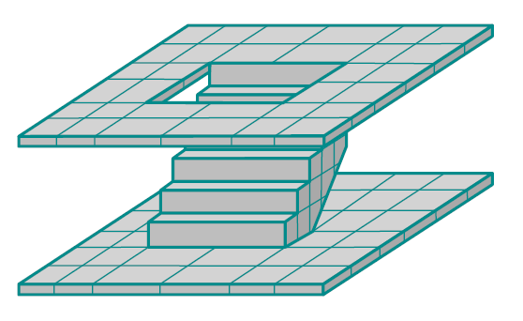
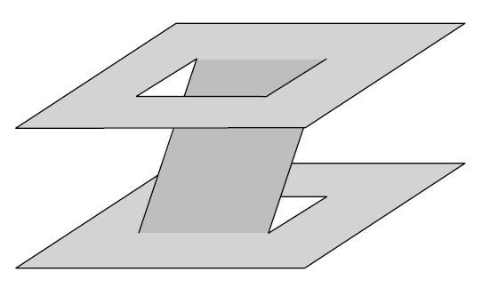
Environments (1/2)
3D environment (3DE)
Raw collection of polygons: floors, walls, staircases, ...
Assuming a common gravity direction / ground plane P
Walkable environment (WE)
Polygons in 3D on which characters can walk
Free space E_{free} of a 3DE based on parameters
Character height, maximum slope w.r.t. P, ...

Slide 8
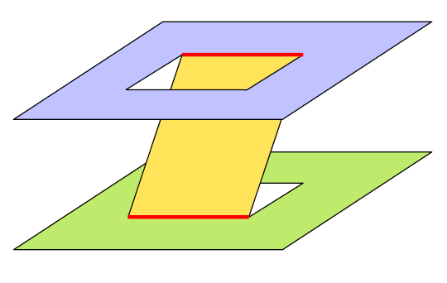
Environments (2/2)
Multi-layered environment (MLE)
Subdivision of a WE into layers {L₀, L₁, ...}
Each L_{i} can be projected onto P without overlap
2D environment (2DE)
Polygons in 2D on which characters can walk
2DE embedded in 3D == MLE with one layer
Next presentation

Slide 9
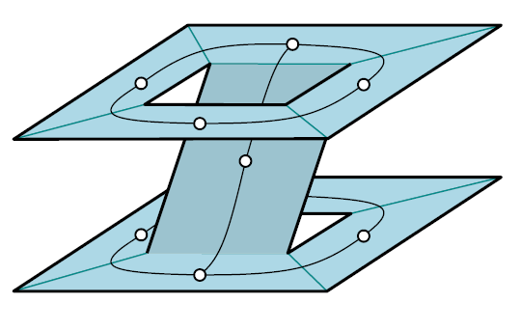
Navigation Mesh
Navigation mesh
R = {R₀, R₁, ...} = regions in 3D that represent E_{free}
G = (V,E) = graph that describes how to move between regions
Often, G is the dual graph of R
Two types of construction algorithms
Voxel-based
Exact

Slide 10
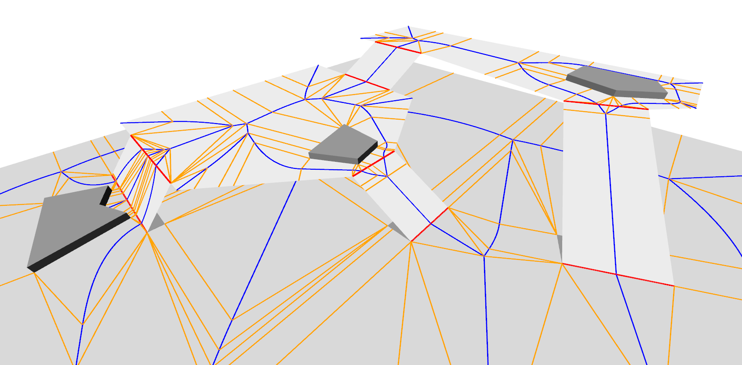
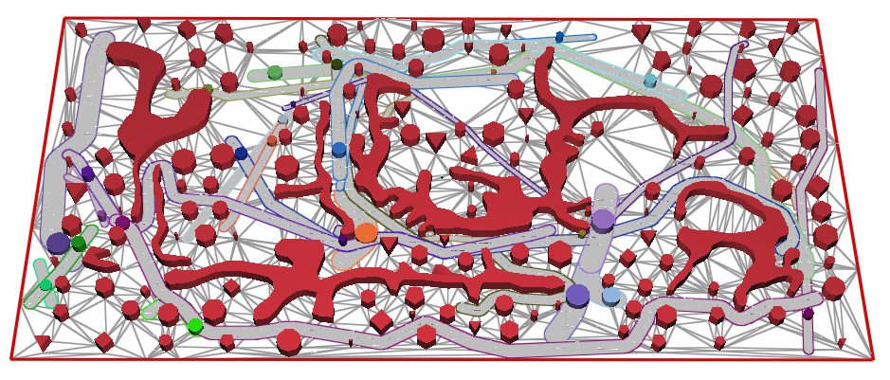
Featured Navigation Meshes (1/2)
Exact
Local Clearance Triangulation (LCT) [Kallmann 2014]
Explicit Corridor Map (ECM) [van Toll et al. 2011]
The Explicit Corridor Map: Using the Medial Axis for Real-Time Path Planning and Crowd Simulation
W. van Toll, A.F. Cook IV, M.J. van Kreveld, R. Geraerts
Computational Geometry Multimedia Exposition 2016
Dynamic and Robust Local Clearance Triangulations M. Kallmann ACM ToG, 2014

Slide 11
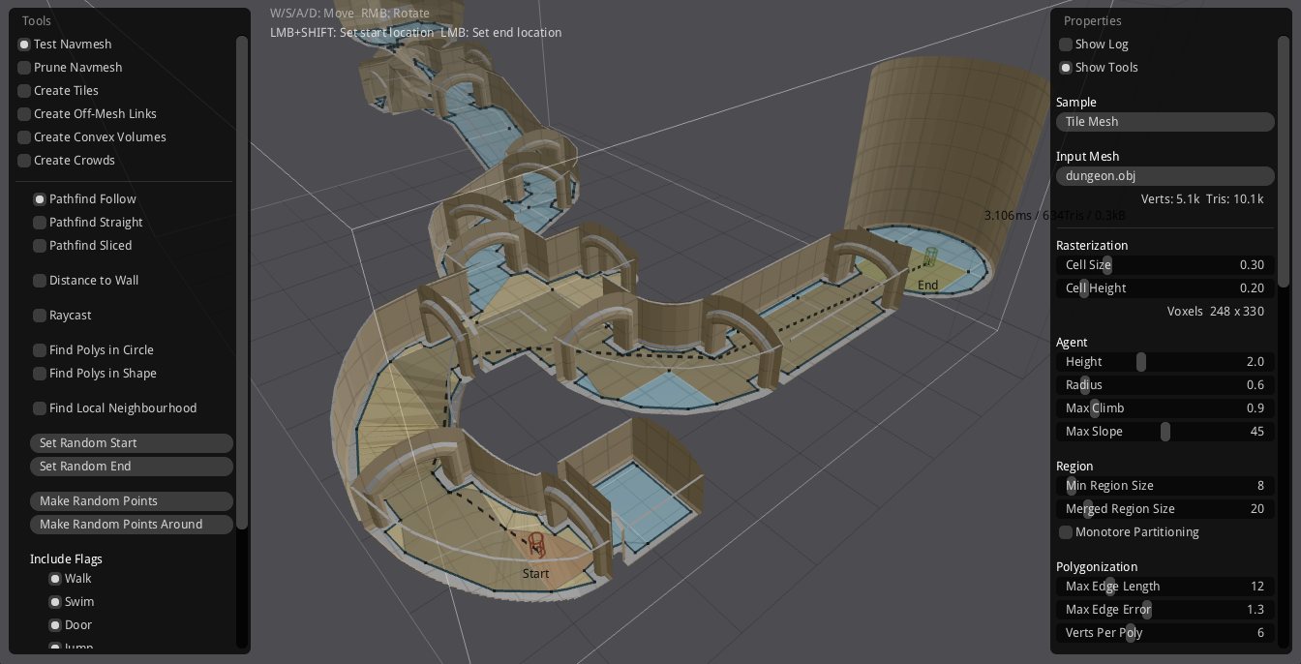
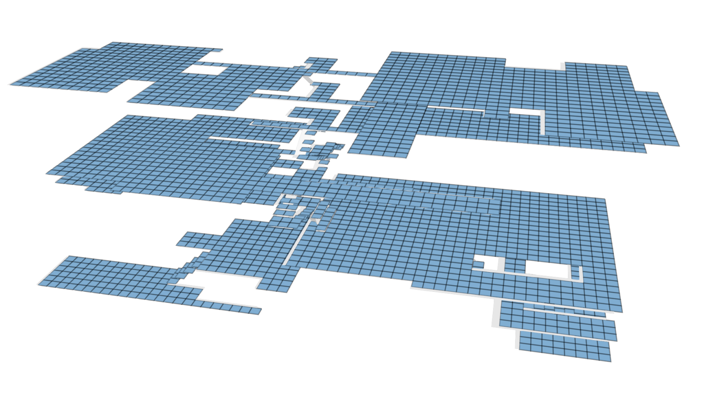
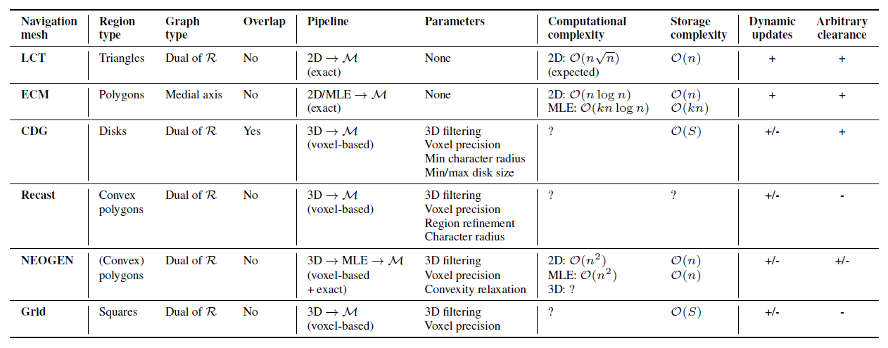
Featured Navigation Meshes (2/2)
Voxel-based
Clearance Disk Graph (CDG) [Pettré et al. 2005]
Recast Navigation [Mononen ~2011-now]
NEOGEN [Oliva and Pelechano 2013]
Grid
Theoretical comparison: see paper
https://github.com/recastnavigation/recastnavigation
NEOGEN: Near optimal generator of navigation meshes for 3D multi-layered environments
R. Oliva, N. Pelechano
Computers & Graphics, 2013
A navigation graph for real-time crowd animation on multilayered and uneven terrain
J. Pettré, J.-P. Laumond, D. Thalmann
1st International Workshop on Crowd Simulation, 2005

Slide 12
Quality Metrics
Implementation + Environment = Numbers

Slide 13
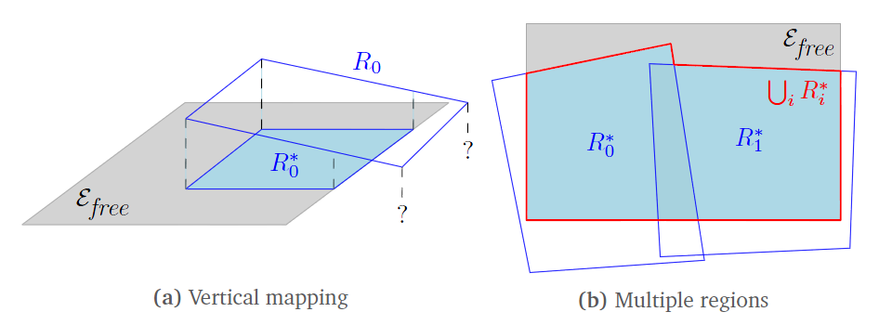
Coverage Metrics (1/2)
How accurately do the navmesh regions cover E_{free}?
(Only interesting for voxel-based methods)
2D: compute unions/differences in the plane
3D: more difficult
Vertically map each region R_{i} onto E_{free} → R*_{i}
Compute unions/differences of mapped regions
Compute projected areas (ignoring height differences)

Slide 14
Coverage Metrics (2/2)
Free space covered
Total area of E_{free} that is covered by some region
Incorrect area
Total area of the regions that does not map to E_{free}
Overlap
Area of E_{free} that is covered more than once

Slide 15
Other Metrics
Connectivity
#Connected components in G
#Boundaries of R according to G
Complexity
#Vertices and edges in G
#Regions in R
Region complexity: average, SD, total
Performance
Construction time (avg/SD over 10 runs)
Memory usage (avg/SD over 10 runs)
Application-dependent importance
Should match E_{free}
Lower = better,
but difficult to minimize all of them
Lower = better

Slide 16
Experiments and Results
Putting it into practice

Slide 17
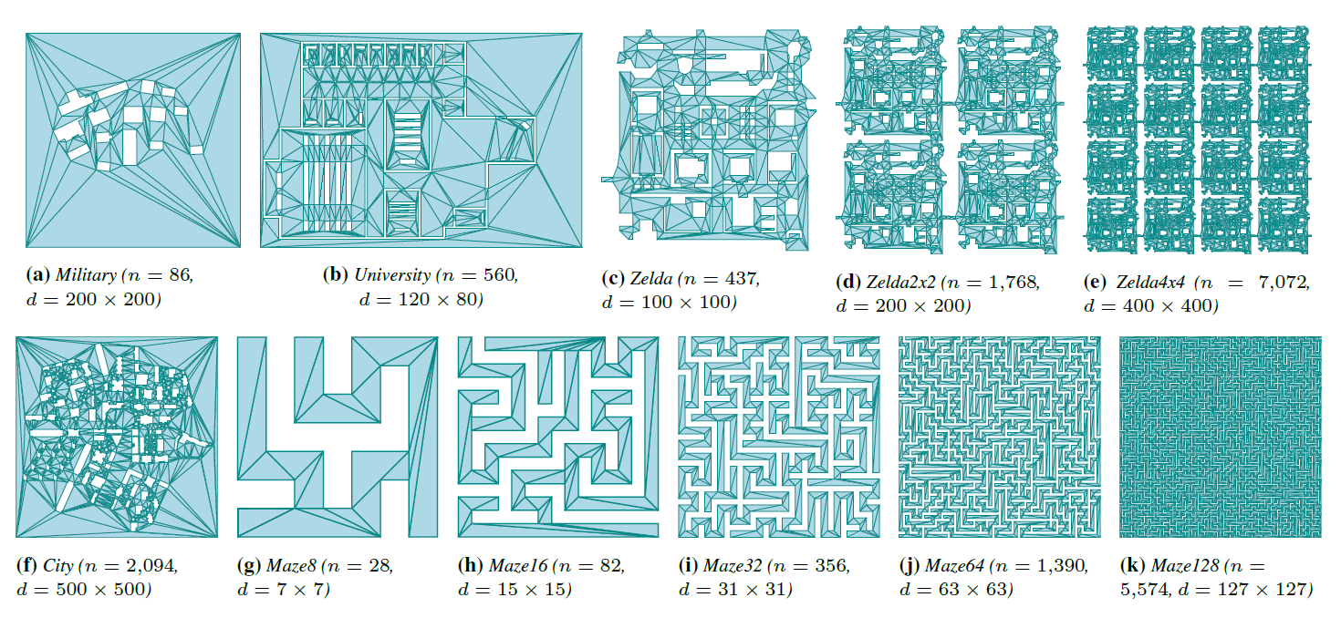
Environments: 2D

Slide 18
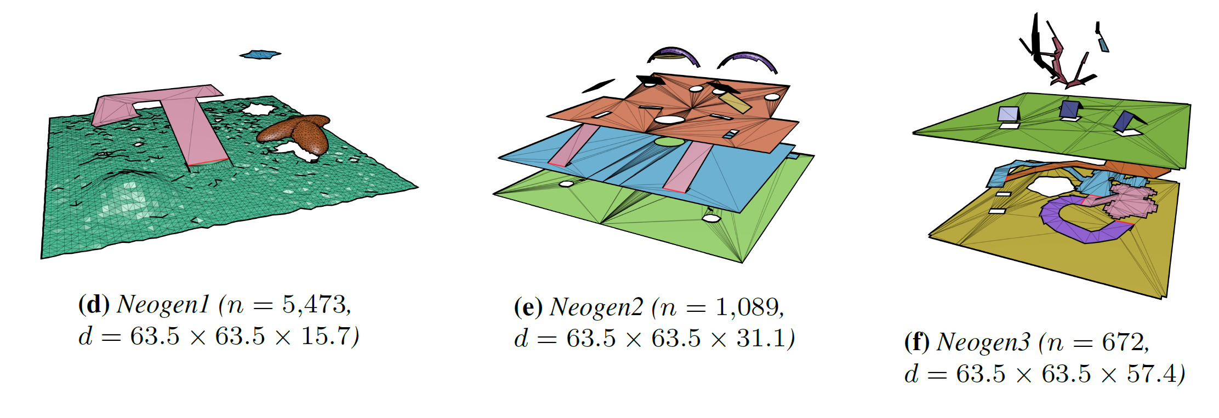
Environments: MLEs (1/2)

Slide 19
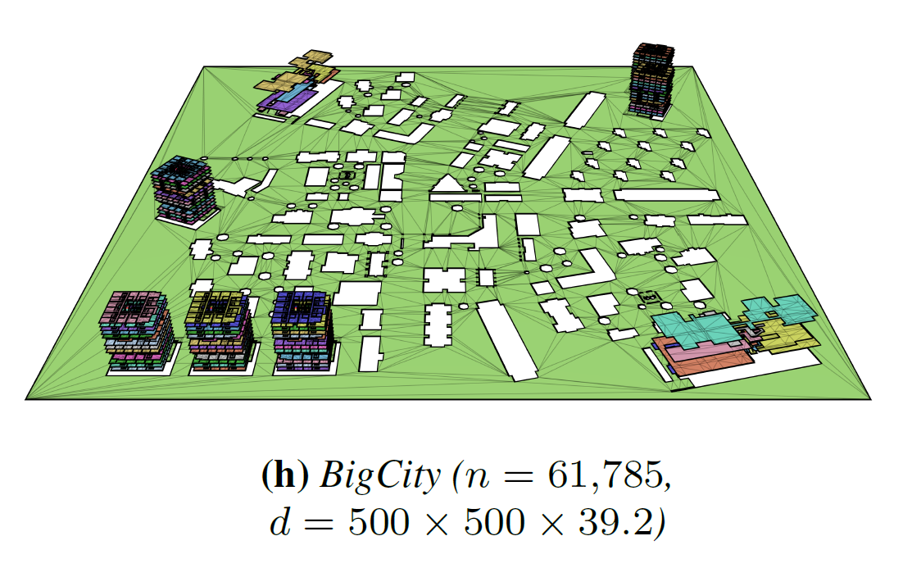
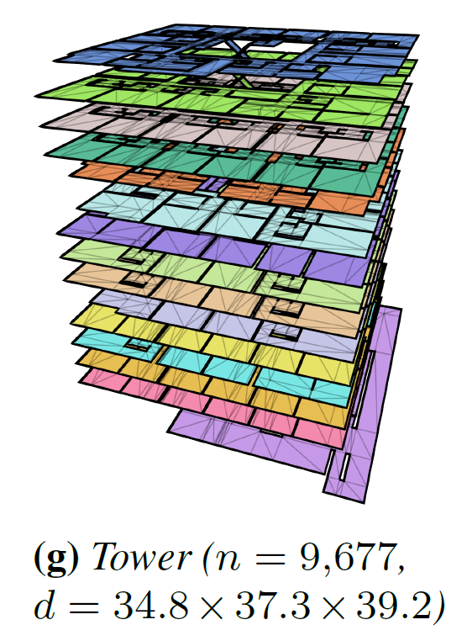
Environments: MLEs (2/2)

Slide 20
Results: Example
Ground truth

Slide 21
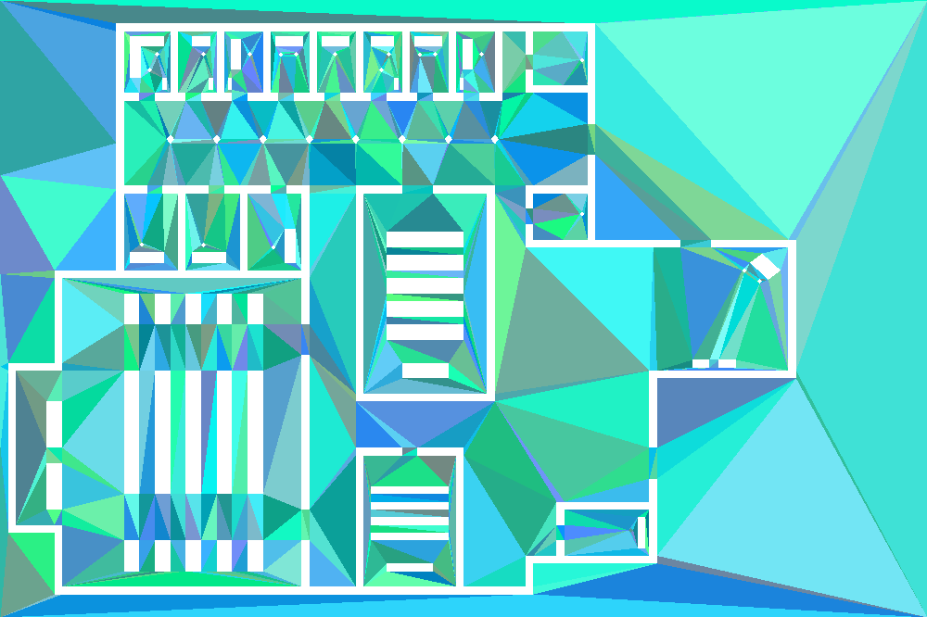
Results: Example
LCT

Slide 22
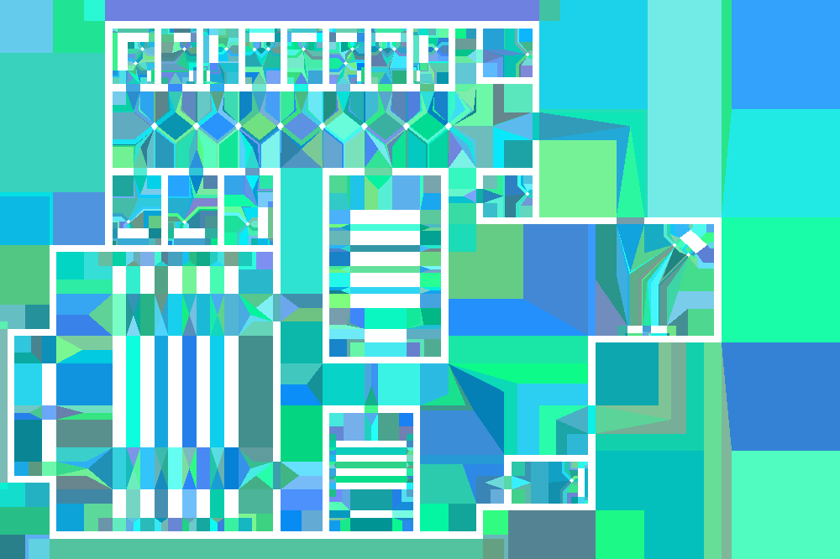
Results: Example
ECM

Slide 23
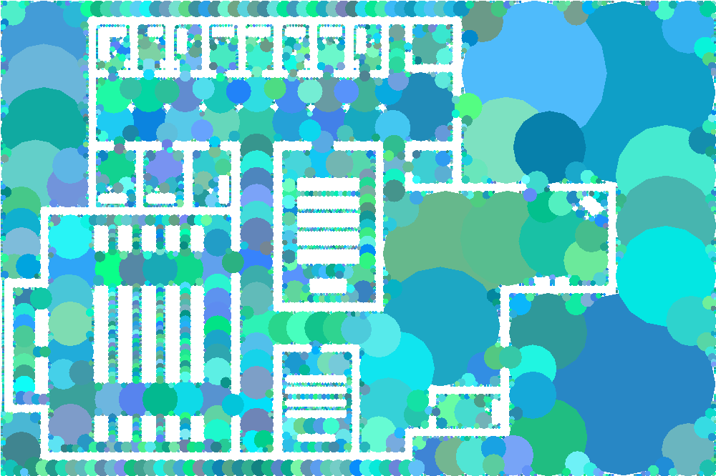
Results: Example
CDG

Slide 24
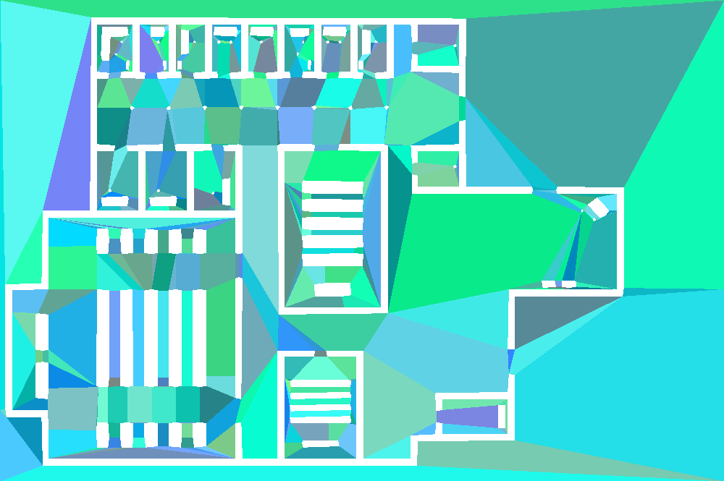
Results: Example
Recast

Slide 25
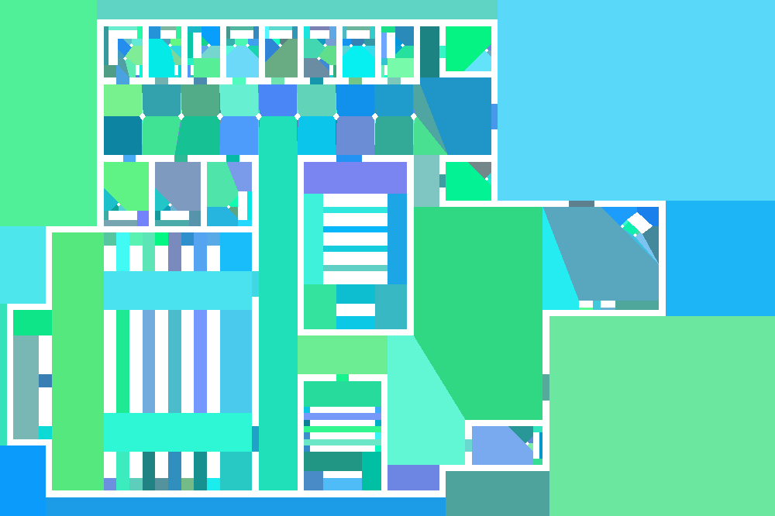
Results: Example
NEOGEN

Slide 26
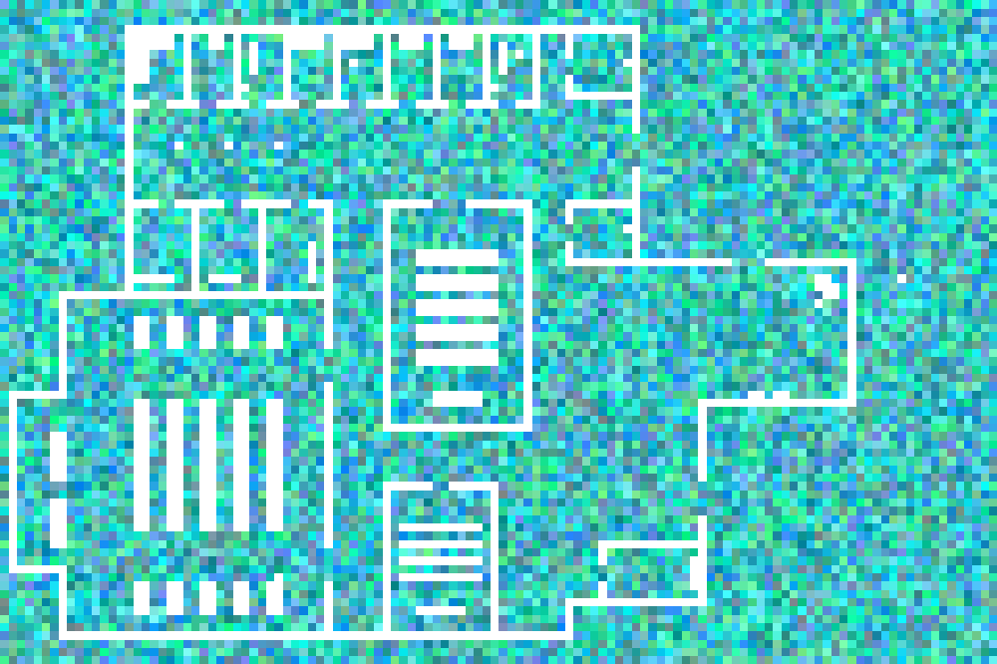
Results: Example
Grid

Slide 27
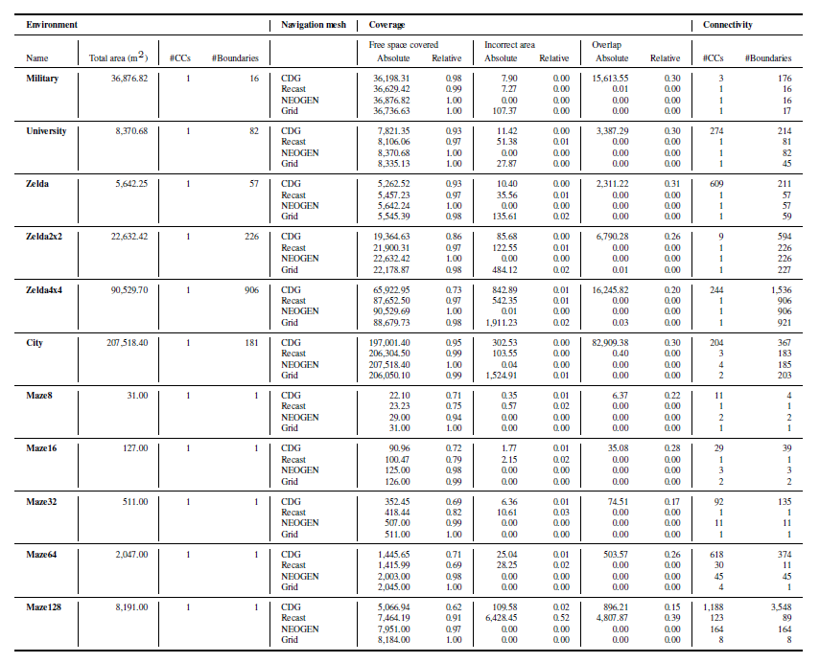
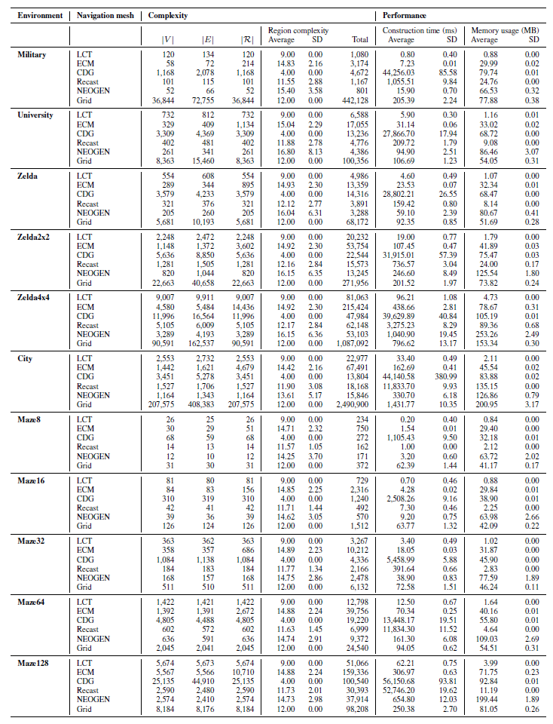
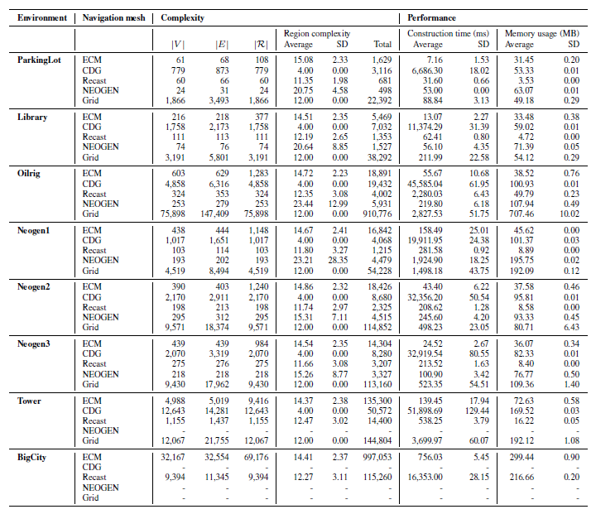
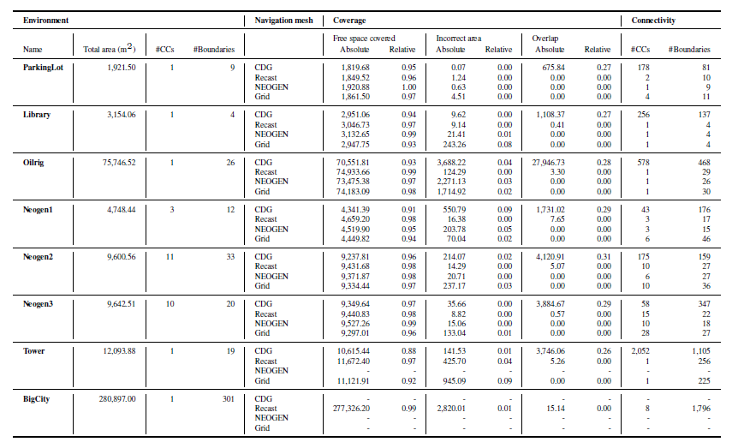
Results: Metrics

Slide 28
Results: Selected Observations
Coverage/connectivity
Voxels often imperfect, even in mazes (Recast/CDG)
Higher resolutions could help (but...)
Numbers match visual inspection
Complexity
NEOGEN/ECM: Smaller graph, higher region complexity
Recast: in-between, thanks to imperfections
Grids are inefficient (but...)
Performance
LCT: fastest overall
NEOGEN: usually fastest voxel-based method
Voxels: time/memory doesn’t scale well to large environments
Voxels vs. exact: difficult to judge

Slide 29
Conclusions and Discussion
and what to do next

Slide 30
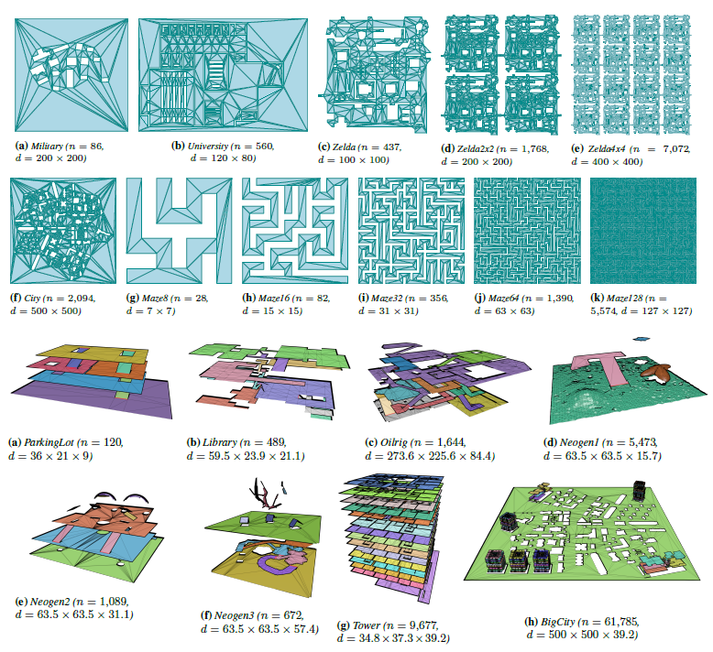
Summary
Comparative study of navigation meshes
Unified definitions
Theoretical properties for classification
Quality metrics
3D coverage
Experimental comparison
5 state-of-the-art navmeshes
1 baseline grid
Unified settings / environments
Main goals:
Set a standard for evaluating/comparing navmeshes
Gain insight in (dis)advantages of each method
Steer future research

Slide 31
Current Limitations
Metrics
How quickly can we compute paths in G?
How short are the resulting routes through R?
How realistic are these routes? (What is realistic?)
Environments
Add examples from more papers
Add real-world locations
Add actual game levels (if allowed)
Settings
Some methods have many parameters
Many possible combinations; we only used 1
Automatically deduce the best settings?

Slide 32
Future Work
Work on limitations
Add more environments
Try a range of settings
Develop new metrics: planning time, path quality, realism
Make our ingredients publicly available
(Environment OBJs are in the supplementary file)
Website with environments, like [Sturtevant 2012]
Donwloadable benchmark tool, like [Singh et al. 2009]
Develop exact algorithms for 3DE → WE → MLE
Or hybrid techniques?

Slide 33
The final slide
Join the comparison?
W.G.vanToll@uu.nl

