Slide 1
Cumulative carbon emissions and economic policy: in search of general principles
Simon Dietz (LSE & Oxford)
Frank Venmans (U. Mons & LSE)
Notes:
Strategy will be not to bore you with the details of the paper particularly, rather to try to interest you in the subject by majoring on the motivation, which comes from the science

Slide 2
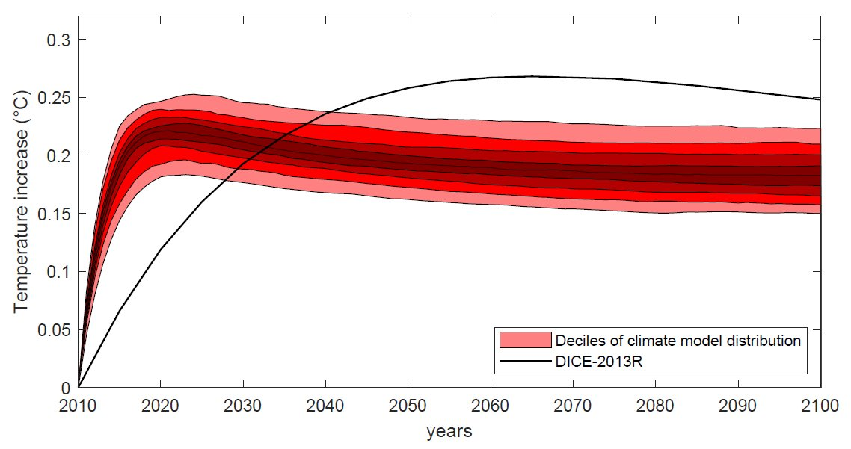
Exhibit 1: the temperature response to a CO₂ emission is approximately instantaneous and constant as a function of time
“it is a widely held misconception that the main effects of a CO₂ emission will not be felt for several decades” (Ricke and Caldeira, ERL, 2014)
Notes:
Temperature response of 16 x 16 (256) climate model combinations to an instantaneous 100GtC emission of CO2 on a background atmospheric CO2 concentration of 389ppm.
Could describe this as an ensemble of IPCC physical climate models.
Paper in CCE by Rose, Diaz and Blanford (2017) effectively showing FUND and PAGE also have a long delay.

Slide 3
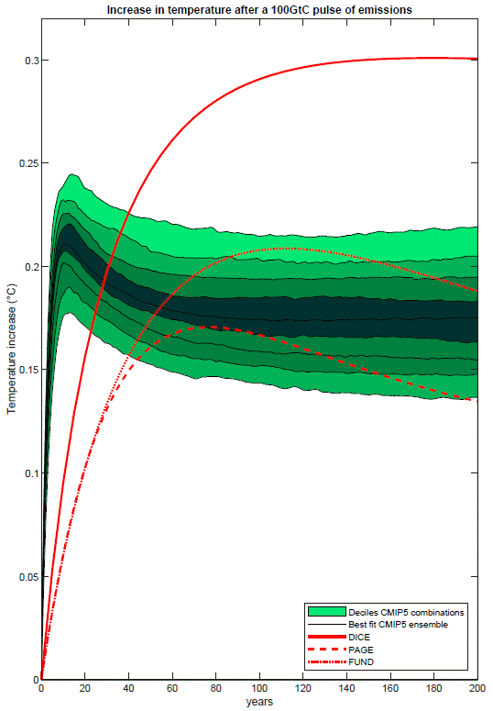
Other examples of warming up too slowly in response to an emissions of CO₂: FUND and PAGE

Slide 4
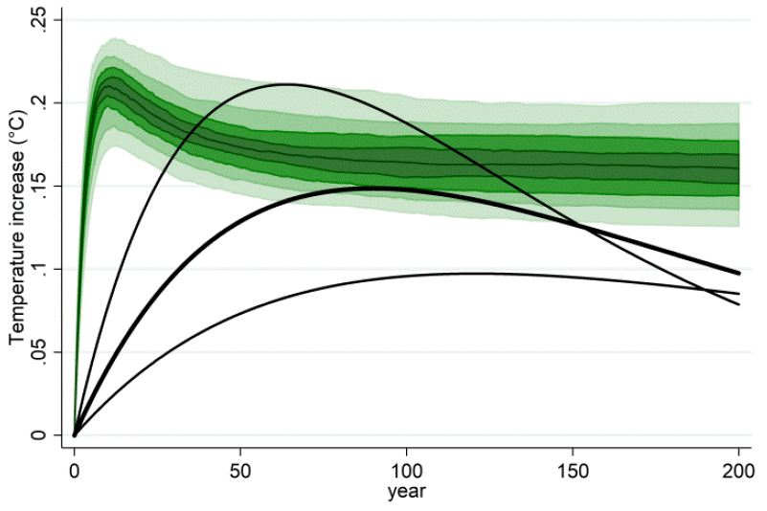
Other examples of warming up too slowly in response to an emissions of CO₂: Lemoine and Rudik (2017, AER)
See Mattauch, Dietz et al., 2019, “Steering the climate system: an extended comment”, for a critique of LR17

Slide 5
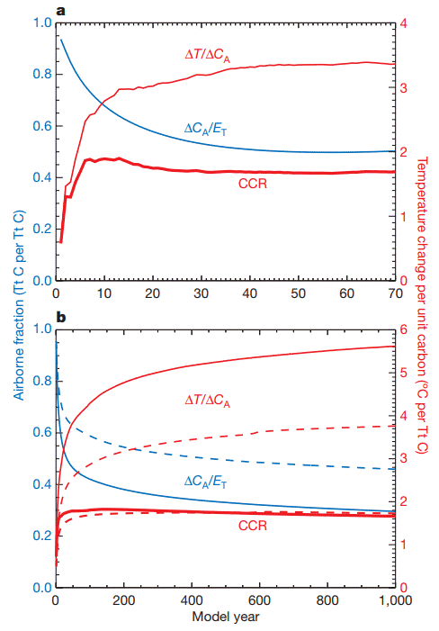
Why is the temperature response ~ instantaneous and constant as a function of time?
Source: Matthews et al., (2009) Nature
Define the Carbon-Climate Response (CCR), or Transient Climate Response to Cumulative Carbon Emissions (TCRE), as
$$\text{CCR}\text{/}\text{T}\text{CRE}≝\frac{ΔT}{E_{T}}=\frac{ΔT}{{ΔC}_{A}}∙\frac{{ΔC}_{A}}{E_{T}}$$
TCRE is approximately constant, because concave increasing $∆T/∆C_{A}$ (thermal inertia) is almost exactly offset by convex decreasing $∆C_{A}/E_{T}$ (gradual CO₂ absorption)
Why the offsetting? Likely because both processes are governed by mixing of surface and deep ocean waters

Slide 6
Why is the temperature response ~ instantaneous and constant as a function of time?
Source: Matthews et al., (2009) Nature
Parts (a) and (b) of the chart show three model experiments – vastly different amounts of CO₂ being pumped in, against different background concentrations
Notice that TCRE (CCR) is always about 1.7°C/TtC
This shows the TCRE is not only time-independent, it is concentration-independent
Why? $∆T/∆C_{A}$ decreases with concentration (log forcing), but this is exactly offset by increasing $∆C_{A}/E_{T}$ (saturation of carbon sinks)
If the TCRE is time- and concentration-independent, then…

Slide 7
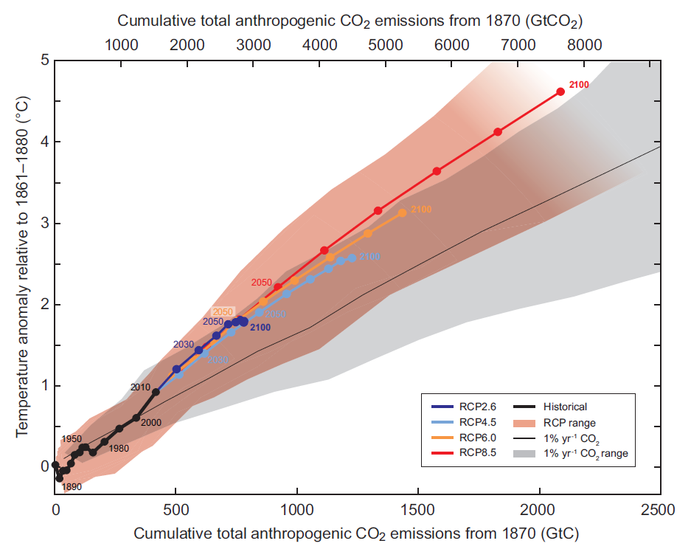
Exhibit #2: global warming is approximately linearly proportional to cumulative CO₂ emissions
Source: IPCC (2013)

Slide 8
Implications of these results from climate science
Some (most?) important economic models are out of step with the current crop of physical climate models
Warm up too slowly
Don’t include positive feedback from saturation of carbon sinks (i.e. they typically assume decay of atmospheric CO₂ only depends on time, not concentration)
A surprisingly simple, linear model is consistent with the science shown here
Warming:
$$\dot{T}=ε\left(ζS−T\right)$$
Cumulative emissions:
$$\dot{S}=E$$
Notes:
Articulate purpose of paper here and mention related literature.
Purpose is to incorporate these implications in a simple climate-economy model and try to extract general principles for climate policy, comparing them with results in the existing literature.
Paper belongs to emerging literature on analytical IAMs.

Slide 9
Implications of these results from climate science
Some (most?) important economic models are out of step with the current crop of physical climate models
Warm up too slowly
Don’t include +ve feedback from saturation of carbon sinks (i.e. they typically assume decay of atmospheric CO2 does not depend on concentration)
A surprisingly simple, linear model is consistent with the science shown here
Warming:
$$\dot{T}=ε\left(ζS−T\right)$$
Cumulative emissions:
$$\dot{S}=E$$
Pulse-adjustment timescale parameter
TCRE
Cumulative emissions
Notes:
At the end of this slide state the purpose of the paper and also mention the literature we relate to, i.e. analytical IAMs

Slide 10
Time to take stock of this paper
We exploit the insights in exhibits 1 and 2 to build a simple climate-economy model
Take the climate model just set out
Combine it with a simple neoclassical growth model with reduced-form representations of climate damages and CO₂ abatement that can reproduce stylised facts
Look for general principles of optimal climate policy
What is optimal peak warming?
How fast do we transition to it?
What is the trajectory of the optimal carbon price?
Contribution belongs to the class of ‘analytical Integrated Assessment Models’
Golosov et al. (2014, ECTA), Traeger, (2015), Rezai & van der Ploeg (2016, JAERE), van den Bijgaart et al. (2016, JEEM), Lemoine and Rudik (2017, AER), Gerlagh and Liski (2018, JEEA)

Slide 11
Economic model
Classical/total utilitarian SWF:
$$\max_{E}{W}=\int_{0}^{∞}{e^{\left(n−ρ\right)t}u\left(c\right)dt}$$
Iso-elastic utility:
$u\left(c\right)=\frac{c^{1−η}}{1−η}$ and $c=e^{−nt}\left(1−s\right)Q$
Neoclassical production, labour-augmenting tech. progress:
$$Q=\hat{L}f\left(\hat{k}\right)\text{exp}\left(−\frac{γ}{2}T^{2}+φE−\frac{φ}{2}E^{2}\right)$$
$$\hat{L}=e^{(n+g)t}$$
$$\dot{\hat{k}}=\hat{q}−\hat{c}−\left(δ+n+g\right)\hat{k}$$

Slide 12
Economic model
Classical/total utilitarian SWF:
$$\max_{E}{W}=\int_{0}^{∞}{e^{\left(n−ρ\right)t}u\left(c\right)dt}$$
Iso-elastic utility:
$u\left(c\right)=\frac{c^{1−η}}{1−η}$ and $c=e^{−nt}\left(1−s\right)Q$
Neoclassical production, labour-augmenting tech. progress:
$$Q=\hat{L}f\left(\hat{k}\right)\text{exp}\left(−\frac{γ}{2}T^{2}+φE−\frac{φ}{2}E^{2}\right)$$
$$\hat{L}=e^{(n+g)t}$$
$$\dot{\hat{k}}=\hat{q}−\hat{c}−\left(δ+n+g\right)\hat{k}$$

Slide 13
Damages
Damage multiplier
$$D\left(T\right)=\text{exp}\left(−\frac{γ}{2}T^{2}\right)$$

Slide 14
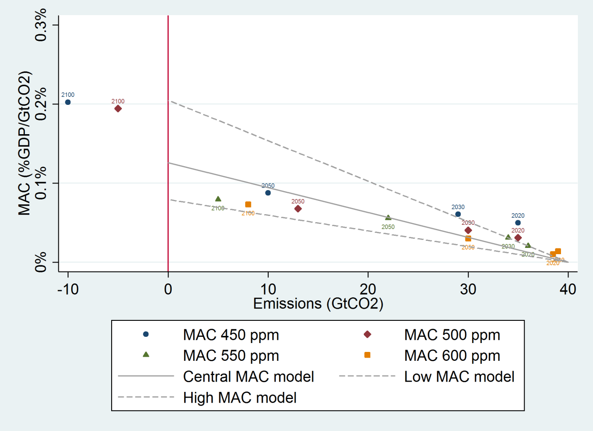
Abatement costs
We treat emissions as an input, specifically the multiplier
$$\text{exp}\left(φE−\frac{φ}{2}E^{2}\right)$$
Marginal productivity of emissions
$\frac{Q_{E}}{Q}=φ−φE$
implies abatement costs are proportional to output and linear increasing in abatement, as a % of output
Tractable and consistent with energy model results from IPCC 5th Assessment Report →
Implicitly technological progress in abatement brings about linearity (learning offsets increasing marginal costs)
Solving the model
Notes:
This formulation is particularly tractable, and it is consistent with the energy modelling evidence presented in IPCC AR5.

Slide 15
Result 1: simple policy rule for optimal peak warming
Proposition 1. Optimal peak warming is given by
$$T^{∗}=\frac{\left(ρ−n+ε\right)}{ε}\frac{\left[ρ−n+\left(η−1\right)\hat{g}\right]φ}{ζγ}$$
A long delay increases optimal peak warming (and obviously all associated optimal variables like prices)
We estimate the delay factor is just 1.01, so the delay can be ignored
For DICE-2013, it is 1.1-1.3
Unit cost of the backstop
Growth-adjusted discount rate
Delay factor
The damage function coefficient
TCRE
Notes:
The range 1.1 to 1.3 depends on whether we use our discount rate (lower value) or Bill’s (higher value).

Slide 16
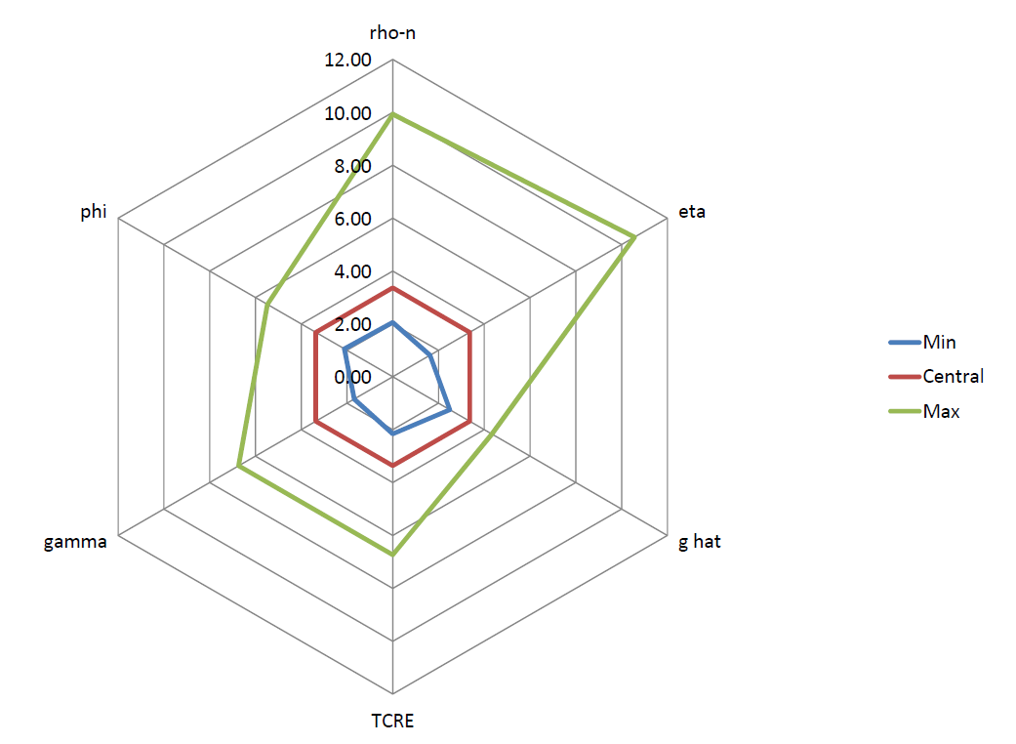
Applications of optimal peak warming
Sensitivity analysis: optimal peak warming is highly uncertain
Switching value of damages for optimal warming to be 1.5°C
In “The economics of 1.5°C climate change” (Ann. Rev. Env. Res., 2018), we set all parameters to their central values and calculated the value of the damage function coefficient that sets optimal peak warming to 1.5°C
Answer was 9.8% of global GDP at 3°C warming
Outlier by traditional standards, not according to Climate Econometrics/New Climate Economy results
Notes:
Note we exactly calculated the point elasticities.

Slide 17
Result 2: the optimal carbon price grows faster than the economy
Proposition 2. The optimal carbon price is
$$p^{∗}\text{=}\underset{\text{growth} \text{effect}}{\underbrace{Q_{0}e^{\left(\tilde{g}+n\right)t}}}∙\underset{\text{emissions} \text{effect}}{\underbrace{\left(φ−φE\right)}}$$
$$\frac{\dot{p^{∗}}}{p^{∗}}=\tilde{g}+n+\frac{\dot{A}}{A}$$
This contrasts with the result in Golosov et al. (2014, ECTA), where the carbon price grows at the same rate as the economy
We argue this is because Golosov et al. (2014) ignore saturation of carbon sinks
Our optimal carbon price initially rises at 3%, which is 0.5 ppts faster than assumed output growth
Change in abatement, A
Notes:
Optimal initial carbon price is $44/tCO2.

Slide 18
Result 3: carbon prices under the Paris Agreement
Proposition 3. The optimal carbon price under a binding temperature constraint is
$$p^{∗}=SCC+\underset{\text{Hotelling} \text{premium}}{\underbrace{\left(φ−\frac{γζ^{2}\overline{S}}{ρ−n+\left(η−1\right)\hat{g}}\right)Q_{\overline{t}}e^{−\left(ρ−n+η\hat{g}\right)\left(\overline{t}−t\right)}}}$$
Proposition 4. If you ignore damages (cost-effectiveness analysis), the optimal carbon price under a binding temperature constraint just follows the simple Hotelling rule
$$p^{∗}=Q_{0}\left(φ−φE_{0}\right)e^{\left(ρ−n+η\hat{g}\right)t}$$
Notes:
n.b. It has often been assumed that the cost-effective carbon price grows at the discount rate plus the decay rate of atmospheric CO₂ – the “augmented Hotelling rule” – but this does not hold once the saturation of carbon sinks is taken into account.

Slide 19
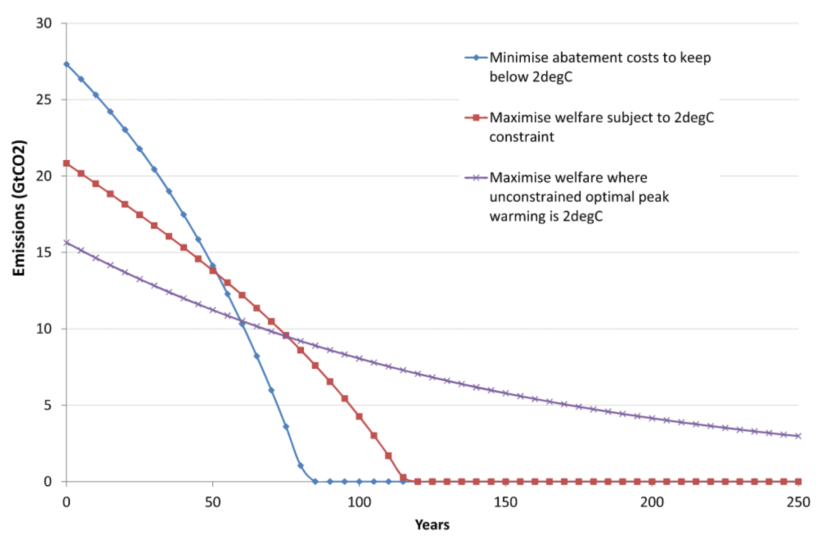
Taking damages into account under the Paris Agreement brings abatement effort forward significantly
Corresponding carbon price c. 1/3 higher
Notes:
Emphasise how this result bridges the SCC literature and the literature on carbon prices to deliver temperature targets.

Slide 20
Cumulative carbon emissions and economic policy: in search of general principles
Simon Dietz (LSE & Oxford)
Frank Venmans (U. Mons & LSE)

Slide 21
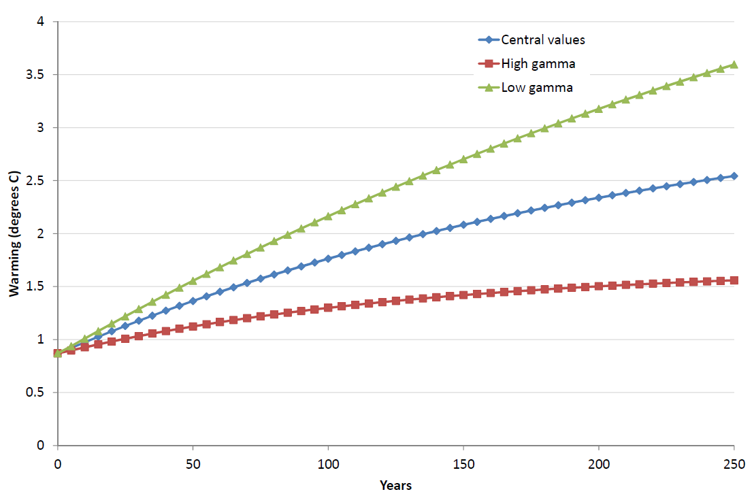
Result : the optimal transition is slow
Flow-stock property of CO₂ makes us want to smooth abatement over time (reminiscent of “prices & quantities”)
Because carbon sinks get saturated, abatement needs to be brought forward
So although optimal peak warming is highly uncertain, 21st century warming is much less so

Slide 22
Growth of the optimal carbon price
We find that the optimal carbon price grows faster than output
Golosov et al. (2014) find that it grows at the same rate
How do we reconcile these accounts?
Marginal damage as a function of cumulative emissions is
$$\frac{d\ln{Q}}{dS}=\frac{d\ln{Q}}{dT}\frac{dT}{dM}\frac{dM}{dS}$$
In Golosov et al., d²lnQ/dT²>0, but this is exactly offset by d²T/dM²<0, while d²M/dS²=0
In our model, there is saturation of carbon sinks, d²M/dS²>0, and this exactly offsets d²T/dM²<0, while d²lnQ/dT²>0
Back to results

Slide 23
Assumptions to generate a simple solution
We assume the economy is approximately on a BGP throughout, with constant growth and savings
Strictly speaking this only happens when $E→0$
But we can assume the economy starts close to this as:
Historically growth has been broadly trendless
On optimal paths, temperature and emissions should have small effects on growth relative to technological progress:
Notes:
Over just a few years, we can safely assume that the marginal disutility of warming is constant: while marginal utility c− decreases over the space of a few years in a growing economy, marginal damage qT is increasing in a warming world, and neither will change much.

Slide 24
Assumptions to generate a simple solution
Because the climate system adjusts quickly to CO₂ emissions,
$$\begin{matrix}λ^{T} & =\int_{0}^{∞}{e^{−\left(ρ−n+ε\right)t}c^{−η}qγTdt} \\ & ≈\frac{c^{−η}qγT}{ρ−n+ε}\end{matrix}$$
Intuition: $ε≫ρ−n$, which means $λ^{T}$ depends on$c^{−η}qγT$ over first few years. Over a short period, $c^{−η}qγT$ is approximately constant.
Notes:
Over just a few years, we can safely assume that the marginal disutility of warming is constant: while marginal utility c− decreases over the space of a few years in a growing economy, marginal damage qT is increasing in a warming world, and neither will change much.

Slide 25
Assumptions to generate a simple solution
Because the climate system adjusts quickly to CO₂ emissions,
$$T_{t}=\int_{−∞}^{t}{e^{−ε\left(t−τ\right)}εζSdτ}$$
$$T≈\frac{ε}{ε+θ}ζS$$
where $θ≡\dot{S}/S$
Intuition: again it comes down to the fact that $ε$ is large (about 0.5). Then $T_{t}$ depends on last few years, over which $θ$ is approximately constant

Slide 26
The optimal path of cumulative emissions
Using these assumptions we obtain a linear differential equation for cumulative emissions:
$$\begin{matrix}\ddot{S}= & \underset{a}{\underbrace{\left[ρ−n+\left(η−1\right)\hat{g}\right]\dot{S}}}+ \\ & \underset{b}{\underbrace{\frac{ε^{2}}{\left(ε+θ\right)\left(ρ−n+ε\right)}∙\frac{ζ^{2}γ}{φ}S}+} \\ & \underset{c}{\underbrace{\left[ρ−n+\left(η−1\right)\hat{g}\right]\frac{φ}{φ}}}\end{matrix}$$
The solution to this is such that $S=c/b$ in the steady state
Notes:
The constant a is the standard ‘Ramsey’ discount rate minus the growth rate g hat. As such it is the discount rate that is applied to the future flow of marginal damages from a tonne of CO2 emitted at time t, when those damages are expressed as a proportion of output.
The first element is the delay factor, which can be further broken down into the physical effect of thermal inertia on marginal damages, epsilon / (epsilon + vartheta), and the discounting effect of thermal inertia, epsilon / (rho – n + epsilon).
If temperature would adjust instantaneously to CO2 emissions, then the delay factor would be equal to one. This second element of b can also be written as (Q_S/ − Q_A) (A/S). This can be interpreted the ratio of the slope of the marginal damage function with respect to S and the slope of the MAC function with respect to E, when both marginal damages and abatement costs are expressed as a proportion of output.

Slide 27
Testing alternative solution concepts
Solve optimal control problem with short warming delay numerically, which does not require Assumptions 1-3
Solve optimal control problem assuming no warming delay. Again this does not require Assumptions 1-3.
Back to results

