Slide 1
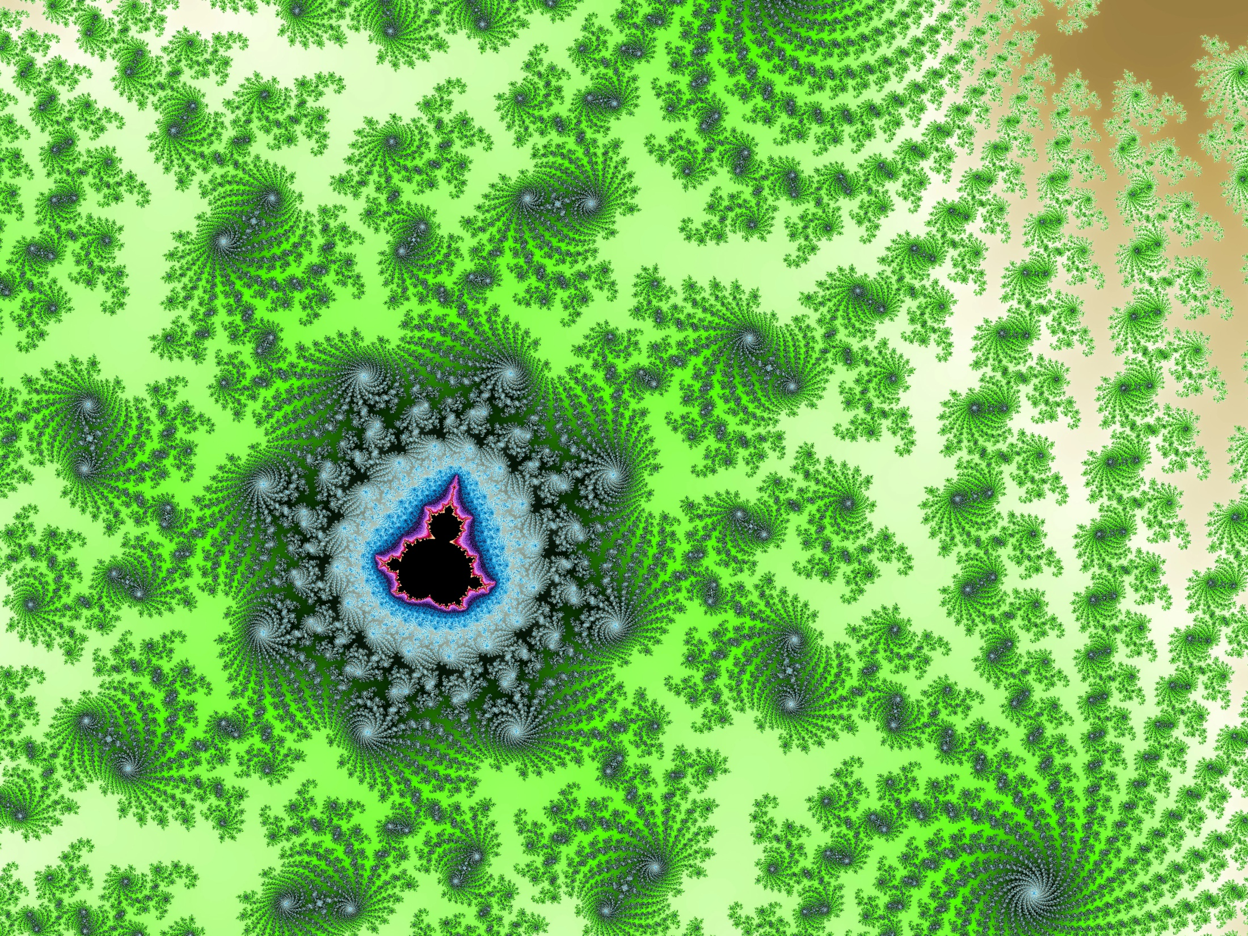
The Unique Beauty
of the Subatomic Landscape
and Mystery
Gerard ’t Hooft
Utrecht University

Slide 2
Recollections and reflections
Theme:
- Nature is more beautiful than we think
- Nature is smarter than we are
The landscape around 1965:

Slide 3
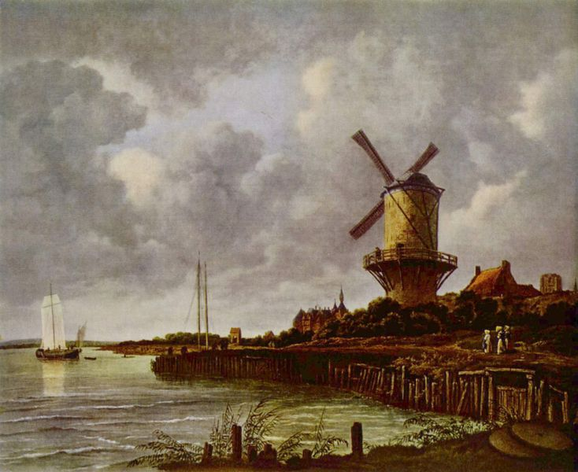

Slide 4
1969
photon
Leptons
anti-
leptons
Hadrons
mesons
baryons
anti-
baryons
anti-
Ω

Slide 5
Quantum Electrodynamics (QED) was beautiful:
Renormalizable
+
+
+ …
g_{e} = 2.00231930436 …

Slide 6
But how did the weak force go ?
Gell-Mann, Feynman, Sudarshan Marshak
V - A
Too many lines at one point:
NOT RENORMALIZABLE
The Intermediate Vector Boson:
?
?
?
s
t
u

Slide 7
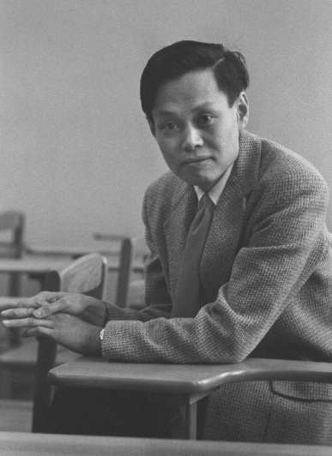
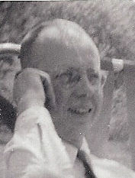
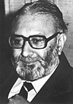
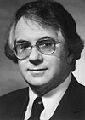
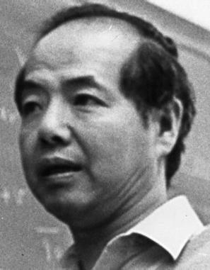
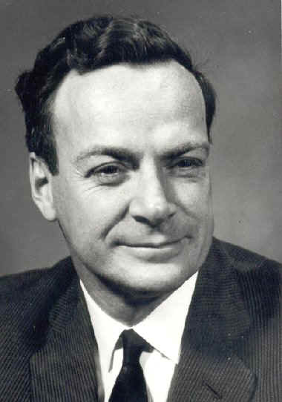
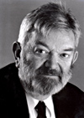
C.N. Yang
R. Mills
S. Weinberg
A. Salam
S. Glashow
How do we deal with the mass of the IVB ?
T.D. Lee
R. Feynman
M. Veltman

Slide 8
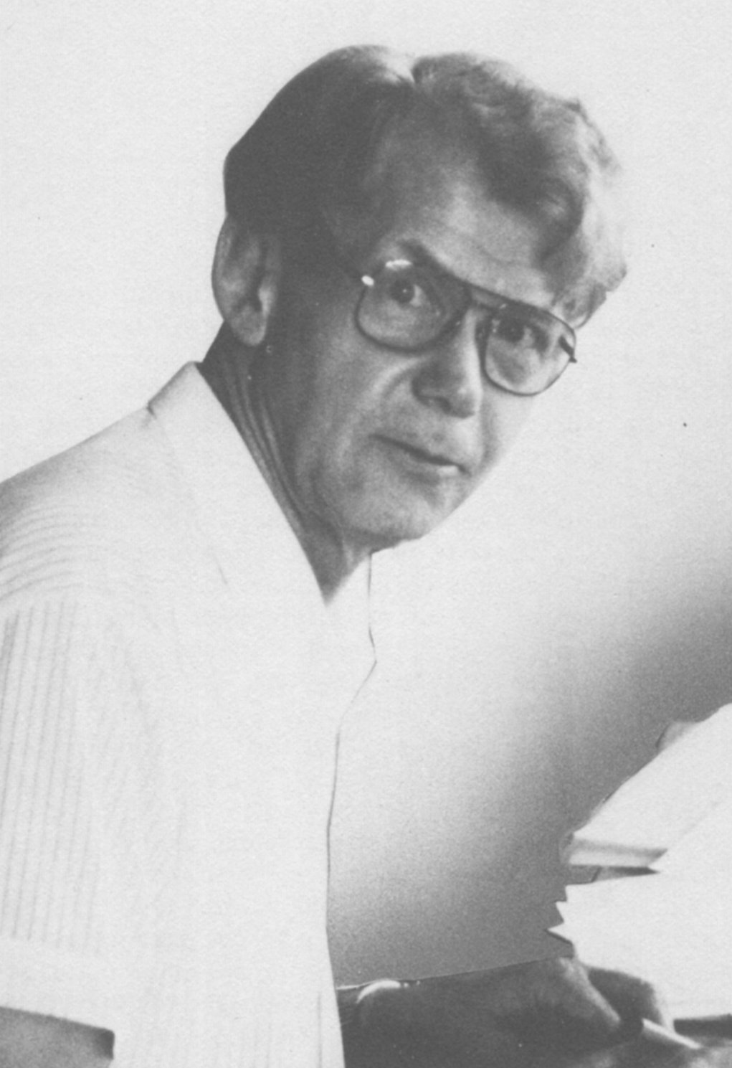
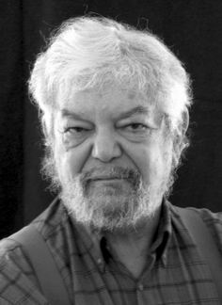
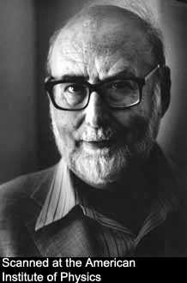
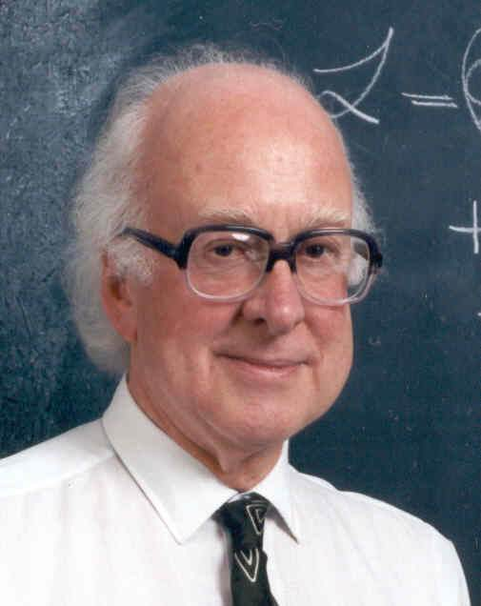
“Spontaneous symmetry breaking does not affect renormalizability”
“You have to understand the small distance structure of a theory”
K. Symanzik
What is the small distance structure of a massive Yang-Mills theory ?
The gauge symmetry becomes exact, and the longitudinal mode of the vector boson behaves as a scalar particle – the Higgs !
Only the Brout – Englert - Higgs mechanism can generate renormalizable massive
vector particles such as the
Intermediate Vecor Bosons
of the weak interactions.

Slide 9
Now work out the details: will the renormalized theory be unitary ?
What are the Feynman rules? What are the counter terms?
Feynman rules:
How to check self-consistency and unitarity ?
Veltman : use diagrammatic cutting rules
Which are the correct Feynman rules ?
Faddeev-Popov, DeWitt: use path integrals

Slide 10
Will there be anomalies ?
The decay was known to violate the symmetry laws of the Lagrangian that generates its Feynman rules.
Such an anomaly could jeopardize the renormalizability of massive vector theories. How can we assure that such anomalies stay harmless ? Should the small-distance behavior provide answers?
This was an important reason for studying the scaling behavior of gauge theories. What is their small-distance structure?
If they stay regular, should the absence of 1-loop anomalies then not be sufficient to guarantee their absence at higher loops?

Slide 11
Indeed, in 1971, our Feynman rules could be used to calculate what happens if you scale all momenta by a factor . Pure gauge theories behave fine (they are now called “asymptotically free”)
In modern words:
An elementary calculation. Why was that nowhere published before ?
Did nobody take notice of off - shell physics ?
Anyway, there are problems when there are fermions or scalars around, and I was not able to prove that asymptotic freedom would ensure absence of higher order anomalies
There was a better approach:
…
Add to the theory a 5th dimension! Take and use diagrams with this going around in a loop as regulator diagrams. This works to renormalize all 1-loop diagrams without anomalies

Slide 12
But what about higher loop diagrams? It would be elegant if you could use 6, 7, or more dimensions. But this did not work !
A last, desparate attempt:
Take dimensions and use as a regulator:
Dimensional renormalization !
We were led to the following beautiful discoveries:

Slide 13
All quantized field theories are renormalizable iff they contain
- vector fields in the form, of Yang-Mills fileds,
- scalar fields and spinor fields in the form of representations of the YM gauge groups,
where the scalar fields may give mass to the vector particles via the Brout-Englert-Higgs mechanism,
Although also composite spin 0 particles can give mass: the proton owes its mass to a meson quadruplet, (quark bound states).
and where the ABJ anomalies cancel out.
This gives elementary particles of spin 0, ½ and 1.
No other field theories are renormalizable.
Renormalizability means nothing more than that the effective coupling strengths run logarithmically when we scale the momenta. If we want them to run to zero at high energies, this gives much more stringent conditions, which are met nearly but not entirely by the SM :
ASYMPTOTIC FREEDOM
The more modern landscape:

Slide 14
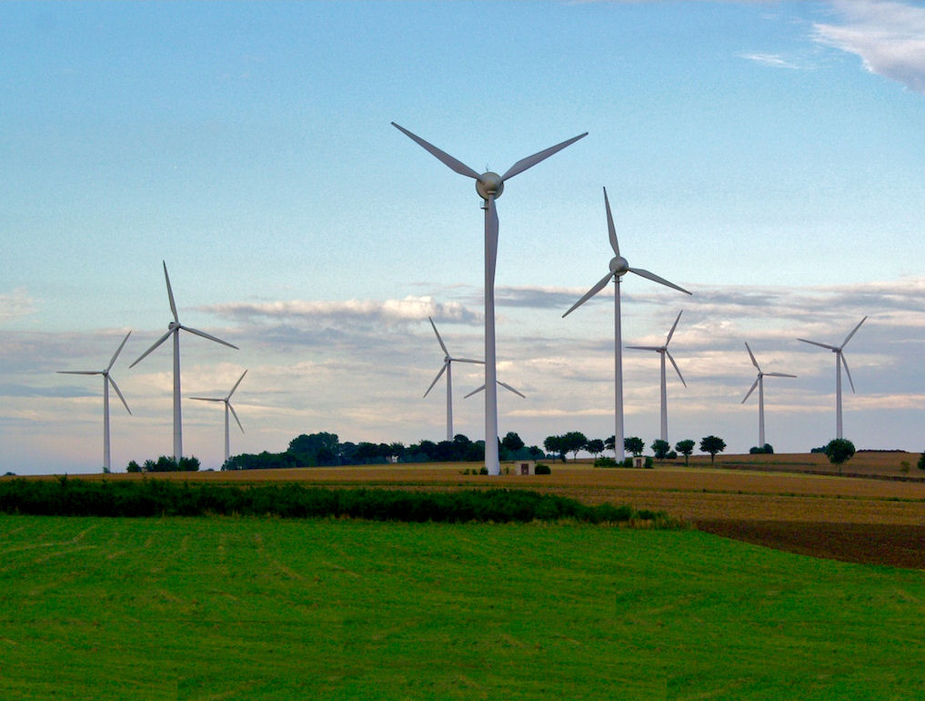

Slide 15
The Standard Model
Generation I
Generation II
Generation III
Leptons
Quarks
g
Higgs
Gauge
Bosons
Graviton

Slide 16
This model explains in a magnificent way all observed strong, weak and electromagnetic interactions
It predicted/predicts totally new phenomena:
Instanton effects in the strong and the weak force:
• mass splittings in the pseudoscalar and the scalar sector of QCD
• baryon number non-conservation during early Big Bang
Running coupling strengths
• strong force gets weaker at higher energies
• 3 forces unite at extremely high energies
Anomalies must always cancel out
• whenever new forces or fermionic particles (new generations) are
added to the scheme.

Slide 17
Grand Unification
And, there is intrinsic beauty:
(left rotating)
× 3 generations
Who would have suspected such a powerful theory in the 1960s?

Slide 18
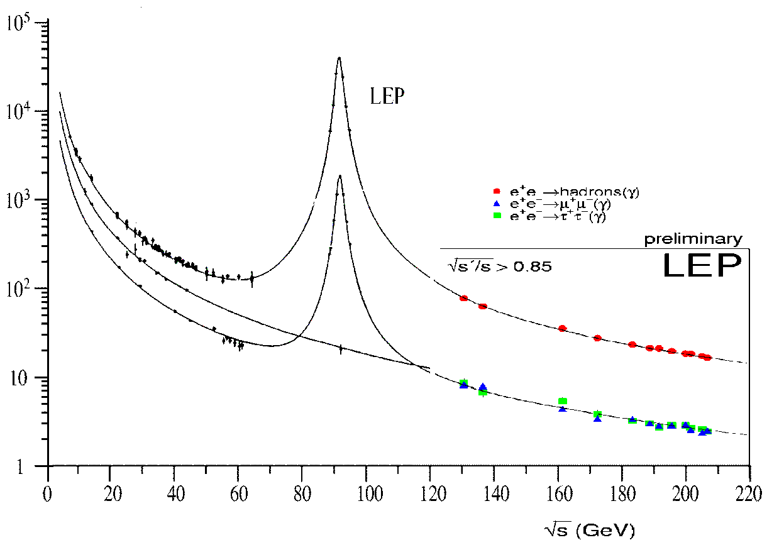
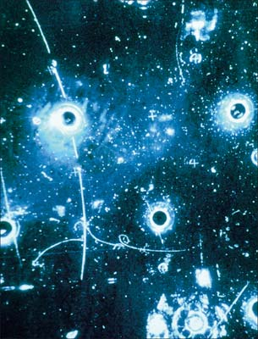
None of this could have been possible without the magnificent achievements of the experimental laboratories,
In particular CERN
During the most exciting periods when these discoveries were made, the CERN theory group was very strongly involved

Slide 19
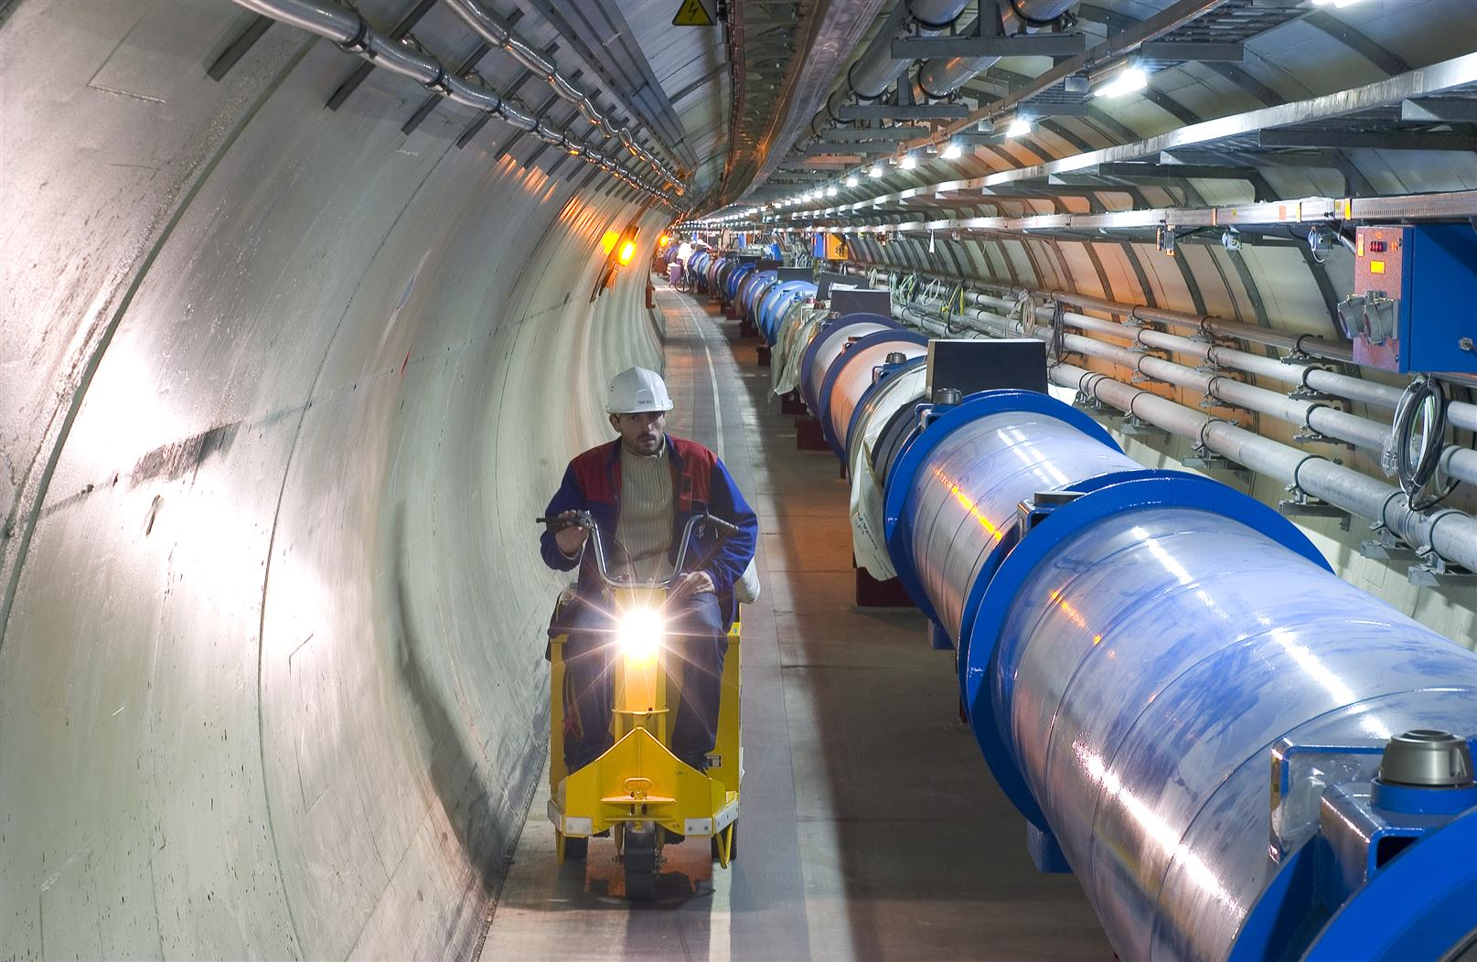

Slide 20
What will the landscape of the 21st century be like ?
Will it be as beautiful as today’s or more beautiful?
Will it include super symmetry, or super strings?
Will it be a
Theory of everything
?

Slide 21
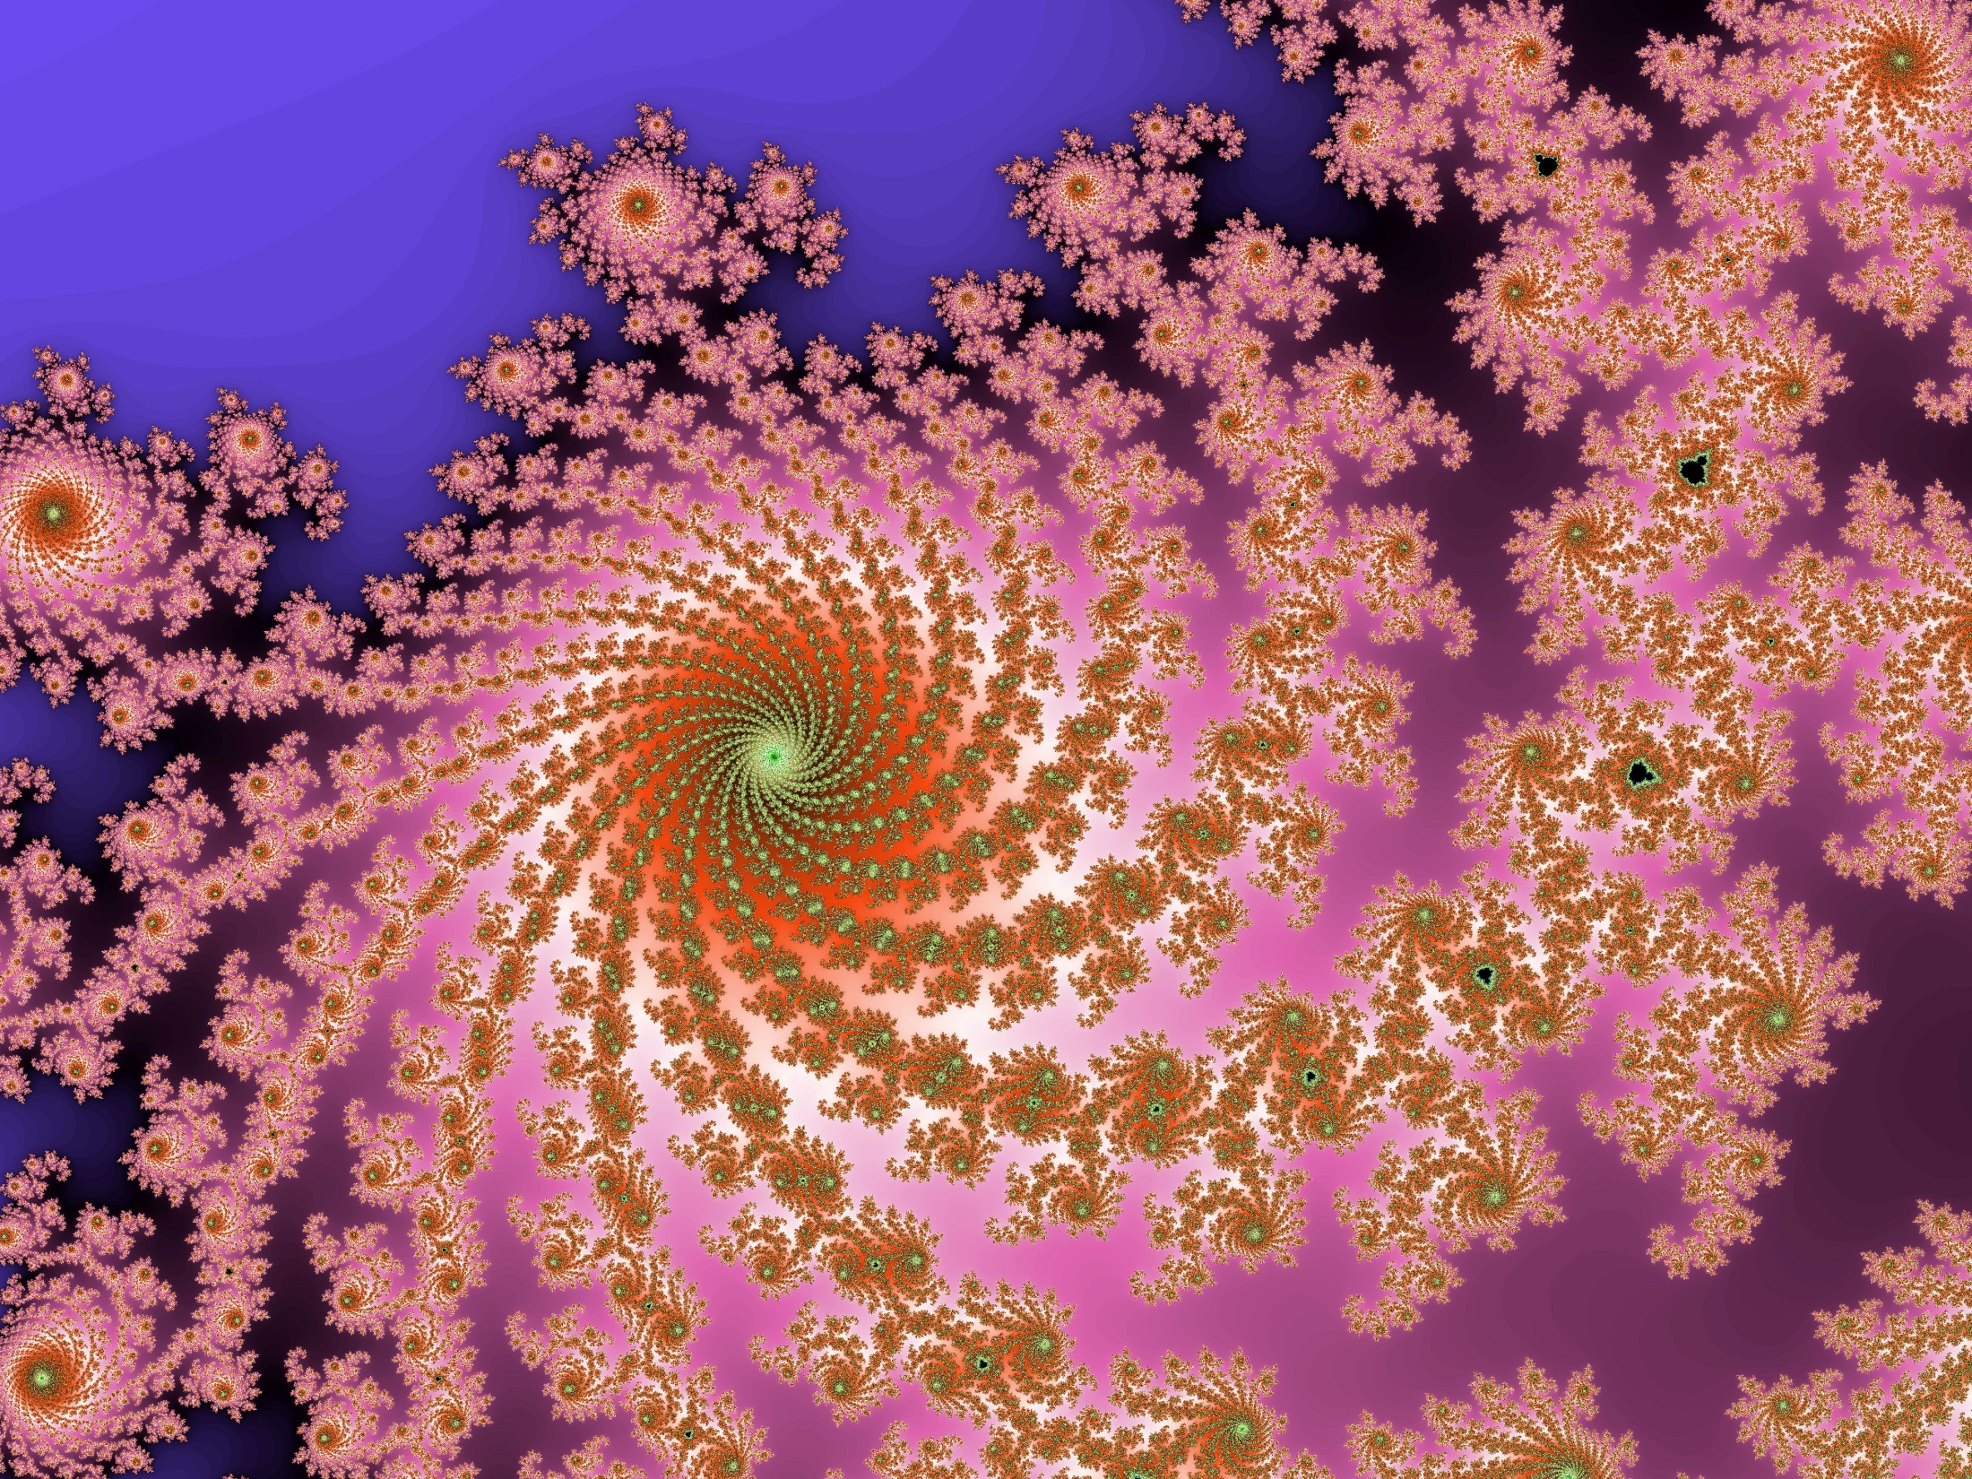
THANKS to CERN

Slide 22
Total cross sections
CESR
DORIS
PEP
PETRA
TRISTAN

