Slide 1
Graphs and Algorithms (2MMD30)
Lecture 11
Randomized exponential time algorithms

Slide 2
Outline
Stirling’s approximation
Color Coding
${O^{∗}(k}^{k})$ for $k$-path
${O^{∗}(\left(2e\right)}^{k})$ for $k$-path
Schöning’s Algorithm
Feedback Vertex Set

Slide 3
Stirling’s approximation
$n!≈\sqrt{2πn} {\left(\frac{n}{e}\right)}^{n}$
More precise $\sqrt{2πn} {\left(\frac{n}{e}\right)}^{n}≤n!≤e\sqrt{n} {\left(\frac{n}{e}\right)}^{n}$
Really not important for us. $n!≈ {\left(\frac{n}{e}\right)}^{n}$ suffices, when using $O^{∗}\left(⋅\right)$ notation

Slide 4
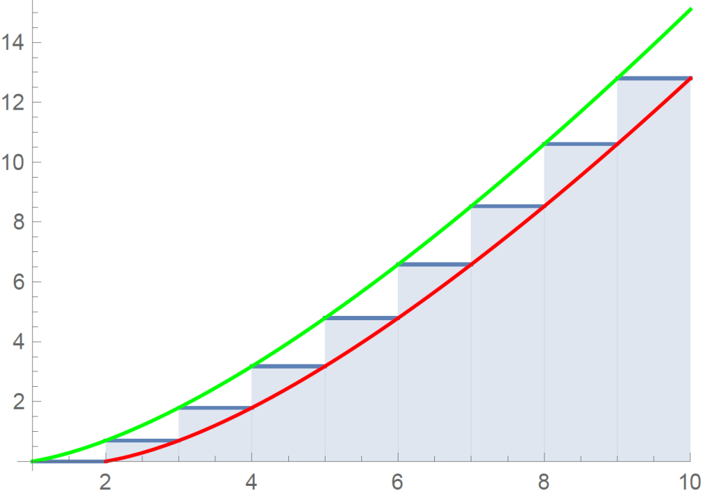
Derivation Stirling’s approximation (not examined)
$\ln\left(n!\right)=\ln\left(1⋅2⋅3⋯n\right)= \sum_{i=1}^{n}{ln⁡(i)}$
$\int_{1}^{n}{\ln\left(x\right)dx }≤ \sum_{i=1}^{n}{\ln\left(i\right)}≤\int_{1}^{n+1}{\ln\left(x\right)dx }$
${[x\ln{x−x}]}_{1}^{n}≤\sum_{i=1}^{n}{\ln\left(i\right)}≤{\left[x\ln{x−x}\right]}_{1}^{n+1}$
$n\ln{n}−n+1≤\sum_{i=1}^{n}{\ln\left(i\right)}≤\left(n+1\right)\ln\left(n+1\right)−n$
Taking exponentials:
${e\left(\frac{n}{e}\right)}^{n}≤n!$
$n!≤{\left(n+1\right)\left(\frac{n+1}{e}\right)}^{n}$
Using $1+x≤e^{x}$
for all x
$$≤\left(n+1\right){\left(1+\frac{1}{n}\right)}^{n}{\left(\frac{n}{e}\right)}^{n}$$
$≤\left(n+1\right)e{\left(\frac{n}{e}\right)}^{n}$

Slide 5
One-sided constant error probability
All algorithms today
never return false positives (i.e. return true while answer should have been false)
may return false negatives (i.e. if given a true instance, they return false)
However, the latter will occur with only constant probability i.e.
If given a true instance, the algorithm returns true with probability at least a constant $0<c<1$ ($c$ can be boosted to any constant $c^{′}<1$) by repetitions.

Slide 6
Color Coding 1
Directed $k$-path problem: given directed graph $G$, is there a simple path on at least $k$ vertices.
In polynomial time if $G$ is acyclic:
Crux: cannot collide with previous part of the path
$$v_{1}$$
$$v_{2}$$
$$v_{3}$$
$$v_{i}$$
$$v_{n}$$
1
2
1

Slide 7
Color Coding 1
Idea: try to reduce the general case to acyclic case.
If true is returned, $G^{′}$ has a $k$-path so $G$ as well
If $G$ has a $k$-path, look at one iteration:
$\underset{c}{Pr}\left[G^{′}\text{has} \text{k}\text{−}\text{path} \right]≥\underset{c}{Pr}\left[∀i∈\{1,…,k\}:c\left(p_{i}\right)=i\right]={\left(\frac{1}{k}\right)}^{k}$
So prob. we won’t find a path in the whole loop is at most
$$1+x≤e^{x}$$
for $$x=−1/k^{k}$$
${\left(1−\frac{1}{k^{k}}\right)}^{k^{k}}≤1/e$, if $k$-path exists, return true with prob $1−\frac{1}{e}$
$O^{∗}(k^{k})$ time algorithm with constant one-sided err.

Slide 8
Color Coding 2
Let’s try to do faster now, we’ll see $O^{∗}({\left(2e\right)}^{k})$ time.
Requirement vertices consecutively ordered was too strict
Think of the values $c(v)$ as colors

Slide 9
Color Coding 2
Let’s try to do faster now, we’ll see $O^{∗}({\left(2e\right)}^{k})$ time.
Requirement vertices consecutively ordered was too strict
Think of the values $c(v)$ as colors
Call a $k$-path $p_{1},…,p_{k}$ colorful if $c\left(p_{i}\right)≠c(p_{j})$ for $i≠j$
Equivalently, if $c:V→\{1,…,k\}$, $\{c\left(p_{i}\right):i∈\{1,…,k\}\}= \{1,…,k\}$
Algorithm misses $k$-path with prob at most $1/e$.

Slide 10
Color Coding 2
Call a $k$-path $p_{1},…,p_{k}$ colorful if $c\left(p_{i}\right)≠c(p_{j})$ for $i≠j$
Equivalently, if $c:V→\{1,…,k\}$, $\{c\left(p_{i}\right):i∈\{1,…,k\}\}= \{1,…,k\}$
X
u
u
v
u

Slide 11
Schöning’s algorithm for k-CNF-SAT
Determines whether a given $k$-CNF formula on $n$ vars is satisfiable in $O^{∗}\left({\left(\frac{2k}{k+1} \right)}^{n}\right)$ time, for constant $k$.
for $k=100$, this is about $O^{∗}({1.9802}^{n})$
relies on local search subroutine, similarities with Papadimitriou’s 2SAT algorithm.
Given $x,y∈\{0,1\}^{n}, H(x,y)$ is Hamming distance (i.e. nr. Of coordinates where $x$ and $y$ differ)

Slide 12
Schöning’s algorithm for k-CNF-SAT
Run time: recursion tree of depth $≤k$, $ℓ≤k$ fanout
Polynomial time per recursive call so $O^{∗}(k^{d}$) time.
Only considers assignments of HD $≤d$:
decreases $d$ if it flips a coordinate
if true is returned, found a solution of HD $≤d$
By induction on $d$: if sol $y$ of HD $≤d$, it returns true
True for $d=0$, since condition on L2 fails
For $d>0$, $x,y$ must differ on variable occuring in $C_{j}$
If variable occurs in $i$’th literal $H\left(z^{i},y\right)≤d−1$

Slide 13
Schöning’s algorithm for k-CNF-SAT
x
x
x
x
x

Slide 14
Schöning’s algorithm for k-CNF-SAT
If returns true it is correct since so is localSearch
If sol y exists, prob true is returned in one iteration is
, so in some iteration $≥1−\frac{1}{e}$
For the run time, ${O^{∗}(c}^{n})=O^{∗}\left(c^{n+k}\right)$ for constant $k$
And the running time boils down to:

Slide 15
Feedback Vertex Set
A FVS is a subset $X$ such that $G\left[V∖X\right]$ if a forest.
In other words, every cycle contains a vertex from $X$
This definition directly generalizes to multigraphs
Two parallel edges or single loop form a cycle
Degree also defined in multigraphs
In degrees parallel edges contribute separately
Loop contributes two to degree
Before we get to the algorithm, we start with a useful lemma on graphs with minimum degree $3$
Will later be combined with familiar reduction rules to ensure the graph has minimum degree 3

Slide 16
A useful lemma
Lem: Let $G=(V,E)$ be a multigraph of min. degree at least $3$, and let $X$ be a FVS of $G$. Then for at least half of the edges of $E$, $X$ contains one of its endpoints.
Proof:
Let $F=V∖X$; $I=\{(u,v)∈E:u∈X∨v∈X \}$; $E_{F}=E∩(F×F)$
$I,E_{F}$ partition $E$, so $\left|I\right|+\left|E_{F}\right|=\left|E\right|$
Sufficient to show $\left|I\right|≥|E_{F}|$
Since $F$, is a forest |$E_{F}|≤\left|F\right|$
Let $F_{≤1},F_{2}, F_{≥3}$ be vertices of $F$ with deg. $≤1, 2,≥3$
$\left|F_{≥3}\right|<\left|F_{≤1}\right|:$
Prove by induction by rooting trees and replacing subtrees rooted at deg $≥3$ vertex with no deg $≥3$ below with a leaf until no deg $≥3$ left.
$\left|I\right|≥2\left|F_{≤1}\right|+\left|F_{2}\right|≥\left|F_{≤1}\right|+\left|F_{2}\right|+\left|F_{≥3}\right|≥|E_{F}|$
forest
X

Slide 17
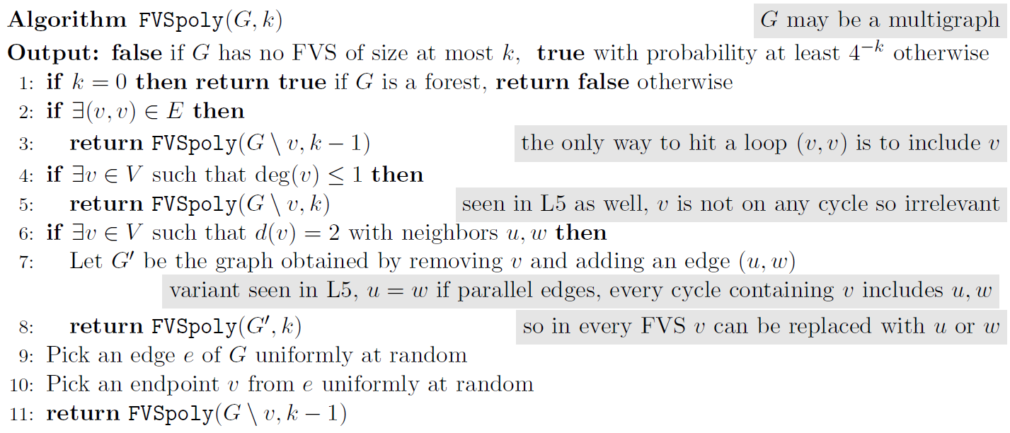
All reductions rules are correct (similarly as in L5)
So if the algorithm returns true it always is correct
By induction on $k$: if a FVS $X$ of size $k$ exists, the algorithm outputs true with probability at least $4^{−k}$
Trivial for $k=0$
For $k>0$, $\underset{v}{Pr}{[v∈X]}≥\frac{1}{4}$ and conditioned on this event, the IH states that ${Pr}_{v}\left[\text{FVSpoly}\left(G∖v,k−1\right)=true\right]≥4^{k−1}$

Slide 18
So the algorithm does what it promises and we can simply boost the probability of finding an FVS if it exists:
$$≤1/e$$
If FVS of size $≤k$ exists, $\operatorname{Pr}\left[FVS2\left(G,k\right)=false\right]≤{\left(1−4^{−k}\right)}^{4^{k}}$

