Slide 1
Graphs and Algorithms (2MMD30)
Lecture 12
Isolation, Vector Coding and Counting Modulo 2

Slide 2
Outline
Today we’ll talk about a big breakthrough result from ‘10.
A slightly more advanced topic…
Short documentary about today’s algorithm (5 mins)
Brief reminder previous time, linear algebra
Vector Coding
Counting Linear Independent $k$-paths modulo 2
Isolation Lemma
$k\text{−}\text{path} \text{in} O^{∗}(2^{k})$ time in directed graphs
$k$-$\text{path} \text{in} O^{∗}(2^{k/2})$ time in bipartite undirected graphs*
$k$-$\text{path} \text{in} O^{∗}(2^{3k/4})$ time in undirected graphs*
*the algorithms itself will not be examined

Slide 3
Recent video about today’s algorithm

Slide 4
Historical account (not examined)
50’s: DP for HC by Bellman, Held&Karp: $O^{∗}(2^{n})$ (L6)
60’s: inclusion exclusion by Karp:${ O}^{∗}(2^{n})$, poly space (L6)
90’s: $O^{∗}({(2e)}^{k})$ for $k$-path with color coding (Alon Yuster& Zwick)(L11)
‘08: Koutis; Koutis& Williams: $O^{∗}(2^{k})$ for $k$-path with vector coding (today)
‘10: Björklund; Björklund&Husfeldt&Kaski&Koivisto: $O^{∗}(2^{k/2})$ for bipartite graphs, $O^{∗}(2^{3k/4})$ for general graphs (today)
Last algorithm improves algorithm from the 50’s by setting $k=n$.

Slide 5
Brief reminder previous time
Crucial point: in a DAG a walk is automatically a path
A colorful walk on $k$ vertices automatically is a $k$-path
Can solve by using i.e. inclusion exclusion with
$U$= all walks on $k$ vertices,
$P_{i}$ = walks visiting vertex v satisfying $c\left(v\right)=i$ (Ex. 11.6)

Slide 6
Brief reminder linear algebra
$ℤ_{2}^{k}$: set of $k$-dimensional binary vectors
for ${x,y∈ℤ}_{2}^{k}, x+y$ is coordinate wise sum mod 2, $〈x,y〉=\left(\sum_{i=1}^{k}{x_{i}y_{i}}\right)\%2$. $x,y$ orthogonal if $〈x,y〉=0$
$1110+1011 = 0101$, $〈1110,1011〉=0$, so orthogonal
$x^{1},…,x^{n}∈ℤ_{2}^{k}$ lin. independent if $λ_{1}x^{1}+…+λ_{n}x^{n}=0$ implies $λ_{1}=⋯=λ_{n}=0$
$span\left(x^{1},…,x^{n}\right)=\{\sum_{i}{λ_{i}x^{i}:λ_{1},…,λ_{n}∈\{0,1\} }\}$ $rk(x^{1},…,x^{n})$ is max size of all subsets $B⊆\{1,…,n\}$ such that $\{x^{i}\}_{i∈B}$ is linearly independent. ($B$ is basis)
$$x^{1}$$ | 1 | 1 | 1 | 0 | 0
$$x^{2}$$ | 1 | 0 | 0 | 1 | 0
$$x^{3}$$ | 0 | 1 | 1 | 1 | 0
$$x^{1}$$ | 1 | 1 | 1 | 0 | 0
$$x^{2}$$ | 1 | 0 | 0 | 1 | 0
$$x^{3}$$ | 0 | 1 | 1 | 1 | 1
$x^{1},x^{2},x^{3}$ are not LI
$${rk(x}^{1},x^{2},x^{3})=2$$
$${span(x}^{1},x^{2},x^{3})={\{0,x}^{1},x^{2},x^{3}\}$$
$x^{1},x^{2},x^{3}$ are LI
$${rk(x}^{1},x^{2},x^{3})=3$$
$$|{span(x}^{1},x^{2},x^{3})|=8$$

Slide 7
Brief reminder linear algebra
$ℤ_{2}^{k}$: set of $k$-dimensional binary vectors
for ${x,y∈ℤ}_{2}^{k}, x+y$ is coordinate wise sum mod 2, $〈x,y〉=\left(\sum_{i=1}^{k}{x_{i}y_{i}}\right)\%2$. $x,y$ orthogonal if $〈x,y〉=0$
$1110+1011 = 0101$, $〈1110,1011〉=0$, so orthogonal
$x^{1},…,x^{n}∈ℤ_{2}^{k}$ lin. independent if $λ_{1}x^{1}+…+λ_{n}x^{n}=0$ implies $λ_{1}=⋯=λ_{n}=0$
$span\left(x^{1},…,x^{n}\right)=\{\sum_{i}{λ_{i}x^{i}:λ_{1},…,λ_{n}∈\{0,1\} }\}$ $rk(x^{1},…,x^{n})$ is max size of all subsets $B⊆\{1,…,n\}$ such that $\{x^{i}\}_{i∈B}$ is linearly independent. ($B$ is basis)
Rank-Nullity Theorem (convenient version):
If $x^{1},…,x^{n}∈ℤ_{2}^{k}$, the number of $y∈ℤ_{2}^{k}$ orthogonal to all $x^{i}$ (i.e. $〈x^{i},y〉=0$ for every $i$) is $2^{k−rk(x^{1},…,x^{n})}$.

Slide 8
Brief reminder linear algebra
Rank-Nullity Theorem (convenient version):
If $x^{1},…,x^{n}∈ℤ_{2}^{k}$, the number of $y∈ℤ_{2}^{k}$ orthogonal to all $x^{i}$ (i.e. $〈x^{i},y〉=0$ for every $i$) is $2^{k−rk(x^{1},…,x^{n})}$.
Proof sketch (not examined):
If $A∈ℤ_{2}^{n×k}$ has $x^{1},…,x^{n}$ as rows vectors, $Ay=0$
$N=\{y∈ℤ_{2}^{k}:Ay=0\}$ is called kernel or null-space
$nul\left(A\right)=rk(N)$ is called nullity; $\left|N\right|=2^{rk(N)}$
Normal Rank-nullity theorem: $rk\left(A\right)+nul\left(A\right)=k$
Proved by using row operations (which do not change the span) to bring $A$ in row-reduced echelon form:
$$x^{1}$$ | 1 | 1 | 1 | 0 | 0
$$x^{2}$$ | 1 | 0 | 0 | 1 | 0
$$x^{3}$$ | 0 | 1 | 1 | 1 | 0
$$x^{1}$$ | 1 | 0 | 0 | 1 | 0
$$x^{2}$$ | 0 | 1 | 1 | 1 | 0
$$x^{3}$$ | 0 | 0 | 0 | 0 | 0
$rk$ = #leading ones
can construct vectors in N for independent choices for all columns without leading ones
pick leading 1 if 1 on that row

Slide 9
Vector coding
Call $k$-path $p_{1},…,p_{k}$ linearly independent if $c\left(p_{1}\right),…,c\left(p_{k}\right)$ are LI
returns whether $G$ has LI $k$-path
001
$3$-paths are
cde c+d
ade a+d+e
bad
abf a+b+f
bfe
c
001
111
d
e
110
a
011
101
f
b

Slide 10
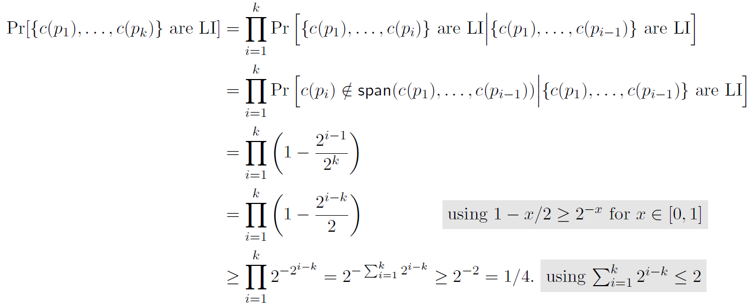
Vector coding
Call $k$-path $p_{1},…,p_{k}$ linearly independent if $c\left(p_{1}\right),…,c\left(p_{k}\right)$ are LI
returns whether $G$ has LI $k$-path
If $k$-path $p_{1},…,p_{k}$ exists, what is the probability algo returns true?
Bayes’ rule:
$\operatorname{Pr}\left[A∩B\right]=\operatorname{Pr}\left[A | B\right]Pr⁡[B]$
applied $k$ times to
$Pr[∩_{i=1}^{k}\{c\left(p_{1}\right),…,c\left(p_{i}\right)\} LI]$

Slide 11
Counting Finding LI $k$-paths mod 2
Finding LI $k$-paths easier? Can focus on LI $k$-walks!
a $k$-walk is a sequence of vertices $p_{1},…,p_{k}$ s.t. $\left(p_{i},p_{i+1}\right)∈E$
a $k$-walk is linearly independent if $c\left(p_{1}\right),…,c(p_{k})$ are
a LI $k$-path is also a LI $k$-walk
a LI $k$-walk is automatically a $k$-path!
so we can focus on finding a LI $k$-walk

Slide 12
Counting Finding LI $k$-paths mod 2
Finding LI $k$-paths easier? Can focus on LI $k$-walks!
Still seems hard to do with inc exc / DP in $O^{∗}(2^{k})$ time
Let’s do something else: count LI $k$-paths mod 2

Slide 13
Counting Finding LI $k$-paths mod 2
Finding LI $k$-paths easier? Can focus on LI $k$-walks!
Still seems hard to do with inc exc / DP in $O^{∗}(2^{k})$ time
Let’s do something else: count LI $k$-paths mod 2
So, for a $k$-walk $p_{1},…,p_{k}$ there are $2^{k−rk(c\left(p_{1}\right),…,c(p_{k}))}$ vectors $y∈ℤ_{2}^{k}$ orthogonal to all $c\left(p_{1}\right),…,c(p_{k})$.
this is an even number, unless $rk\left(c\left(p_{1}\right),…,c\left(p_{k}\right)\right)=k$, i.e. unless the walk is linearly independent.
so if we sum for all $y∈ℤ_{2}^{k}$ over the number of $k$-walks in which all vectors of visited vertices are orthogonal to $y$ the $k$-walks that are not linearly independent cancel modulo 2!
Rank-Nullity Theorem (convenient version):
If $x^{1},…,x^{n}∈ℤ_{2}^{k}$, the number of $y∈ℤ_{2}^{k}$ orthogonal to all $x^{i}$ (i.e. $〈x^{i},y〉=0$ for every $i$) is $2^{k−rk(x^{1},…,x^{n})}$.

Slide 14
Counting Finding LI $k$-paths mod 2
Finding LI $k$-paths easier? Can focus on LI $k$-walks!
Still seems hard to do with inc exc / DP in $O^{∗}(2^{k})$ time
Let’s do something else: count LI $k$-paths mod 2
Rank-Nullity Theorem (convenient version):
If $x^{1},…,x^{n}∈ℤ_{2}^{k}$, the number of $y∈ℤ_{2}^{k}$ orthogonal to all $x^{i}$ (i.e. $〈x^{i},y〉=0$ for every $i$) is $2^{k−rk(x^{1},…,x^{n})}$.
Let $ORTH\left(y\right)$ be all $v∈V$ satisfying $〈c(v),y〉=0$
Let $w_{A}(k)$ be the nr of $k$-walks in $G[A]$
in poly time with DP (as for $w_{A}(k,s,t)$ in L6)
$O^{∗}(2^{k})$ time
Conclusion: can count #LI $k$-paths mod 2 in $O^{∗}(2^{k})$

Slide 15
$ω(S)$ denotes $\sum_{e∈S}{ω\left(e\right)}$
Definition (Isolation) Given a set family $ℱ⊆2^{U}$, and weight function $ω:U→\{1,…,N\},$
we say $ω$ isolates $ℱ$ if there is a unique minimizer $S∈ℱ$ of $ω$, i.e. there is a unique $S∈ℱ$ s.t. $ω\left(S\right)=\min_{S^{′}∈ℱ} ω(S^{′})$.
Isolation Lemma
For every $e∈U$, choose $ω\left(e\right)∈\{1,…,N\}$ uniformly at random. Then, if $ℱ$ is not empty:
$$\underset{ω}{Pr}\left[ω \text{isolates} ℱ\right]≥1−\frac{\left|U\right|}{N}$$

Slide 16
$ω(S)$ denotes $\sum_{e∈S}{ω\left(e\right)}$
Isolation Lemma
For every $e∈U$, choose $ω\left(e\right)∈\{1,…,N\}$ uniformly at random. Then, if $ℱ$ is not empty:
Definition (Isolation) Given a set family $ℱ⊆2^{U}$, and weight function $ω:U→\{1,…,N\},$
we say $ω$ isolates $ℱ$ if there is a unique minimizer $S∈ℱ$ of $ω$, i.e. there is a unique $S∈ℱ$ s.t. $ω\left(S\right)=\min_{S^{′}∈ℱ} ω(S^{′})$.
$$\underset{ω}{Pr}\left[ω \text{isolates} ℱ\right]≥1−\frac{\left|U\right|}{N}$$
Proof:
Define $a\left(e\right)=\min_{e∉S∈ℱ}{ω(S)}− \min_{e∈S∈ℱ}{ω(S∖e})$
Notice $a(e)$ does not depend on $ω\left(e\right)$ so they are independent
Thus for every $e∈U$ we have $\operatorname{Pr}\left[a\left(e\right)=ω\left(e\right)\right]≤\frac{1}{N}$
Assume $S_{1},S_{2}∈ℱ$ are two distinct minimizers of $ω$, $e∈S_{2}∖S_{1}$
But then $a\left(e\right)=\min_{e∉S∈ℱ}{ω(S)}− \min_{e∈S∈ℱ}{ω(S∖e})=ω(e)$
So the event that $ω$ does not isolate $ℱ$ implies $∃e:a\left(e\right)=ω\left(e\right)$
$\operatorname{Pr}\left[ω \text{does} \text{not} \text{isolate} ℱ\right]≤\operatorname{Pr}\left[∃e:a\left(e\right)=ω\left(e\right) \right]$ which is at most $\sum_{e∈U}{Pr⁡[}a\left(e\right)=ω(e)]$ by the union bound, which is $≤|U|/N$
$\min_{e∉S∈ℱ}{ω(S)}=ω\left(S_{1}\right)=ω\left(S_{2}\right)=$ $\min_{e∈S∈ℱ}{ω(S)}=\min_{e∈S∈ℱ}{ω\left(S∖e\right)+ω(e)}$
$$\operatorname{Pr}\left[A∪B\right]≤\operatorname{Pr}\left[A\right]+Pr⁡[B]$$

Slide 17
Finding LI $k$-paths in $O^{∗}(2^{k})$ time
Define as the nr of $k$-walks of weight W in $G\left[A\right]$ i.e.
Similarly as before, we have
$$W$$
of weight $W$
of weight $W$
of weight $W$
of weight $W$

Slide 18
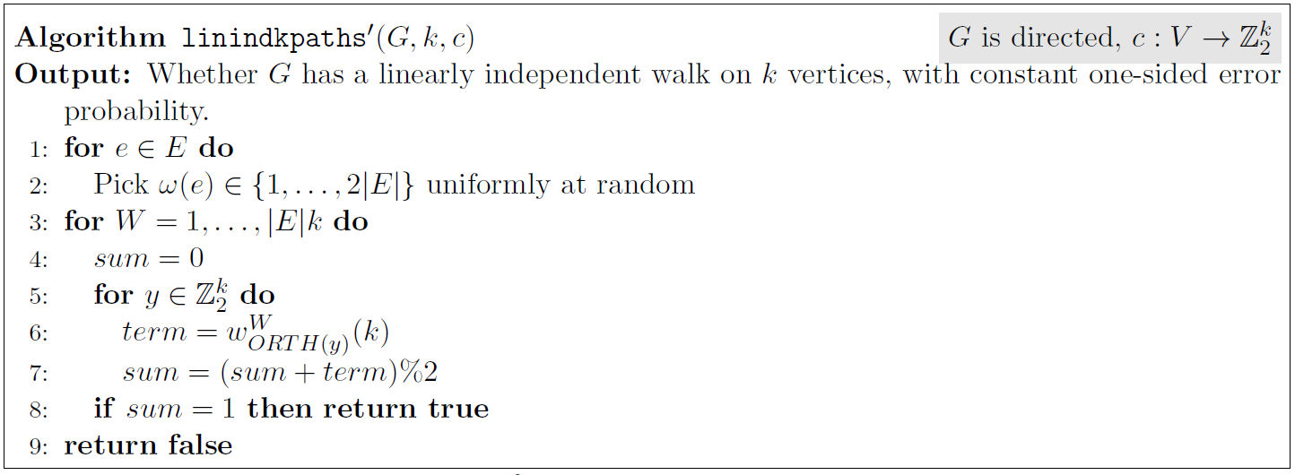
Finding LI $k$-paths in $O^{∗}(2^{k})$ time
Define as the nr of $k$-walks of weight W in $G\left[A\right]$ i.e.
Similarly as before, we have
can be compute in poly time if $W≤2|E|$ using DP as before
Apply isolation with $U=E$, and
$ℱ⊆2^{E}$ being all LI $k$-paths.
There is one of minimum weight W with prob $≥1/2$.
Will encounter odd number in this iteration

Slide 19
$k$-paths in $O^{∗}(2^{k/2})$ time in bipartite undirected graphs
Why stop here with exploiting cancellation modulo 2?
Observation: if $p_{1},…,p_{k}$ is a $k$-walk from $s$ to $t$ and $i<j$ are lexicographically smallest integers such that $p_{i}=p_{j}$ then $φ({(p}_{1},…,p_{k}))=(p_{1},…,\overset{⃖}{p_{j},…,p_{i}},…,p_{k})$ also is a $k$-walk from $s$ to $t$.
b
d
$φ$ is its own inverse
so it pairs all non-simple $k$-walks?!
Then $\#k$-w$alks≡_{2}$ #$k$-paths
Too good to be true?!
Problem: $φ$ has some fixed points i.e. $φ\left(P\right)=P$
$$acbdcef$$
a
c
e
f
b
d
$$φ\left(acbdcef\right)=$$
$$acdbcef$$
$$φ\left(acdbcef\right)=$$
$$acbdcef$$
a
c
e
f

Slide 20
$k$-paths in $O^{∗}(2^{k/2})$ time in bipartite undirected graphs
Why stop here with exploiting cancellation modulo 2?
Observation: if $p_{1},…,p_{k}$ is a $k$-walk from $s$ to $t$ and $i<j$ are lexicographically smallest integers such that $p_{i}=p_{j}$ then $φ({(p}_{1},…,p_{k}))=(p_{1},…,\overset{⃖}{p_{j},…,p_{i}},…,p_{k})$ also is a $k$-walk from $s$ to $t$.
b
d
$φ$ is its own inverse
so it pairs all non-simple $k$-walks?!
Then $\#k$-w$alks≡_{2}$ #$k$-paths
Too good to be true?!
Problem: $φ$ has some fixed points i.e. $φ\left(P\right)=P$
$$φ\left(acbdbdcef\right)=$$
$$acbdbdcef$$
a
c
e
f

Slide 21
$k$-paths in $O^{∗}(2^{k/2})$ time in bipartite undirected graphs
$$V_{1}$$
$$V_{2}$$
Given bip undirected graph with parts $V_{1},V_{2}$
Look for $k$-path from $s∈V_{1}$ to $t∈V_{2}$
For every $v∈V_{1}$ pick $c\left(v\right)∈ℤ_{2}^{k/2}$ uar.
A walk $p_{1},…,p_{k}$ if linearly independent if $c\left(p_{1}\right),c\left(p_{3}\right),…c(p_{k−1})$ are.
A walk is admissible if it does not contain a,b,a as subsequence for $a∈V_{2}$
A candidate walk is an LI admissible $k$-walk from $s$ to $t$.
111
s
d
110
a
e
001
b
f
011
c
t
seaebt: no path
not adm. not LI
sdaebt: path
admissible, not LI
seafct: path
admissible, LI candidate walk

Slide 22
$k$-paths in $O^{∗}(2^{k/2})$ time in bipartite undirected graphs
Claim: #candidate walks $≡_{2}$#LI $k$-paths from $s$ to $t$
Proof:
#non-simple candidate walks even:
$φ$ is a pairing of the non-simple candidate walks:
Let $p_{1},…,p_{i},…,p_{j},…,p_{k}$ be non-simple candidate walk, with $i<j$ lexicographically smallest such that${ p}_{i}=p_{j}$
$p_{1},…,\overset{⃖}{p_{j},…,p_{i}},…,p_{k}$ also is admissible since $p_{i}=p_{j}$
$j>i+2$ since $p_{1},…,p_{k}$ admissible. Vertices of $V_{1}$ occur at most once so $\overset{⃖}{p_{j},…,p_{i}}≠p_{j},…,p_{i}$. Thus not a fixed point.
of weight W
of weight W
Candidate walks
LI $k$-paths
Non-simple
Candidate walks

Slide 23
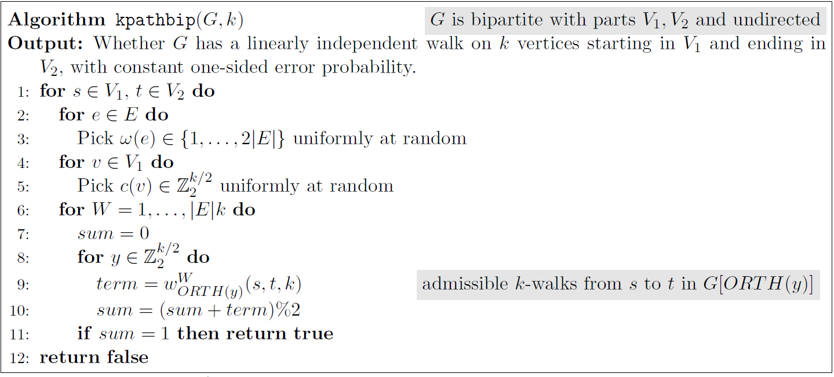
$k$-paths in $O^{∗}(2^{k/2})$ time in bipartite undirected graphs

Slide 24
$k$-paths in $O^{∗}(2^{3k/4})$ time in undirected graphs (not examined)
Pick a random partition $V_{1},V_{2}$ of $V$ by including every vertex in a uniformly random part
Fix $p_{1},…,p_{k}$. Consider$X=|\{i:p_{i}∈V_{1}\}|+\left|\left\{i:p_{i},p_{i+1}∈V_{2}\right\}\right|$
Use Markov’s inequality $\operatorname{Pr}\left[X≥a\right]≤𝔼[X]/a$:
$𝔼\left[X\right]=\frac{k}{2}+\frac{k−1}{4}=\frac{3k−1}{4},\operatorname{Pr}\left[X≥\left\lceil \frac{3k}{4}\right\rceil \right]≤1−\frac{1}{3k}$.
Call $p_{1},…,p_{k}$ d-split if $|\{i:p_{i}∈V_{1}\}|+\left|\left\{i:p_{i},p_{i+1}∈V_{2}\right\}\right|=d$
Search for $d$-split path for $d≤\left\lceil \frac{3k}{4}\right\rceil$
Assign vectors $c(v)$ for $v∈V_{1}$ and $c(e)$ for $e∈E∩(V_{2}×V_{2})$
Call a $k$-walk linearly independent if all vectors of visited vertices and edges are LI.
Candidate walk: all LI admissible walks.

Slide 25
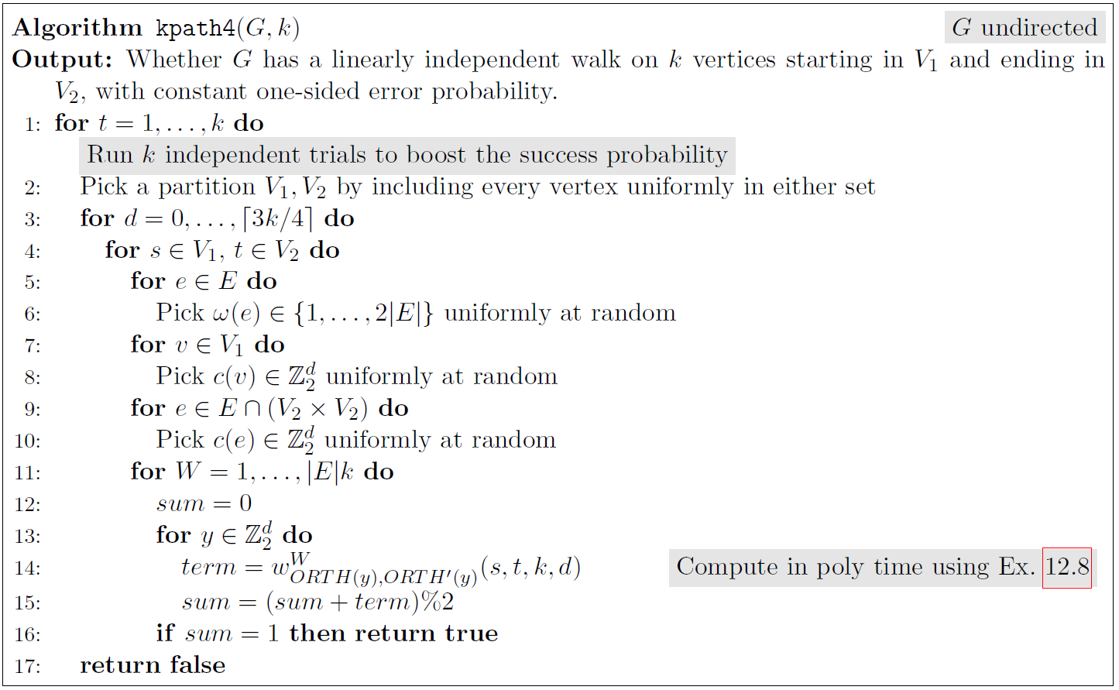
$k$-paths in $O^{∗}(2^{3k/4})$ time in undirected graphs (not examined)
#admissible $k$-walks of weight W from s to t in $(ORTH\left(y\right), ORTH′(y))$,
where $ORTH′(y)$ denotes all $e∈E$ with $〈y,c\left(e\right)〉=0$

