Slide 1
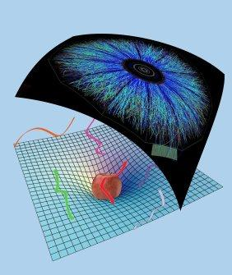
Holographic Thermalisation with Radial Flow
Black hole formation and numerics
Work with Michał Heller, David Mateos, Michał Spalinski, Diego Trancanelli and Miquel Triana
References: 1202.0981 (PRL 108) and 1211.2218
Wilke van der Schee
Supervisors: Gleb Arutyunov, Thomas Peitzmann,
Koenraad Schalm and Raimond Snellings
Iberian Strings 2013, Lisbon
January 25

Slide 2
Outline
How does the Quark-Gluon plasma thermalise?
Model by black hole formation
Usually have to resort to numerics…
Results on evolution of boost-invariant radial flow
Is this really hard?
No, but use Mathematica smartly ☺
Notes:
Many states + linearized

Slide 3
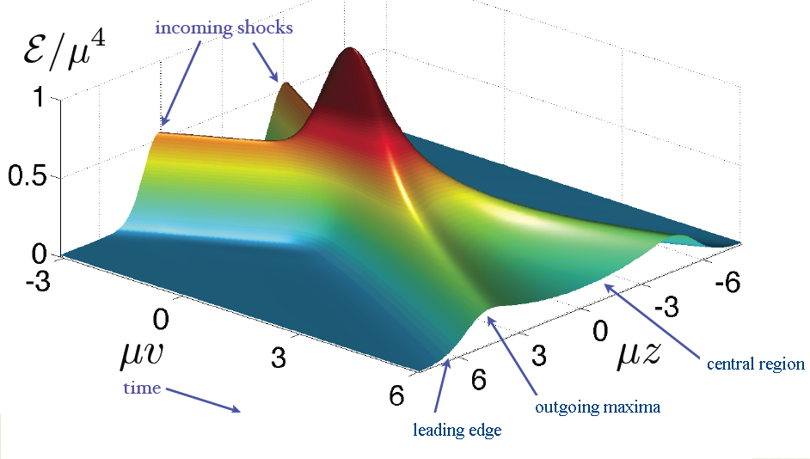
Shock waves
Famous example:
Homogeneous in transverse plane (‘infinite nucleus’)
Final energy density not boost-invariant (feature or drawback?)
P.M. Chesler and L.G. Yaffe, Holography and colliding gravitational shock waves in asymptotically AdS₅ spacetime (2010)

Slide 4
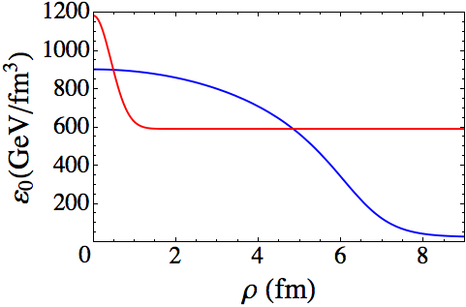
Radial flow – initial conditions
Two scales: energy density and size nucleus
Energy density is from Glauber model (~Gaussian)
No momentum flow (start at τ ~ 0.1fm/c)
Scale solution such that
Metric functions ~ vacuum AdS (can try other things!)
H. Niemi, G.S. Denicol, P. Huovinen, E. Molnár and D.H. Rischke, Inﬂuence of the shear viscosity of the quark-gluon plasma on elliptic ﬂow (2011)

Slide 5
Radial flow – results
WS, Holographic thermalization with radial flow (2012)

Slide 6
Radial flow – results

Slide 7
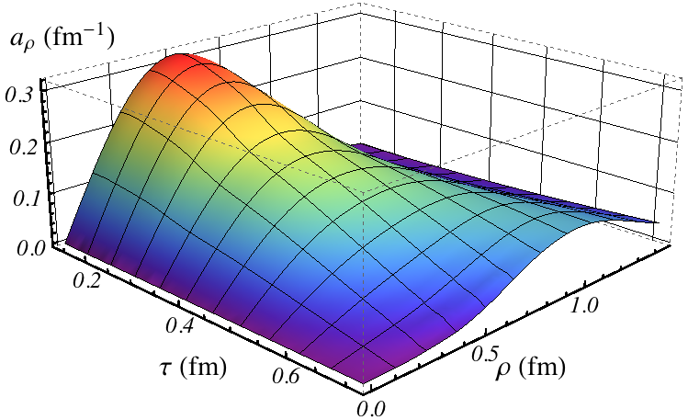
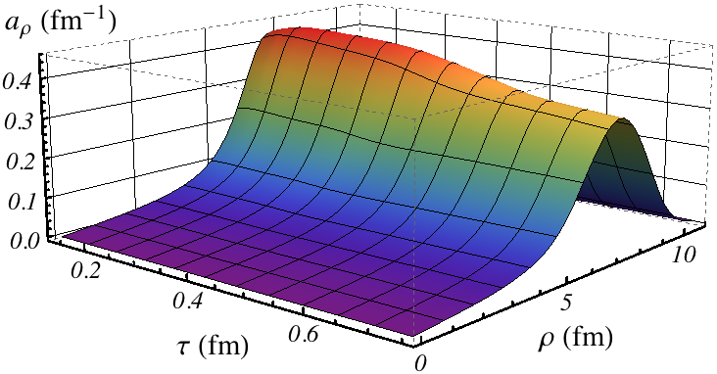
Radial flow – acceleration
Velocity increases rapidly:
Fluctuation spreads out, nucleus keeps accelerating

Slide 8
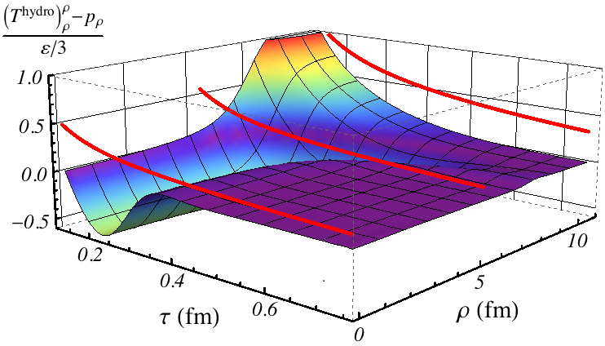
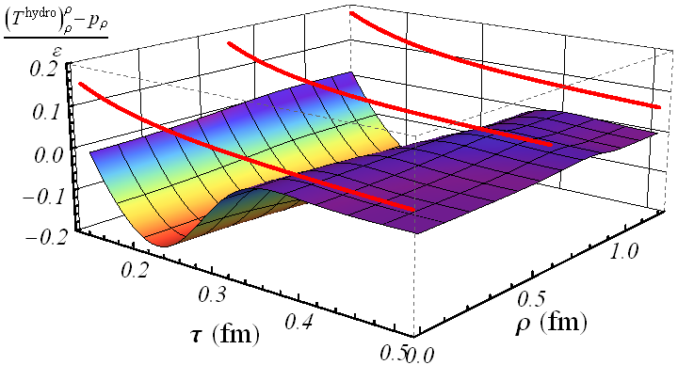
Radial flow – hydrodynamics
Thermalisation is quick, but viscosity contributes

Slide 9
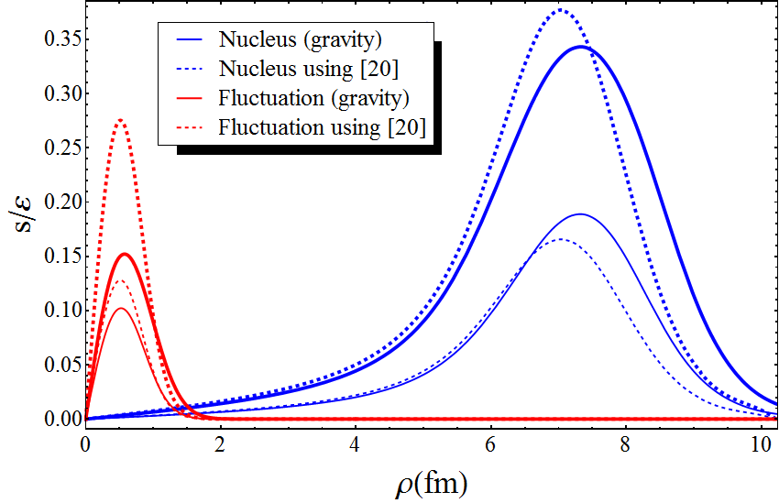
Radial flow – a comparison
Gives AdS/CFT comparison to i.e. Vredevoogd and Pratt:
So have a local formula for velocity at some time
Works especially well at larger scales
s: flux in stress tensor
ε: energy density
ε₀: initial energy density
J. Vredevoogd, S. Pratt, Universal Flow in the First Stage of Relativistic Heavy Ion Collisions (2008)

Slide 10
Radial flow - calculation
Calculation incorporating longitudinal and radial expansion
Numerical scheme very similar to colliding shock waves:
Assume boost-invariance on collision axis
Assume rotational symmetry (central collision)
→ 2+1D nested Einstein equations in AdS
P.M. Chesler and L.G. Yaffe, Holography and colliding gravitational shock waves in asymptotically AdS₅ spacetime (2010)
Notes:
Pressure in transverse plane is not the same

Slide 11
Einstein equations in characteristic formulation
Very old trick:
Use null coordinates
Split out determinant spatial part metric
Write time derivatives along geodesics:
The real trick:
H. Bondi, Gravitational Waves in General Relativity (1960)
P.M. Chesler and L.G. Yaffe, Horizon formation and far-from-equilibrium isotropization in supersymmetric Yang-Mills plasma (2008)

Slide 12
Einstein equations
Einstein equations:
Stress-energy tensor:
With etc
Notes:
Disclaimer: I knew what to look for from 1+1D problem.

Slide 13
Singularity at
Don’t determine etc by taking 4 derivatives…
So subtract first few terms:
Then replace to numerical values:

Slide 14
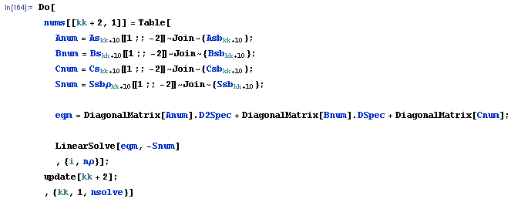
Solving the LDEs
Use spectral methods to solve nested LDEs:
Time stepping with Adams-Bashforth magic?
http://en.wikipedia.org/wiki/Linear_multistep_method#Adams.E2.80.93Bashforth_methods

Slide 15
Technicalities
Use Chebyshev twice (but transform: )
Add regulator energy density (~3%)
Avoid having to solve all the way to Poincare horizon
Avoid caustics, have a planar horizon
Interpret boundary conditions naturally
Avoid imposing conditions in ρ-direction by hand
J. P. Boyd, Chebyshev and Fourier Spectral Methods (2000)

Slide 16
More details…
Slightly cheating:
Need to look at and more carefully
What is ?
Fix apparent horizon at
Use Newton’s method to find it
Find to keep it fixed (more Solve[])
Conservation of SE/constraint equations:
Evolve and separately
Numerical check: is constraint satisfied?
J. Thornburg, Finding Apparent Horizons in Numerical Relativity (1995)

Slide 17
Discussion
Numerical scheme provides excellent basis
Homogeneous setting: study initial states/quasi-normal modes
Radial flow, fluctuations, elliptic flow
Looks like velocity is determined locally
Initial state for radial flow is slightly ad-hoc
What happens universally?
Various problems: very strong coupling, susy, large N etc…
More details/presentations/notebook:
http://www.staff.science.uu.nl/~schee118/

